Slide 1
Sample name | Base pressure (Torr) | Thickness setpoint (nm) | Measured thickness (nm), (Ellipsometer) | Substrate | Deposition rate (Å/s) | Sheet resistance (Ohm/sq) | Lowest oxygen content (At. %)
Al 20 nm 2Å/s | 1E-6 | 20 | 20.17 | Si with thermal SiO2 (300 nm) | 2 | 3.05 | 17.22
Al 20 nm 2Å/s With Ti Pre-deposition | 2,5E-7 | 20 | 20.54 | Si with thermal SiO2 (300 nm) | 2 | 2.79 | 10.15
Al 20 nm 10Å/s | 1E-6 | 20 | 21.54 | Si with thermal SiO2 (300 nm) | 10 | 2.4 | 7.74
Al 20 nm 10Å/s With Ti Pre-deposition | 2,5E-7 | 20 | 20.84 | Si with thermal SiO2 (300 nm) | 10 | 2.4 | 7.23

Slide 2
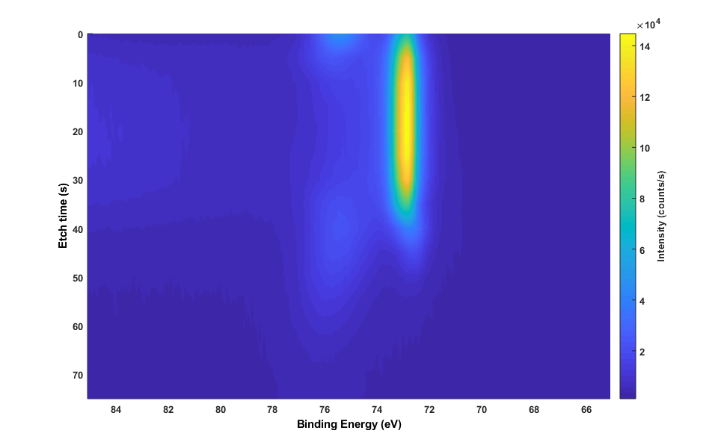
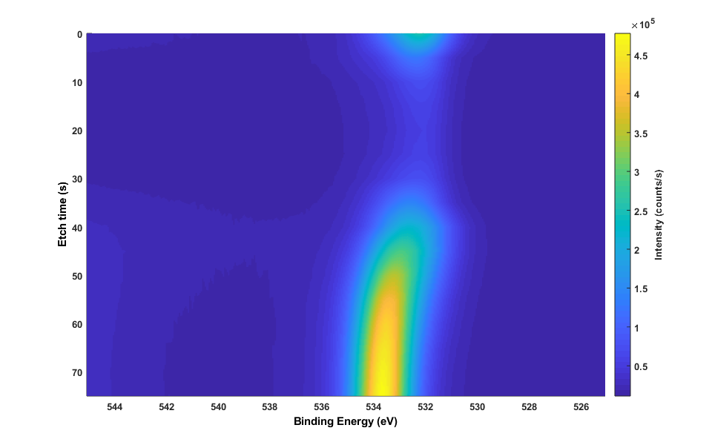
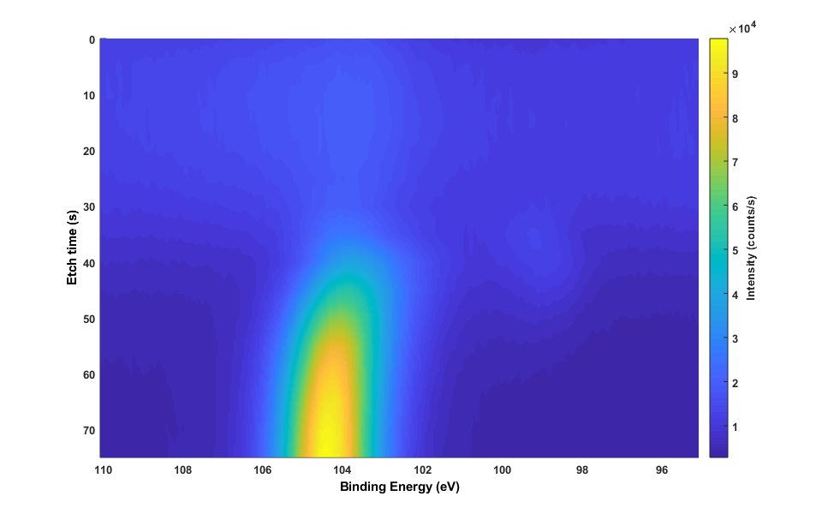
Al 2p
O 1s
Al2O3
Al2O3
Al
Al
(lowest oxygen content zone)
Al2O3
Al2O3
SiO2
SiO2
Si 2p
Four Al samples has been deposited with and without Ti pre-deposition with closed shutter and with deposition rates 2 and 10Å/s. Al thickness setpoint was 20nm in all cases.
Substrates were Si with thermally grown 300 nm SiO2, so it was possible to perform resistance measurements and ellipsometry.
All four samples have been XPS analysed in ”depth-profile” mode – measuring first surface, and gradually etching through the deposited layer and into SiO2 (using Ar ions). All samples have smilar profiles, but different oxygen content.
Drude-Lorentz model has been applied to fit the measurements. Almost identical final thickness within limits (uniformity fluctuations and model uncertanties).
Sheet resistance correlated with oxygen content.
All films are metallic, nothing unusual observed, compared to other PVD tools.
Al2O3
Al
Al2O3
SiO2
Summary (If low oxygen needed):
Use high deposition rate
Peform Ti predeposition

