Slide 1
Au target monitoring
Temescal

Slide 2
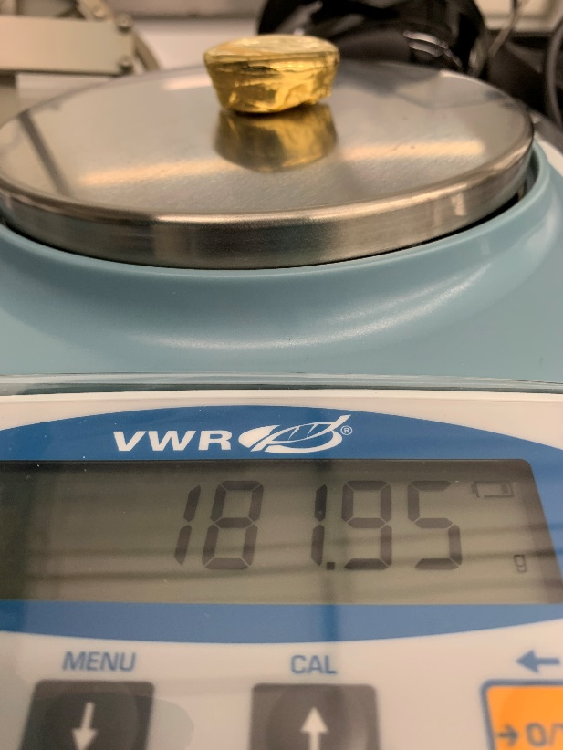
Target image name | Target mass (g) | Deposition date | Recipe | Log file | Au TF (%) | Au CG | Au TC | Au DT | Crystal life time | Ti dep. Rate s.p. (Å/s) | Au dep. Rate s.p. (Å/s) | Ti thickness s.p. (nm) | Au thickness s.p. (nm)
Au_target_20210120 | 181.95 | 2021 01 20 | TiAu | 2101220 | 78 | 0.1 | 0.1 | 0.1 | 0 | 10 | 2 | 10 | 90
Au Rise1 time (s) | Au Rise 1 power (W) | Au Soak 1 time (s) | Au Rise2 time (s) | Au Rise2 power (W) | Au Soak 2 time (s) | Chamber pressure before Ti dep. (T) | Chamber pressure before Au dep. (T) | Chamber pressure during Au dep. (T) | Final power at stable Au deposition rate (W) | Measured sheet resistance (mOhm/sq) | Measured thickness (nm) | Particles Score. 0-no particles; 10-full of particles | Comments
60 | 20 | 120 | 90 | 29 | 60 | 1.4 10-7 | 6.3 10-8 | 3.5 10-7 | 29.5 | 355.7 | 101.6 | 8/10* | **
* 30-40 particles in a field of view (20xMag). Recomend to AWAYS USE MICROSCOPE THAT STAYS NEXT TO Plasma Asher 2!
** Waited almost 1 h before start the recipe, it result in low base pressure. Used 20x Mag in optical microscopy.

Slide 3
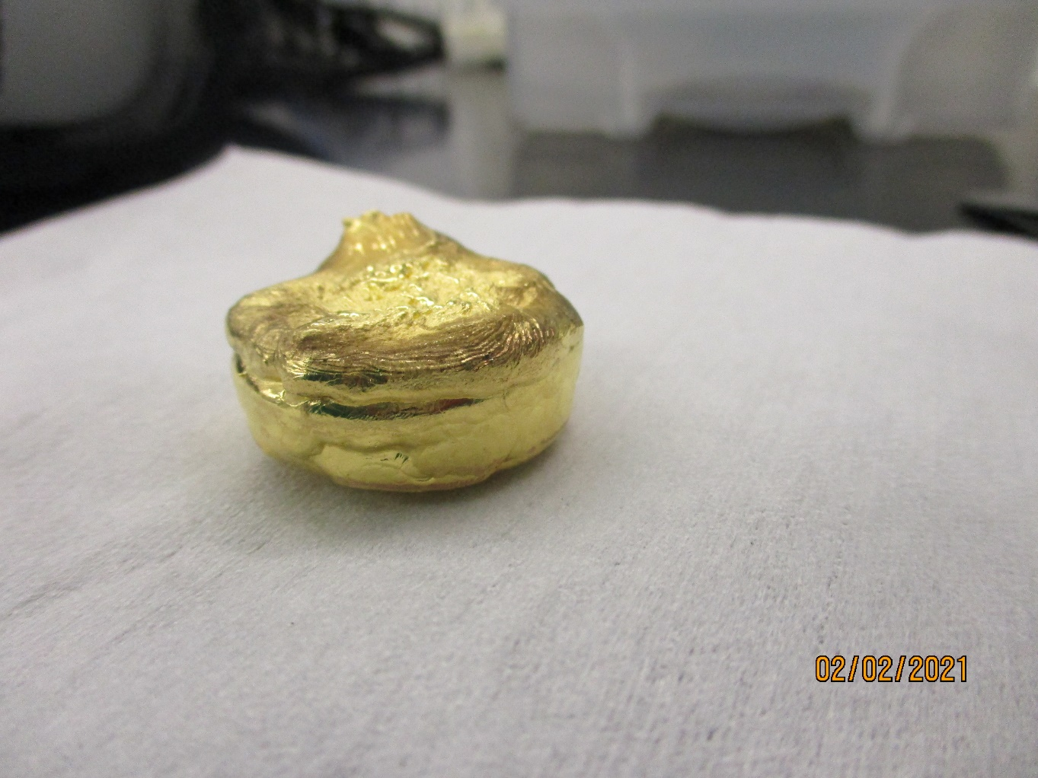
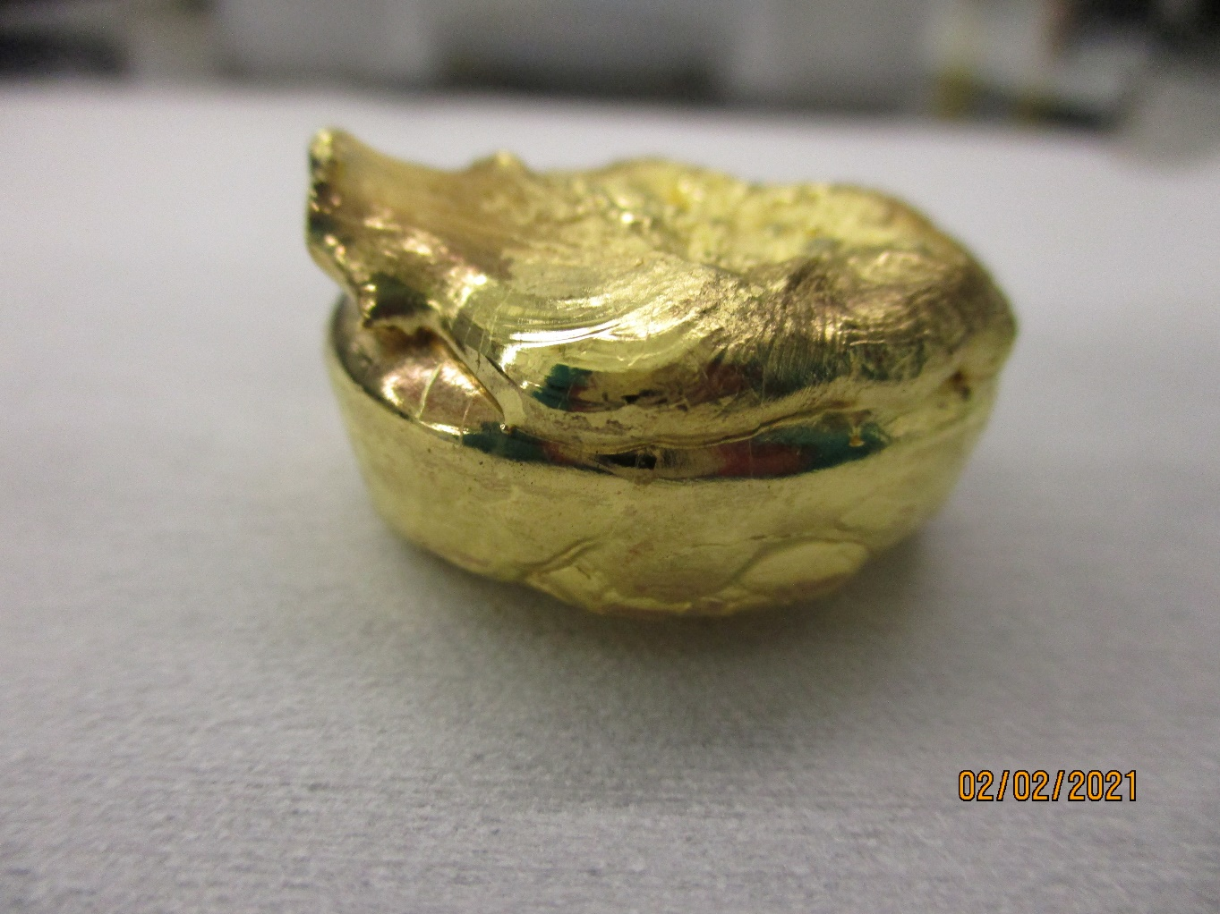
Issue 2021 02 01
43 pellets was added to Temescal during the service according to service book.
It was not properly melted and mixed with the original bulk. Image shows a clear separation between top and the original bulk. Top layer is rough. Attempt to run a deposition result in max power and no deposition rate. Total mass: 184.77g
Henrik melted the gold consequently, which solved the problem.
The new layer of added gold, it is not mixed with the rest, and stays separated on top.
Original gold.

Slide 4
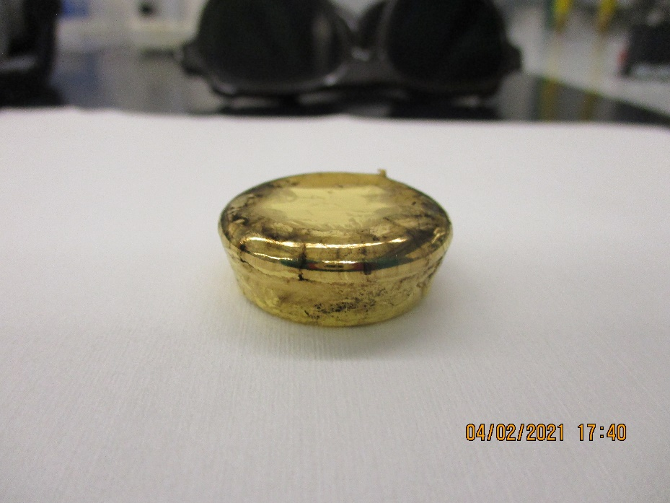
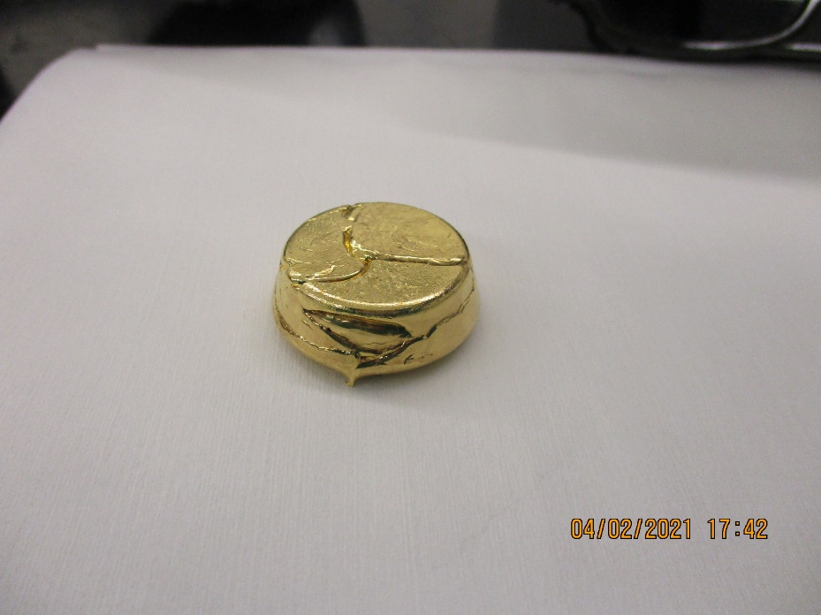
Target image name | Target mass (g) | Deposition date | Recipe | Log file | Au TF (%) | Au CG | Au TC | Au DT | Crystal life time | Ti dep. Rate s.p. (Å/s) | Au dep. Rate s.p. (Å/s) | Ti thickness s.p. (nm) | Au thickness s.p. (nm)
 | 157.77 | 2021 02 04 | TiAu | 2102044 | 78 | 0.1 | 0.1 | 0.1 | 0 | 10 | 2 | 10 | 90
Au Rise1 time (s) | Au Rise 1 power (W) | Au Soak 1 time (s) | Au Rise2 time (s) | Au Rise2 power (W) | Au Soak 2 time (s) | Chamber pressure before Ti dep. (T) | Chamber pressure before Au dep. (T) | Chamber pressure during Au dep. (T) | Final power at stable Au deposition rate (W) | Measured sheet resistance (mOhm/sq) | Measured thickness (nm) | Particles Score. 0-no particles; 10-full of particles | Comments
60 | 20 | 120 | 90 | 29 | 60 | 1.4 10-7 | 6.5 10-8 | 1.8 10-7 | 29.7 | 353.6 | 101.4 | 5/10* | **
* 10-15 particles in a field of view (20xMag).
** Waited almost 1 h before start the recipe, it result in low base pressure. Used 20x Mag in optical microscopy.
I cleaned the target with the napkin, to get rid of the carbon. Napkin was dried, not water or solvents used.
Properly melted gold with some carbon on top. Image taken after deposition!

Slide 5
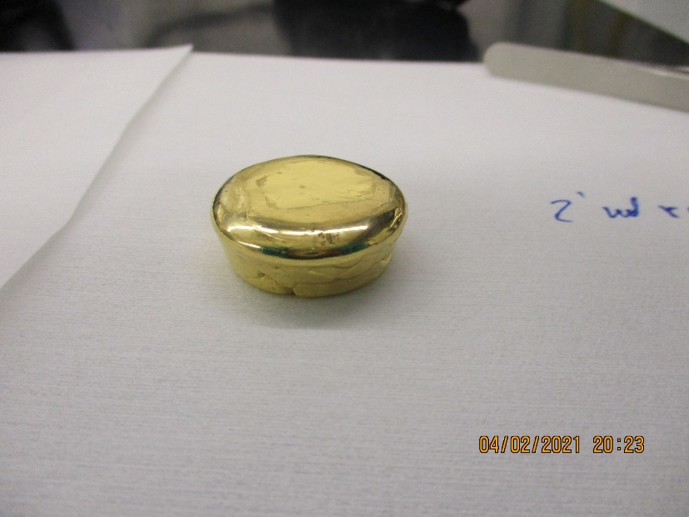
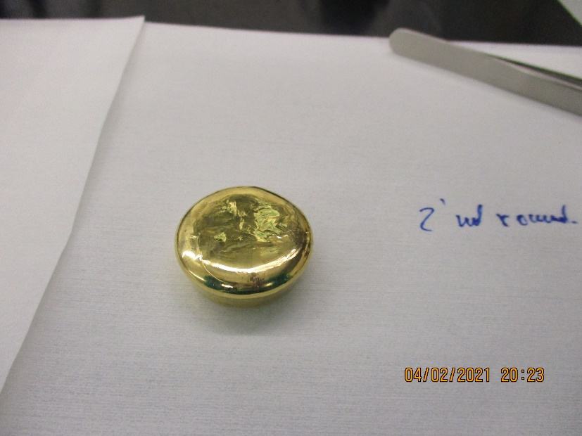
The deposition was performed straight after the previous, in order to see if carbon reappears or to see any influence.
Target image name | Target mass (g) | Deposition date | Recipe | Log file | Au TF (%) | Au CG | Au TC | Au DT | Crystal life time | Ti dep. Rate s.p. (Å/s) | Au dep. Rate s.p. (Å/s) | Ti thickness s.p. (nm) | Au thickness s.p. (nm)
 | 156.27 | 2021 02 04 | TiAu | 2102045 | 78 | 0.1 | 0.1 | 0.1 | 1 | 10 | 2 | 10 | 90
Au Rise1 time (s) | Au Rise 1 power (W) | Au Soak 1 time (s) | Au Rise2 time (s) | Au Rise2 power (W) | Au Soak 2 time (s) | Chamber pressure before Ti dep. (T) | Chamber pressure before Au dep. (T) | Chamber pressure during Au dep. (T) | Final power at stable Au deposition rate (W) | Measured sheet resistance (mOhm/sq) | Measured thickness (nm) | Particles Score. 0-no particles; 10-full of particles | Comments
60 | 20 | 120 | 90 | 29 | 60 | 5.5 10-7 | 6.5 10-8 | 1.3 10-6 | 28.9 | 354.3 | Not measured | 4/10* | **
* 5-12 particles in a field of view (20xMag).
** Waited almost 1 h before start the recipe, since I opened the chamber to inspect the tartget.
Used 20x Mag in optical microscopy.
Properly melted gold with no carbon on top. Image taken after deposition! Number of particles is slightly reduced, but the influence of carbon is not clear. The total power reduced (29.7W->28.9W), which indicates better melting.
Gold consumption for 90 nm @2Å/s: 1.5 g

Slide 6
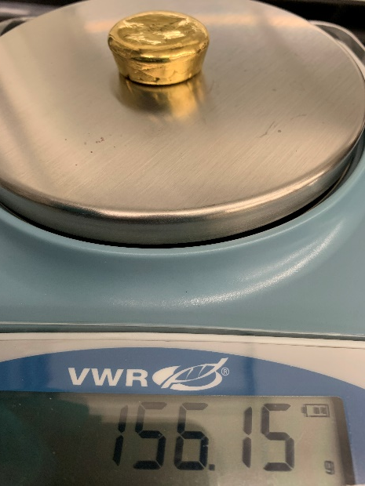
This QC deposition by Reet was the next deposition of Ti and Au after the one done by Eves on the previous slide.
Target image name | Target mass (g) | Deposition date | Recipe | Log file | Au TF (%) | Au CG | Au TC | Au DT | Crystal life time | Ti dep. Rate s.p. (Å/s) | Au dep. Rate s.p. (Å/s) | Ti thickness s.p. (nm) | Au thickness s.p. (nm)
 | 156.15 | 2021 02 08 | TiAu | 2102081 | Not checked | Not checked | Not checked | Not checked | 12 | 10 | 10 | 10 | 90
Au Rise1 time (s) | Au Rise 1 power (W) | Au Soak 1 time (s) | Au Rise2 time (s) | Au Rise2 power (W) | Au Soak 2 time (s) | Chamber pressure before Ti dep. (T) | Chamber pressure before Au dep. (T) | Chamber pressure during Au dep. (T) | Final power at stable Au deposition rate (W) | Measured sheet resistance (mOhm/sq) | Measured thickness (nm) | Particles Score. 0-no particles; 10-full of particles | Comments
60 | 20 | 120 | 90 | 29 | 60 | 1 10-6 | 2.4 10-7 | 1.6 10-6 | 42 | 362 | 103 | 10/10 *
* 135-164 particles (average 145) in a field of view at 20xMag on the microscope in E-2, darkfield, max light.
Service performed on the machine 8/2 early am, but no change to gold target apart from weighing + photo (right). There might be some random error on the scale as the consumption is nearly zero for the last deposition…
Few sparks observed on target during first part of deposition even though rate was very low at first.
Dep rate: 1.4 Å/s at 32 % power; 7 Å/s at about 38 % power during the ramp up to full deposition rate.

Slide 7
Target image name | Target mass (g) | Deposition date | Recipe | Log file | Au TF (%) | Au CG | Au TC | Au DT | Crystal life time | Ti dep. Rate s.p. (Å/s) | Au dep. Rate s.p. (Å/s) | Ti thickness s.p. (nm) | Au thickness s.p. (nm)
 |  | 2021 02 09 | TiAu | 2102092 | 78 | 0.1 | 0.1 | 0.1 | 0 | 10 | 2 | 10 | 90
Au Rise1 time (s) | Au Rise 1 power (W) | Au Soak 1 time (s) | Au Rise2 time (s) | Au Rise2 power (W) | Au Soak 2 time (s) | Chamber pressure before Ti dep. (T) | Chamber pressure before Au dep. (T) | Chamber pressure during Au dep. (T) | Final power at stable Au deposition rate (W) | Measured sheet resistance (mOhm/sq) | Measured thickness (nm) | Particles Score. 0-no particles; 10-full of particles | Comments
60 | 20 | 120 | 90 | 29 | 60 | 4.5 10-7 | 1.2 10-7 | 2.8 10-7 | 29.2 | 347.7 | 101.32 | 3/10* | **
* 6-7 particles in a field of view at 20xMag on the microscope in E-2, darkfield, max light.
** Deposition performed straight after Rebecca did the last one, where she saw a lot of particles for Au deposition rate 10Å/s, this deposition at 2Å/s, has a very limited number of particles.

Slide 8
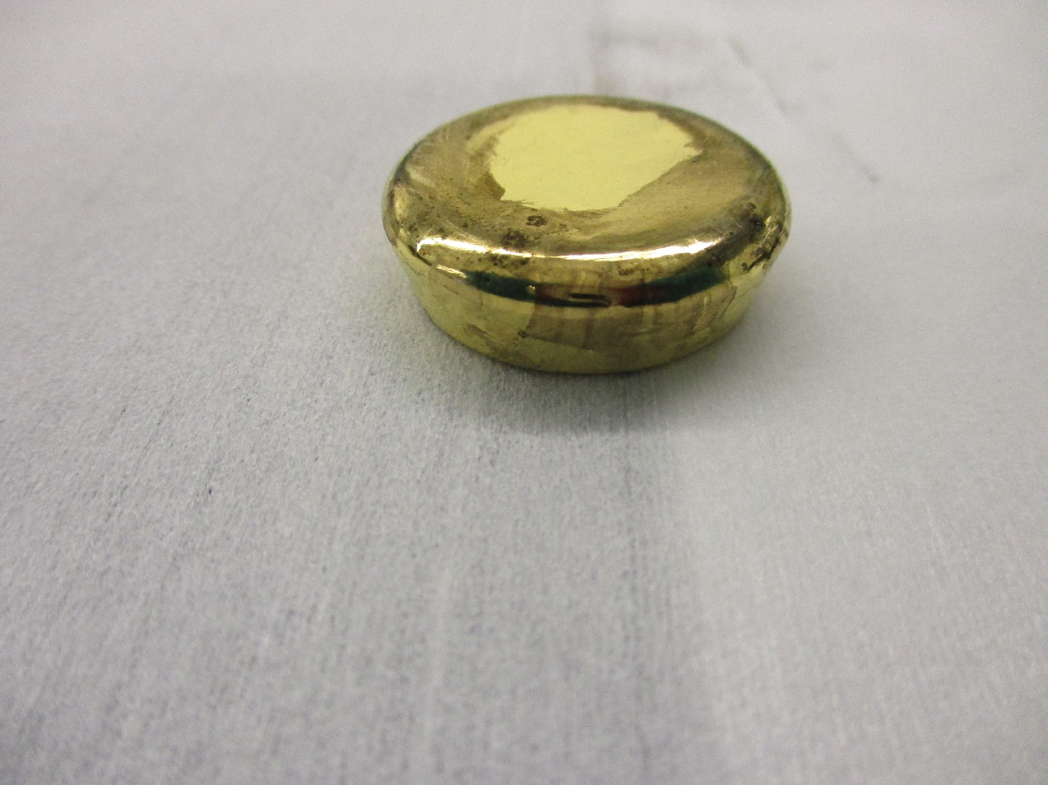
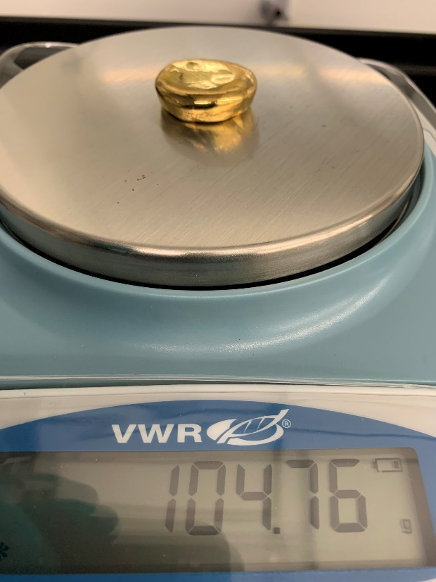
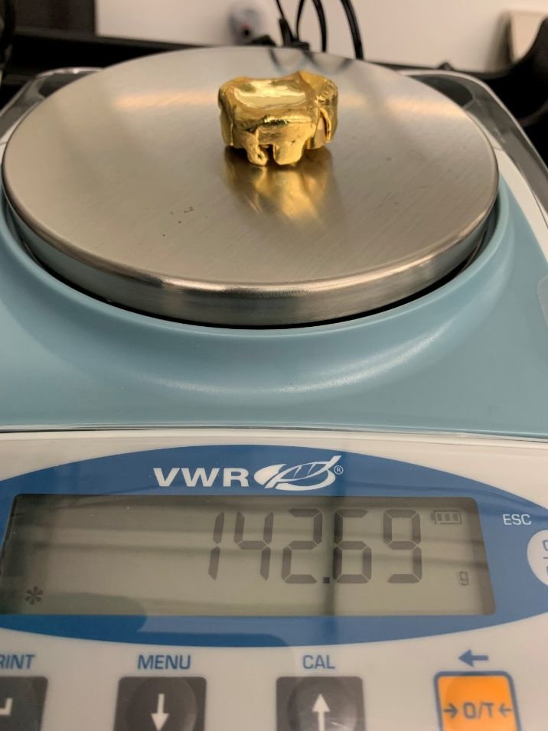
Issue 2021 02 15
Image taken 15.02.2021
Before service. After image was taken 15 pellets was added. Test deposition was performed straight after the tool was released. The result was bad (see next page).
Henrik melted the target once more at 17.02.2021.
during the service. Image taken 18 02.2020 after a test deposition. Target contain visible incorporations of foreign materials. Flakes observed on the shutter, and around the Cu hearth.
15 pellets was added 15.02.2021
during the service. Image taken 17 02.2020. Pellets were not properly melted.

Slide 9
Target image name | Target mass (g) | Deposition date | Recipe | Log file | Au TF (%) | Au CG | Au TC | Au DT | Crystal life time | Ti dep. Rate s.p. (Å/s) | Au dep. Rate s.p. (Å/s) | Ti thickness s.p. (nm) | Au thickness s.p. (nm)
* | 142.69 | 2021 02 15 | TiAu | 2102153 | 78 | 0.1 | 0.1 | 0.1 | 0 | 10 | 2 | 10 | 90
Au Rise1 time (s) | Au Rise 1 power (W) | Au Soak 1 time (s) | Au Rise2 time (s) | Au Rise2 power (W) | Au Soak 2 time (s) | Chamber pressure before Ti dep. (T) | Chamber pressure before Au dep. (T) | Chamber pressure during Au dep. (T) | Final power at stable Au deposition rate (W) | Measured sheet resistance (mOhm/sq) | Measured thickness (nm) | Particles Score. 0-no particles; 10-full of particles | Comments
60 | 20 | 120 | 90 | 29 | 60 | 3.4 10-7 | 8.3 10-8 | 1.6 10-7 | 38** | 348.6 | 103 | 10/10*** | ****
* See previous page. The important note! Henrik added 15 pellets to the remaining target! Deposition had problems in terms of particles and power, so it seems they were not melted properly.
**At the beginning (29W), there was no rate, until power went to 39.4 W (1Å/s), rate formed quickly and become 2Å/s at 39.9 W. During the deposition power gradually decreased to 37.3W in the end. The power is too high, and must be explained by the low remaining mass of the target.
***Too many particles, cannot be counted at 20X Mag.
****Where were no sparks in the target during the deposition, everything looked normal.
1 pellet has a weight of 3.1-3.4 g

Slide 10
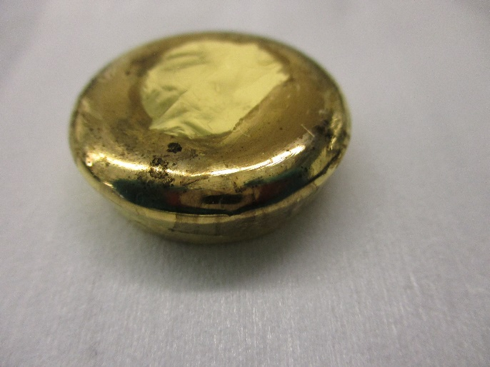
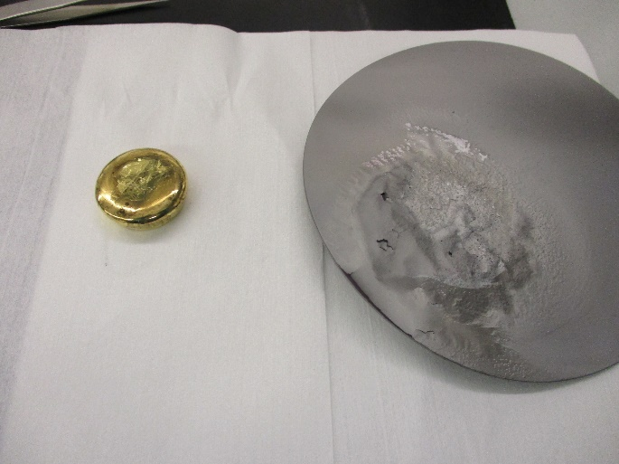
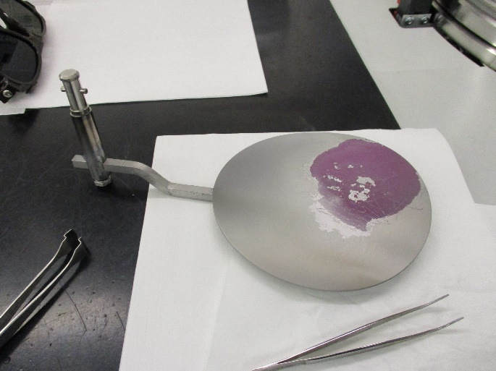
Target image name | Target mass (g) | Deposition date | Recipe | Log file | Au TF (%) | Au CG | Au TC | Au DT | Crystal life time | Ti dep. Rate s.p. (Å/s) | Au dep. Rate s.p. (Å/s) | Ti thickness s.p. (nm) | Au thickness s.p. (nm)
Shown below | 132.2 | 2021 02 18 | TiAu | 2102181 | 78 | 0.1 | 0.1 | 0.1 | 0 | 10 | 2 | 10 | 90
Au Rise1 time (s) | Au Rise 1 power (W) | Au Soak 1 time (s) | Au Rise2 time (s) | Au Rise2 power (W) | Au Soak 2 time (s) | Chamber pressure before Ti dep. (T) | Chamber pressure before Au dep. (T) | Chamber pressure during Au dep. (T) | Final power at stable Au deposition rate (W) | Measured sheet resistance (mOhm/sq) | Measured thickness (nm) | Particles Score. 0-no particles; 10-full of particles | Comments
60 | 20 | 120 | 90 | 29 | 60 | 2.4 10-7 | 6.8 10-8 | 1.2 10-7 | 28.9 | 355.7 | 98 | 6/10* | **
* There are 16-18 particles in a 20X dark field of view
* *The rate fra begyndelsen was ok 29.2W, and went down to 28.9W. During Au deposition pressure in the range 8.1 10-8T - 1.6 10-7T. No sparks in the target.
The target is a bit dirty like the inviroment around (see below).
Shutter after vacuum cleaning
Gold target is visibly contaminated
Shutter how it was found

Slide 11
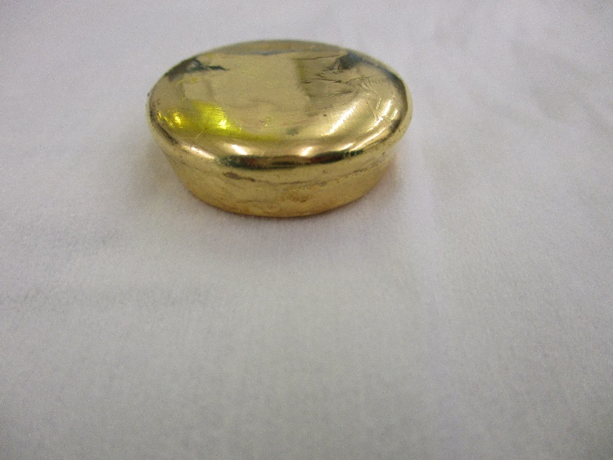
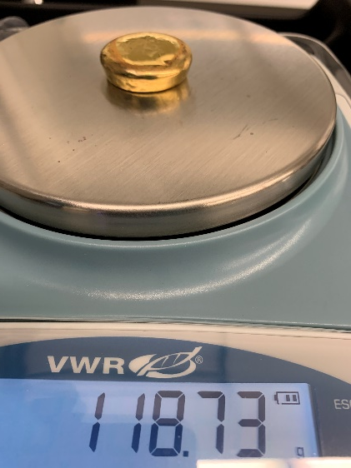
Target image name | Target mass (g) | Deposition date | Recipe | Log file | Au TF (%) | Au CG | Au TC | Au DT | Crystal life time | Ti dep. Rate s.p. (Å/s) | Au dep. Rate s.p. (Å/s) | Ti thickness s.p. (nm) | Au thickness s.p. (nm)
Au_target_20210222 | 162 | 2021 02 22 | TiAu | 2102222 | 78 | 0.1 | 0.1 | 0.1 | 0 | 10 | 2 | 10 | 90
Au Rise1 time (s) | Au Rise 1 power (W) | Au Soak 1 time (s) | Au Rise2 time (s) | Au Rise2 power (W) | Au Soak 2 time (s) | Chamber pressure before Ti dep. (T) | Chamber pressure before Au dep. (T) | Chamber pressure during Au dep. (T) | Final power at stable Au deposition rate (W) | Measured sheet resistance (mOhm/sq) | Measured thickness (nm) | Particles Score. 0-no particles; 10-full of particles | Comments
60 | 20 | 120 | 90 | 29 | 60 | 3.1 10-7 | 8.0 10-8 | 2.9 10-7 | 30.2 | 356 | 101 | 5/10* | **
*Number of particles 12-15 in 20X Mag Dark field
** No sparks. Stable deposition power.
Henrik added13 pellets. Ca. 50g

Slide 12
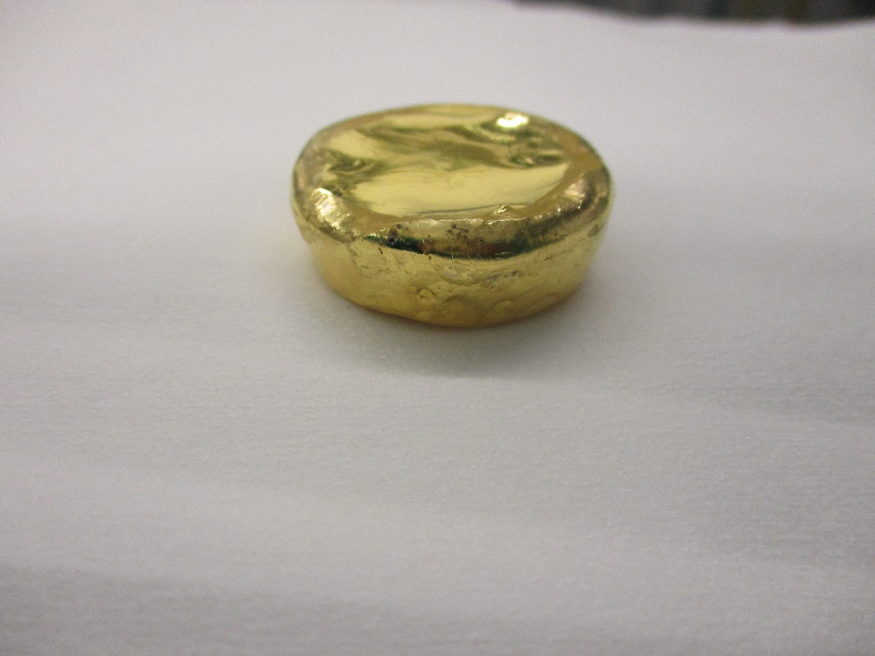
Target image name | Target mass (g) | Deposition date | Recipe | Log file | Au TF (%) | Au CG | Au TC | Au DT | Crystal life time | Ti dep. Rate s.p. (Å/s) | Au dep. Rate s.p. (Å/s) | Ti thickness s.p. (nm) | Au thickness s.p. (nm)
- | 139 | 20210321 | TiAu | 2103022 | 78 | 0.1 | 0.1 | 0.1 | 0 | 10 | 2 | 10 | 90
Au Rise1 time (s) | Au Rise 1 power (W) | Au Soak 1 time (s) | Au Rise2 time (s) | Au Rise2 power (W) | Au Soak 2 time (s) | Chamber pressure before Ti dep. (T) | Chamber pressure before Au dep. (T) | Chamber pressure during Au dep. (T) | Final power at stable Au deposition rate (W) | Measured sheet resistance (mOhm/sq) | Measured thickness (nm) | Particles Score. 0-no particles; 10-full of particles | Comments
60 | 20 | 120 | 90 | 29 | 60 | 2.8 10-7 | 7.3 10-8 | 2.3 10-7 | 32 | 362.8 | 97 | 10/10* | **
*All looked good. No visible sparks during the deposition. But the amount of particles was extremely high. Opened the chamber to inspect the target. It looked good, but the mass was very low. It is all that remained.
* *The rate from beginning was 32.4W, and went down to 31.5W. During Au deposition pressure in the range 1.3 10-7T - 3.1 10-7T.

Slide 13
Target image name | Target mass (g) | Deposition date | Recipe | Log file | Au TF (%) | Au CG | Au TC | Au DT | Crystal life time | Ti dep. Rate s.p. (Å/s) | Au dep. Rate s.p. (Å/s) | Ti thickness s.p. (nm) | Au thickness s.p. (nm)
Au_target_20210325 | 119.9 | 2021.03.25 | TiAu | 2103255 | 78 | 0.1 | 0.1 | 0.1 | 0 | 10 | 10!!! | 10 | 90
Au Rise1 time (s) | Au Rise 1 power (W) | Au Soak 1 time (s) | Au Rise2 time (s) | Au Rise2 power (W) | Au Soak 2 time (s) | Chamber pressure before Ti dep. (T) | Chamber pressure before Au dep. (T) | Chamber pressure during Au dep. (T) | Final power at stable Au deposition rate (W) | Measured sheet resistance (mOhm/sq) | Measured thickness (nm) | Particles Score. 0-no particles; 10-full of particles | Comments
60 | 20 | 120 | 90 | 29 | 60 | 8 10-7 | 2.4 10-7 | 1.2 10-6 | 41.6 | 355.1 | 105 | 2/10 | *
*Chamber was opened before the run (unfortunately). Had to wait a longer time before start. It was a very small remaining target (119.9 g). I forgot to put dep. Rate for gild to 2Å/s and deposited at 10 Å/s instead. Surprisingly there were almost no particles (5-7 in 20x dark field mode view).
Target image name | Target mass (g) | Deposition date | Recipe | Log file | Au TF (%) | Au CG | Au TC | Au DT | Crystal life time | Ti dep. Rate s.p. (Å/s) | Au dep. Rate s.p. (Å/s) | Ti thickness s.p. (nm) | Au thickness s.p. (nm)
Au_target_20210325 | 119.9 | 2021.03.25 | TiAu | 2103256 | 78 | 0.1 | 0.1 | 0.1 | 0 | 10 | 2 | 10 | 90
Au Rise1 time (s) | Au Rise 1 power (W) | Au Soak 1 time (s) | Au Rise2 time (s) | Au Rise2 power (W) | Au Soak 2 time (s) | Chamber pressure before Ti dep. (T) | Chamber pressure before Au dep. (T) | Chamber pressure during Au dep. (T) | Final power at stable Au deposition rate (W) | Measured sheet resistance (mOhm/sq) | Measured thickness (nm) | Particles Score. 0-no particles; 10-full of particles | Comments
60 | 20 | 120 | 90 | 29 | 60 | 8.4 10-7 | 2.3 10-7 | 1.1 10-6 | 27.9 | 352.9 | 106 | 1/10 | *
*Had to repeat the deposition with Au 2 Å/s this time. It was a very small remaining target (119.9 g). Low stable power, no sparks. Pressure increased from 4.3 10-7 T to 1.1 10-6 T during the Au evaporation. Surprisingly there were almost no particles (1-3 in 20x dark field mode view).

Slide 14
Target image name | Target mass (g) | Deposition date | Recipe | Log file | Au TF (%) | Au CG | Au TC | Au DT | Crystal life time | Ti dep. Rate s.p. (Å/s) | Au dep. Rate s.p. (Å/s) | Ti thickness s.p. (nm) | Au thickness s.p. (nm)
Au_target_20210331 | 241.98 | 2021.03.31 | TiAu | 2103310 | 78 | 0.1 | 0.1 | 0.1 | 0 | 10 | 2 | 10 | 90
Au Rise1 time (s) | Au Rise 1 power (W) | Au Soak 1 time (s) | Au Rise2 time (s) | Au Rise2 power (W) | Au Soak 2 time (s) | Chamber pressure before Ti dep. (T) | Chamber pressure before Au dep. (T) | Chamber pressure during Au dep. (T) | Final power at stable Au deposition rate (W) | Measured sheet resistance (mOhm/sq) | Measured thickness (nm) | Particles Score. 0-no particles; 10-full of particles | Comments
60 | 20 | 120 | 90 | 29 | 60 | 4.7 10-7 | 1.9 10-7 | 1.1 10-6 | 33.4 | 353.7 | 107 | 5/10* | **
*10-15 particles in 20X Mag Dark field. Number of particles is relatively low.
** New target was installed just before the Easter. All was ok, no visible sparks or anything unusual. Power 33.4W, and went down to 32.9W at the end.

