Slide 1
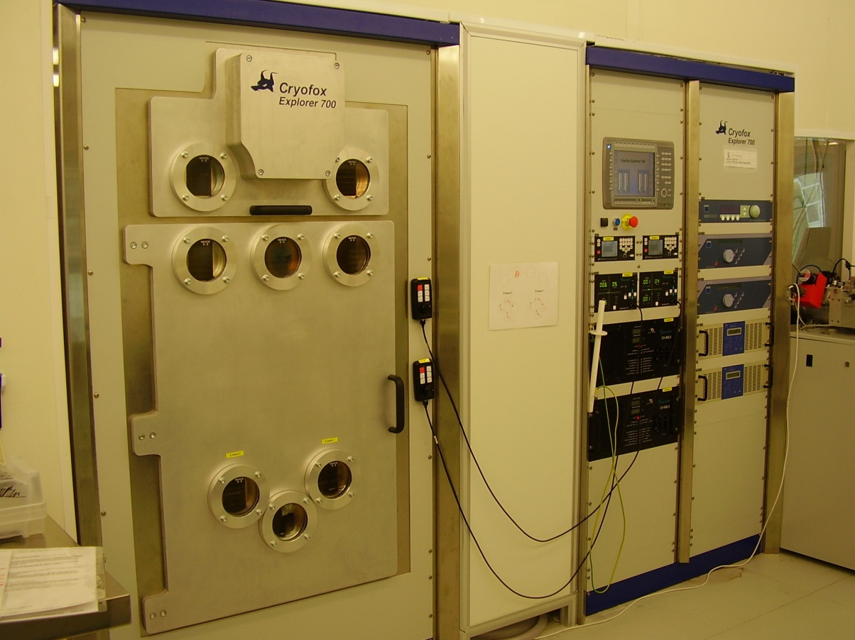
PVD co-sputter/evaporation Cryofox, Polyteknik
Deposition of
thin layers
Sputtering
E-beam
Co-sputtering
Co-ebeam

Slide 2
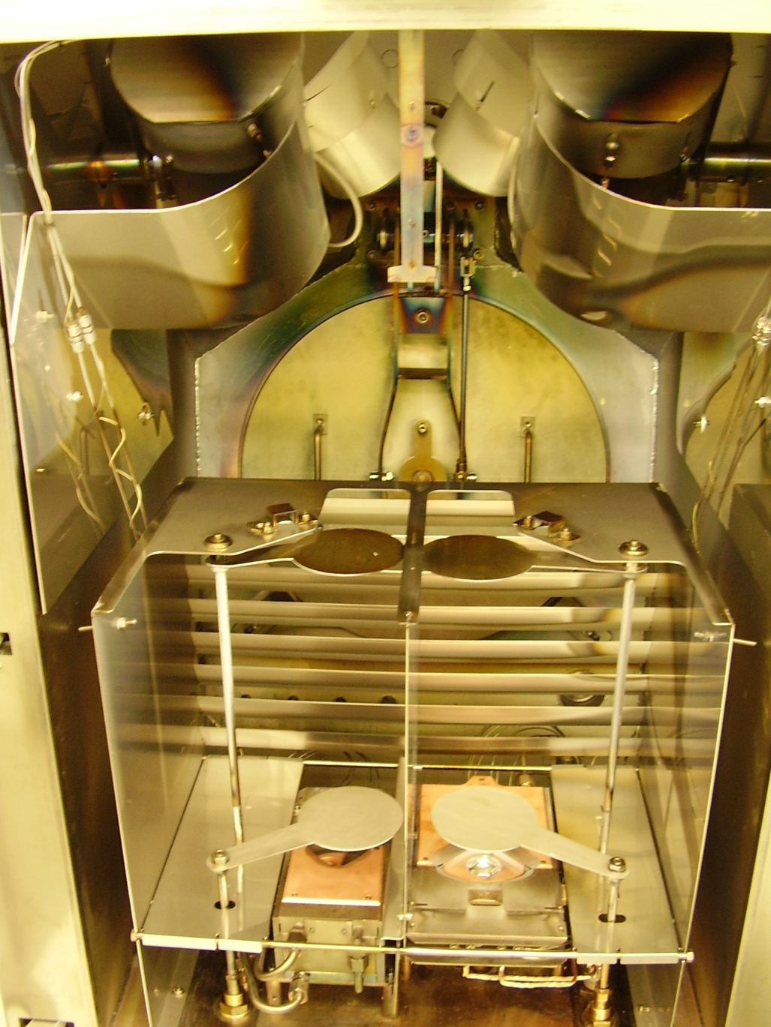
Sputter sources
Quartz crystals for thickness measurement
Valve to cryopump
E-beam source 2
Shielding against cross contamination
E-beam source 1

Slide 3
Options and sputter processes:
Options:
Sputter processes so far
2,4 or 6” wafers
Up to 24x 4” wafers…
Load lock, short pump time
Heating of wafers
Cleaning or wafers with plasma (RF clean)
Material | Uniformity | Rate
Al | +/- 2% | ~ 1 Å/s
Si | +/- 2% | ~ 0.5 Å/s
Al+ Si | +/- 5% | ~ 1 Å/s
AlxNy | +/- 4% | ~ 0.3 Å/s
(With higher rates, less uniform layers).
Sputter targets
Al, Si, ITO, SiO₂, Ni, Ag

Slide 4
E-beam processes
E-beam processes so far
Material | Uniformity | Rate
Ti | +/- 4% | ~ 2 Å/s
Al | +/- 4% | ~ 2 Å/s
Ag | +/- 3% | ~ 2 Å/s
Ni+Cr* | +/- 3% | ~ 3 Å/s
Ti+Al |  | ~ 3 Å/s
Example Al +Ti
3 depositions with 3 different rates for Al and Ti
Wafer 1: 58% Al, 42% Ti
Wafer 2: 74% Al, 26% Ti
Wafer 3: 96% Al, 4% Ti
*Ni/Cr stochiometric relationship stable (about 55% Ni, 45% Cr) through the film.

