Slide 1
Thin Film Tool Package Training (TPT) course at DTU Nanolab 1st part September 2021

Slide 2
Thin film TPT course - Learning goals
Learning goals:
Be aware of relevant material properties for thin films made in the cleanroom
Understand different thin film deposition techniques
Compare and be able to select appropriate thin film technique
The slides from the course can be found in LabAdviser:
http://labadviser.nanolab.dtu.dk/index.php/LabAdviser/Courses/TPT_Thin_Film
(look in the bottom of the page)
Notes:
Learning goals:
A list of what we expect you to learn from this course

Slide 3
Thin film TPT course - Course schedule
Plan for the 1st part of the course (today’s plan):
Lecture (2-2½ hours):
An introduction to thin films
Material properties
Overview of different thin film techniques at DTU Nanolab - 1st part:
Thermal oxidation
Electroplating
Notes:
Learning goals:
A list of what we expect you to learn from this course

Slide 4
Thin film TPT course - Course schedule
Plan for the 2nd part of the course:
Lecture (3-3½ hours):
Overview of techniques
PVD Vacuum system
Thin film techniques – 2nd part
PVD (physical vapour deposition):
E-beam evaporation
Thermal evaporation
Sputter deposition
CVD (chemical vapour deposition):
LPCVD
PECVD
Diamond CVD
ALD (atomic layer deposition)
Comparison of thin film deposition techniques
Before you use an equipment:
Contact training@nanolab.dtu.dk for individual training sessions for each thin film equipment (usually 1-2 sessions for each piece of equipment)
Receive user competences in LabManager
Notes:
Learning goals:
A list of what we expect you to learn from this course

Slide 5
Introduction - Thin Film responsible persons
Process responsible:
Pernille Larsen
pevo@dtu.dk
(Furnaces, ALD)
Patama Pholprasit
paphol@dtu.dk
(PVD, furnaces)
Evgeniy Shkondin
eves@dtu.dk
(PVD, ALD)
Berit Herstrøm
bghe@dtu.dk
(PECVD)
Rebecca Ettlinger
reet@dtu.dk
(PVD)
Maintenance responsible:
Henrik Nielsen
henie@dtu.dk
(PVD)
Roy Cork
roco@dtu.dk
(Furnaces, PECVD, PVD)
Peter Windmann
pewin@dtu.dk
(ALD, PECVD)
Flemming Nielsen
flemnie@dtu.dk
(Furnaces)
Contact emails:
Thin film group: thinfilm@nanolab.dtu.dk
Training: training@nanolab.dtu.dk

Slide 6
Thin film TPT course – 1st part
Introduction to thin films
Before you start – Material properties to consider
Overview of techniques
Equipment overview in LabAdviser
Thin film techniques – 1st part
Thermal oxidation
Electroplating
Notes:
SEM course contents

Slide 7
Thin film TPT course – 1st part
Introduction to thin films
Before you start – Material properties to consider
Overview of techniques
Equipment overview in LabAdviser
Thin film techniques – 1st part
Thermal oxidation
Electroplating
Notes:
SEM course contents

Slide 8
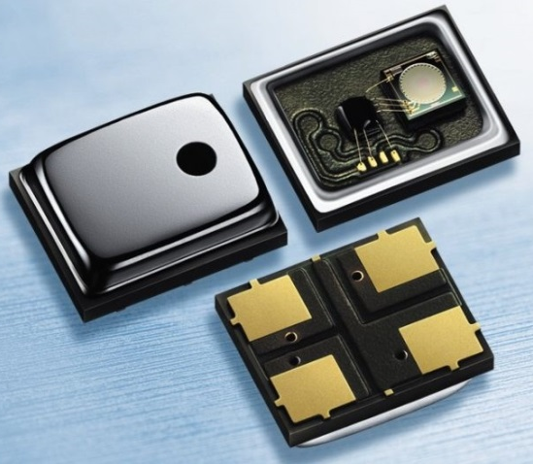
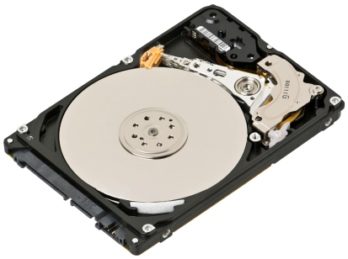
Introduction - Thin film applications
Thin films play an important role in almost every micro- and nanostructure
Thin film functions:
Complex structures
Micro-Electro Mechanical systems (MEMS, for example microphones and gyroscopes)
Optical
Transparent conductive windows for solar cells
Waveguides
Electrical
Thin film transistors
Piezoelectric layers
Metallic contacts
Magnetic
Chemical
Dopant sources
Adhesion and surface bonding
Notes:
Hvad er en MOS?
Måske deles op i to slides

Slide 9
Introduction – What is a ”thin film”?
Atomic separation on a substrate – not yet a thin film
Å to nm
Substrate
Silicon wafer
Other semiconductors (III-V, II-VI, etc.)
Others: Metals, glass, polymer, ceramics, …
Thin film: Nanometer (monolayer) to several micrometers
Special for thin films: Material so thin that its characteristics are dominated primarily by two dimensional effects and are mostly different than its bulk properties
nm to μm
“thin film”
Once a film is above a critical thickness,
it behaves essentially as a bulk material
Hundreds of atomic layers
Bulk material
Notes:
What is a thin film and how thin can the film be so that we consider as a thin film ?
The top image showing atoming separation on a substrate and the thickness can be from A to a few nanometers so this’s too thin too be a thin film.
And when there is more material on the substrate then it will start to form a film. So a thin film can be from a monolayer to several microns or until approaching bulk material properties. Thin films have a very high surface to volume ratio.
What is so special about thin films? They can have some properties that different from bulk.
Once a film is above a critical thickness, it behaves essentially as a bulk material
Depending on the property, however, this critical thickness ranges from 100 Angstroms (e.g. electronic bandstructure) to
several microns (e.g. internal stress)
Bulk(a thick layer of film) : the material properties will be the same as bulk properties.
Because thin films are so thin and it’s not easy to handle and that the reason we need to put them on a substrate. Most often, we will put them on a silicon wafer and that’s because it’s cheap, easy to handle and the best understood material. We can also put them on something else such as III-V material (InP, InAS, GeP, GeAs…) can also put them on metals, glass, polymer or ceramics.

Slide 10
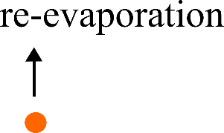
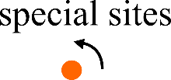
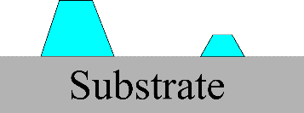
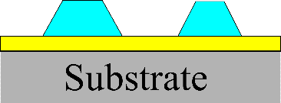
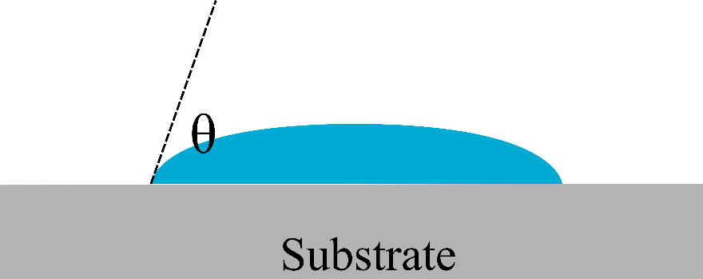
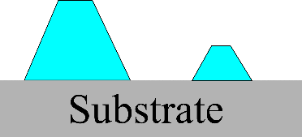
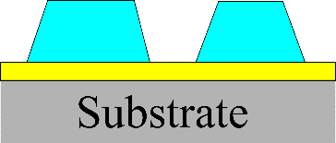
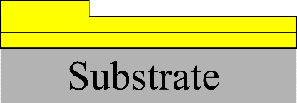
Introduction – Thin film formation. Three principal modes of growth
1
2
3
1
Layer-by-layer, or Frank-van der Merve. The interaction between atoms or molecules is smaller than their bonding to the substrate.
2
Island, or Vollmer- Weber. Film atoms are more strongly bound to each other than to the substrate.
If θ=0 Layer-by-layer formation
If θ>0 Island growth
3
Layer-plus-island, or Stranski-Krastanov. Represents the intermediate case.

Slide 11
Thin film TPT course – 1st part
Introduction to thin films
Before you start – Material properties to consider
Overview of techniques
Equipment overview in LabAdviser
Thin film techniques – 1st part
Thermal oxidation
Electroplating
Notes:
SEM course contents

Slide 12
Material properties
Material properties that will be explained in the course:
Step coverage
Crystal structure
Film stress
Electrical properties
Composition

Slide 13
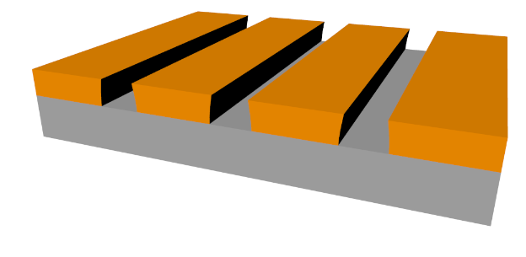
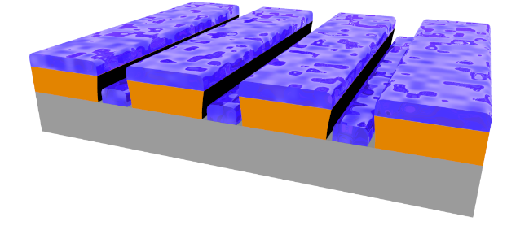
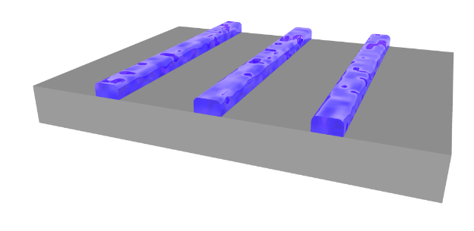
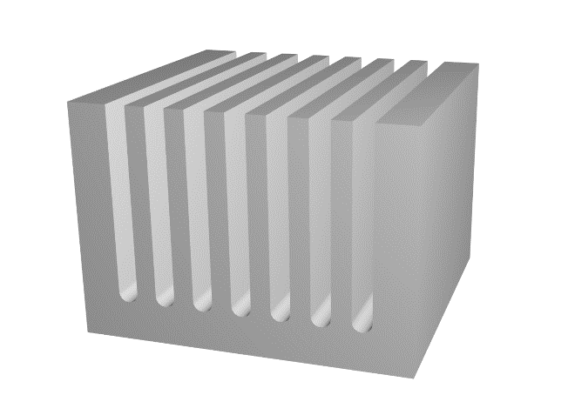
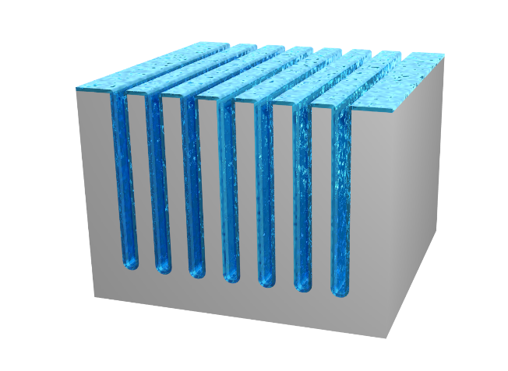
Step coverage: What you need depends on subsequent application/processing
Material properties – Step coverage
Line-of-sight deposition on a structured mask:
No step coverage may be wanted to allow mask dissolution (lift-off)
Conformal deposition on etched structures:
Some methods are better than others for uniform step coverage
Good step coverage may be desired on deeply etched structures
Si
Mask (resist)
Deposited material

Slide 14
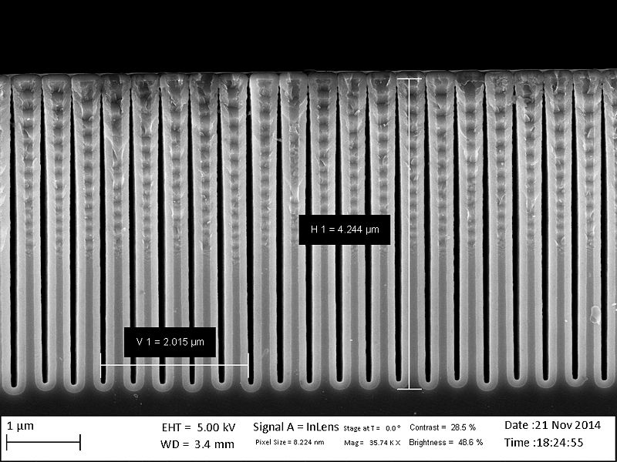
Material properties – Step coverage
Ti/Au film
Depth
Ti/Au film
Width
Aspect ratio:
Depth to width relationship of holes or trenches
resist
Ti/Au film
200 nm
Si-wafer
Cross section of Si wafer with resist pattern + Ti/Au thin film deposited by e-beam evaporation (PVD).
No side-wall deposition (line-of-sight).
Solvent removes resist and leaves part of the Si wafer bare.
Cross section of high aspect ratio Si trenches covered with Al₂O₃ by
atomic layer deposition (ALD).
Good step coverage – conformal deposition.
Notes:
Tydeliggør at kan være behov for at have en coating der dækker hele overfladen: både horisontal, veritical + hjørner
Men også kan være behov for ikke at dække sidevægge, fx ved lift-off
Evt. flere og bedre eksempler.

Slide 15
Material properties – Crystal structure
Possible crystal structures:
Monocrystalline/single crystalline (e.g. Si wafers)
Continuous and unbroken crystal lattice, no grain boundaries
Poly-crystalline
Consists of multiple small crystals
Amorphous
Non-crystalline lattice, the atoms form a continuous random network
Be aware:
You may get a mix of crystal structures
Structure affected by deposition method and parameters
Post process, e.g. annealing can change the crystal structures
https://en.wikipedia.org/wiki/Amorphous_silicon

Slide 16
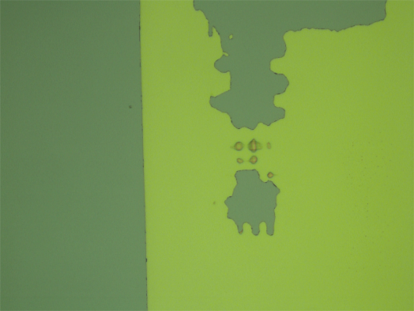
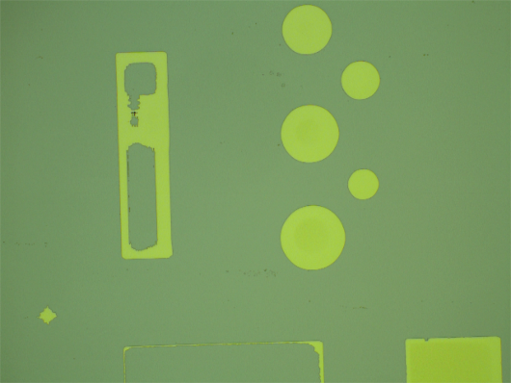
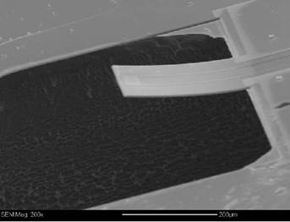
Material properties – Film stress σ
Substrate with no film
Substrate with compressive stressed film
(film wants to expand)
Substrate with tensile stressed film
(film wants to shrink)
Possible effects of stress
Bending samples (cantilever, membranes …)
Film cracking
Film delamination
Void formation
Cracks on thick Si₃N₄ film by LPCVD
Delamination of Ni films
Stressed cantilever
http://www.ece.eng.wayne.edu/~yxu/doc/researches/nanomechanical%20biochemical%20sensor.htm
Notes:
Film stress:
Most films have a level of residual stress. This can be due to several reasons. It can be due to intrinsic stress like stress that evolves during film growth, for example if the surface mobility has been low during deposition then atoms can be pinned by other atoms giving intrinsic stress. It can also be caused by lattice mismatch between epitaxial layers. It can also be caused by extrinsic stress which is stress that is imposed by external factors such as temperature changes or if pressure is applied to a chip during packaging for example.
The effect of the stress is that it can bend that sample. The stress can be either compressive or tensile. A compressive film wants to expand and will make the sample convex. A tensile film wants to shrink and will make the sample concave. The result of a very stressful film can be bending of the sample which can be a problem of cantilevers and membranes, it can be film cracking, delamination of the film and void formation among other things.

Slide 17
Material properties – Electrical properties
Doping
Impurities provide free electrons (n-type) or ”holes” (p-type) in semiconductors
Phosphorus for ”n” – doping and Boron for ”p” – doping.
Not easy to measure dopant concentration directly as it is usually very low (~10¹³ atoms/cm³)
Conductivity/resistivity (sheet resistance, metals and semiconductors)
Can vary across sample, thickness dependent
Depends on doping (intended/unintended)
Insulator quality: Measure breakdown voltage
The maximum voltage that can be applied to an insulating material before it starts to conduct
Gate oxide breakdown, Navid Azizi
No bias
Increasing voltage
Notes:
Measuring e.g. a diode can tell you about short circuits, etc.
Isulator quality :
Any insulation material remains its insulating properties up to a certain limit (There is no ideal insulator). After this limit, it starts a leakage currents go beyond limit and there is a failure insulation.
Figure: the oxide initially is almost perfect with a few in-grown traps/defects. As apply voltage generate more traps, then some percolative paths will be formed and there will be some small conductive paths through the layer. And at the end the Silicon wil melt and the Oxygen is released.

Slide 18
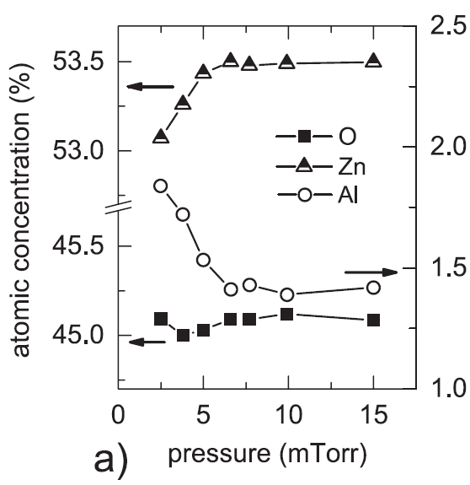
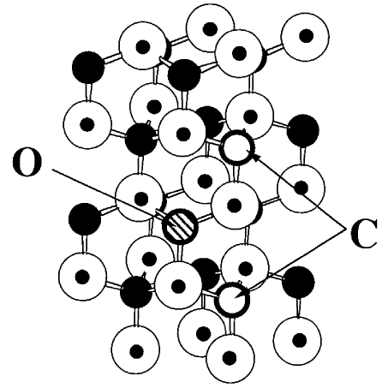
Material properties – Composition
Some films have complex chemical composition
Indium Tin Oxide (ITO)
Al-doped Zinc Oxide (AZO)
Silicon nitride (Si_{x}N_{y} vs Si₃N₄)
Stoichiometry (proportion of components in the film)
Affected by deposition parameters
Can vary across substrate/depth
Surface may oxidize after deposition
Contamination
Trace gases in vacuum systems (water, carbon compounds..)
Contamination of source material
e.g. many metals deposited in same chamber
Volatile substrates/coatings from previous users
Check cross-contamination information in LabManager!
Sputtered AZO: Al concentration (and resistivity) varies with pressure.
Crovetto et al 2016 J. Phys. D: Appl. Phys. 49 295101
AlN with C and O incorporation
Yamamoto and Yoshida 1999, Physica B 273-274, 113-115
N
Al
Notes:
Composition may not always be as you expect
-an issue with oxides, nitrides, alloys.. Any non-elemental depositions!
-sometimes it matters to your application – sometimes not
-examples are the transparent conductive oxides ITO and AZO (indium tin oxide, Al-doped Zinc oxide) as well as silicon nitride
-FIGURE Conductivity of AZO affected by Al-content, affected by deposition pressure in sputtering. Al is the open circles, look at the axis on the right of the figure.
-you can also get inhomogeneity in the composition across the substrate width due to geometry of the deposition system, or in the depth of the film if there is change over time as the film grows. Both things may happen in sputtering, but can also occur with other techniques
Surfaces (e.g. Ti, Al) can oxidize after deposition – be aware for example if you are doing characterization by optical methods
You can also get oxygen and other things you don’t want in your film during deposition
-water likes to adhere to the walls of the deposition chamber (it is adsorbed to the surfaces) and is hard to remove completely → oxidation
FIGURE example of O and C present in AlN lattice – this can change the material from n- to p-type. May or may not be intentional ☺
-in some systems like the sputter system, there are more than one metal source present at a time and we cannot promise that they do not contaminate each other a little bit –
-there may also (rarely) be contamination due to previous users putting volatile substances in the system that they really should not do (can happen for instance if a resist was not properly baked)
For such things, check the cross-contamination sheets found in Labmanager to make sure there will not be a problem for your application

Slide 19
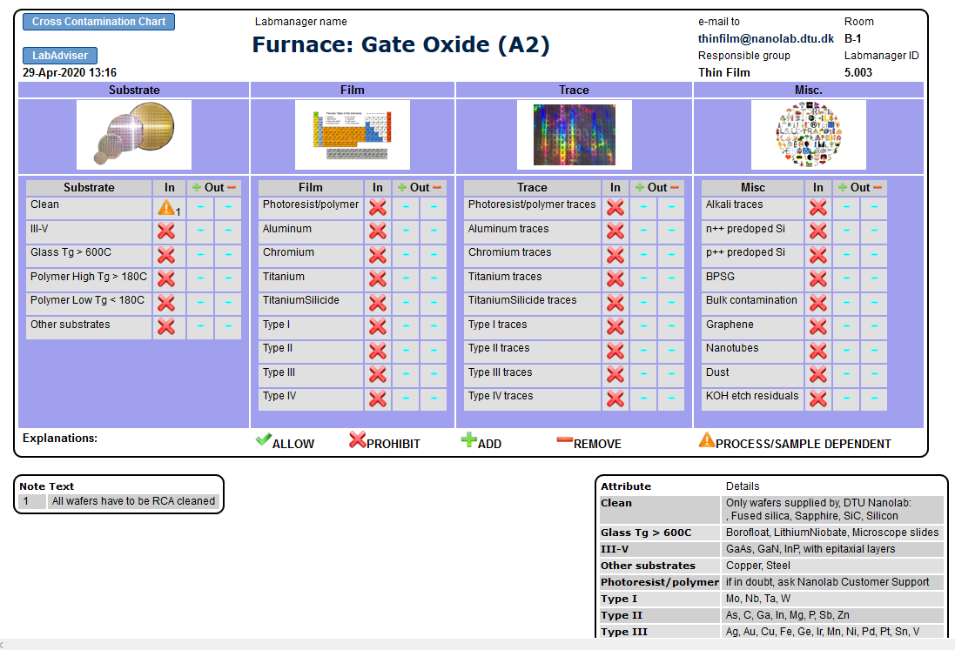
Overview of techniques – Cross contamination
Information about:
What materials that are allowed in different tools
When is it allowed to bring samples from one tool to another
Before you use an equipment:
Check the cross contamination information in LabManager and/or LabAdviser to ensure that only allowed sample materials enter an equipment
Especially for furnaces: Check the RCA cleaning rules in the user manuals
Contact the Thin Film group (thinfilm@Nanolab.dtu.dk), if you have any questions
Notes:
Only techniques at Danchip

Slide 20
Thin film TPT course – 1st part
Introduction to thin films
Before you start – Material properties to consider
Overview of techniques
Equipment overview in LabAdviser
Thin film techniques – 1st part
Thermal oxidation
Electroplating
Notes:
SEM course contents

Slide 21
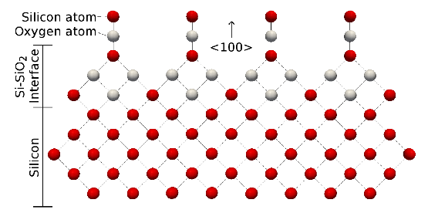
Overview of techniques - How to make a thin film
Thin films can be made either by growth or deposition
Growth
Adding gas + Surface atoms ➔ Film growth
Consumes the substrate
Oxygen + Silicon wafer ➔ Silicon oxide film
(Dry thermal oxidation)
http://www.iue.tuwien.ac.at/phd/filipovic/node27.html
Deposition
Deposition on the surface without reaction with the substrate
(Poly-crystalline silicon, Poly-Si)
SiH₄
H₂
Silicon
LPCVD deposition of Poly-Si
Notes:
Thin film can be made either by growth or deposition.
By growth, the film will be made from an adding gas plus surface atoms and that will consumes the substrate.
The most common film that made by growth is a Silicon dioxcide film and it can be made by using silicon wafer as a substrate and adding oxygen gas in a hot environment. The oxygen atom will react with silicon atom and form SiO₂ .
By deposition, the film will be made by just depositing on a substrate without any reaction with the substrate.

Slide 22
Overview of techniques - Thin film growth and deposition techniques at DTU Nanolab
Growth
Thin film deposition
Thermal oxidation
Chemical processes
Physical processes
Chemical Vapor Deposition (CVD)
Atomic Layer Deposition (ALD)
Electroplating
Evaporation
Sputter deposition
E-beam
DC Magnetron
Low Pressure CVD (LPCVD)
Thermal
Plasma
Thermal
RF Magnetron
Plasma Enhanced CVD (PECVD)
Reactive
Ion beam
1st part of the course (today)
2nd part of the course
Notes:
Only techniques at Danchip

Slide 23
Thin film TPT course – 1st part
Introduction to thin films
Before you start – Material properties to consider
Overview of techniques
Equipment overview in LabAdviser
Thin film techniques – 1st part
Thermal oxidation
Electroplating
Notes:
SEM course contents

Slide 24
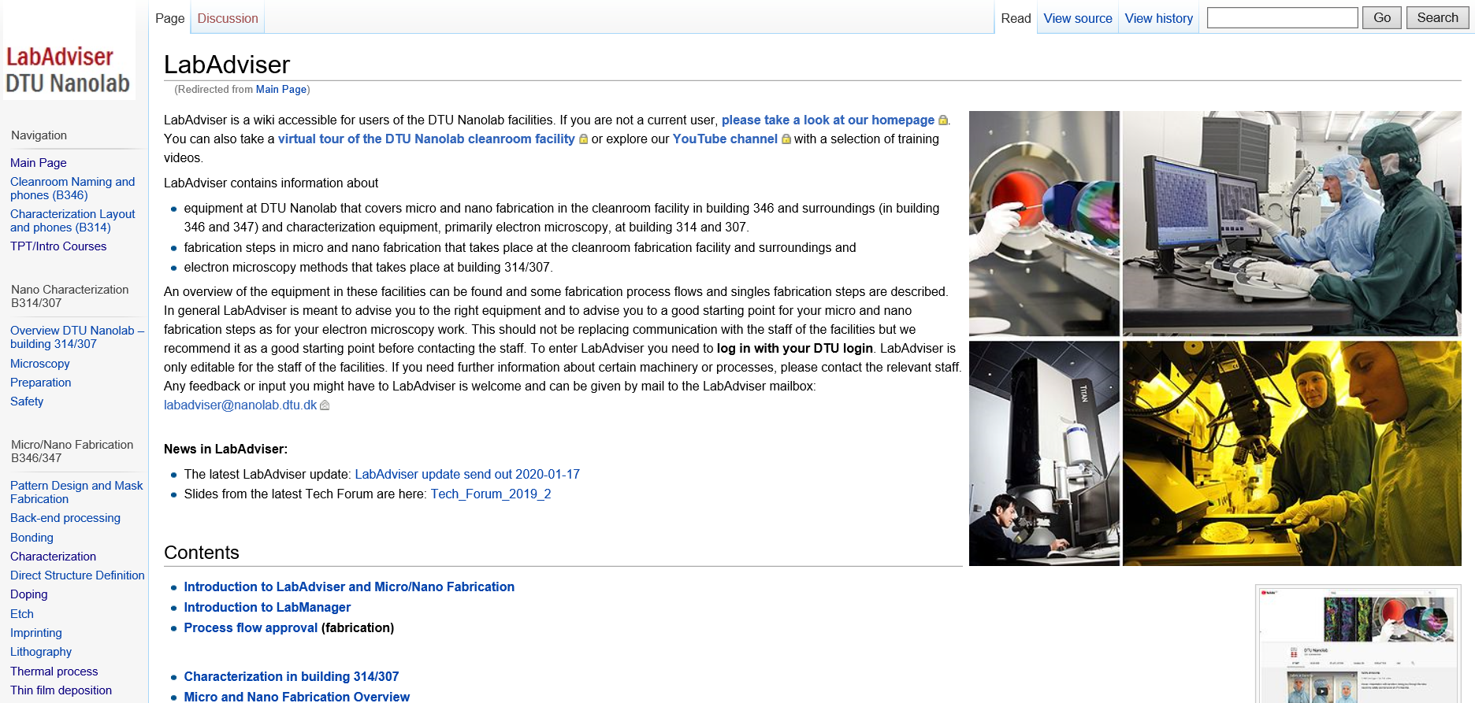
Introduction: Thin film information in LabAdviser
labadviser.nanolab.dtu.dk

Slide 25
Thin film TPT course – 1st part
Introduction to thin films
Before you start – Material properties to consider
Overview of techniques
Equipment overview in LabAdviser
Thin film techniques – 1st part
Thermal oxidation
Electroplating
Notes:
SEM course contents

Slide 26
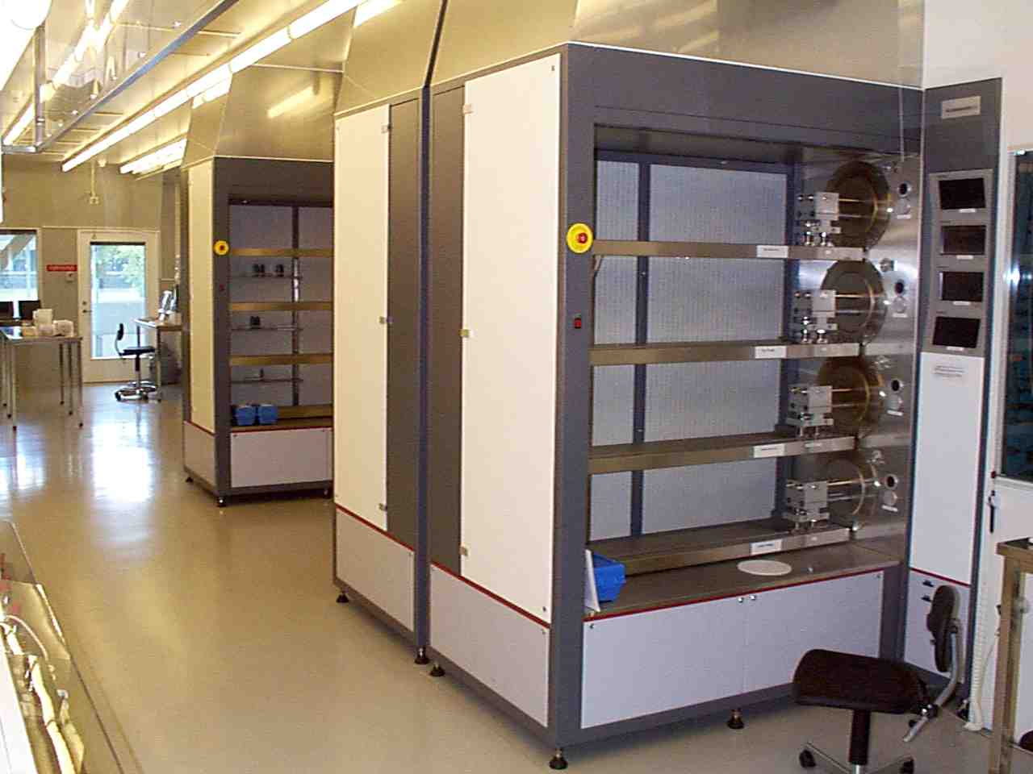
Thermal oxidation of silicon
Silicon dioxide (SiO₂) can be grown on silicon samples in a thermal oxidation furnace
Two types of thermal oxidation:
Dry oxidation – Oxygen (O₂) reacts with Si to form SiO₂:
Wet oxidation – Water (H₂O) vapour reacts with Si to form SiO₂:
More details will come later…
B-stack
A-stack
C-stack
Si(s) + O₂(g) → SiO₂(s)
Si(s) + 2H₂O(g) → SiO₂(s) + 2H₂(g)
A-, B- and C-stack furnaces in the cleanroom
Some of the A- and C- stack furnaces are used for thermal oxidation

Slide 27
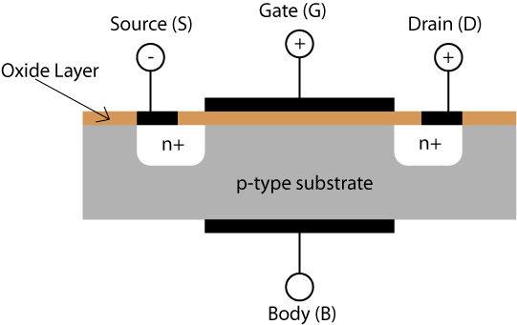
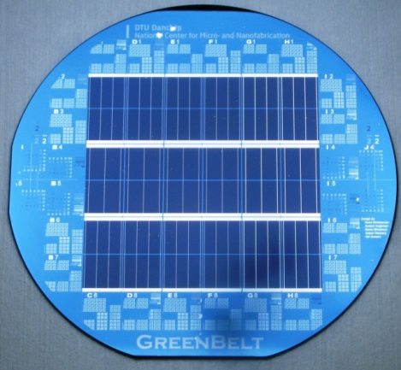
Thermal oxidation - Applications
Applications - What is thermal silicon dioxide (SiO₂) used for?
Structural layers (material for microsystem devices, e.g. membranes)
Electrical insulating layers
Protecting silicon surfaces (passivation layers, hard masks)
Gate oxide layers (< 100 nm dry oxide). Essential component in the gate of a MOSFET
Optical layers
Sacrificial layers - Removed/sacrificed later in a process
SiO₂ is etched very fast in HF (hydrofluoric acid) compared to Si
MOSFET (Metal-Oxide Semiconductor Field-Effect transistor)
https://www.doitpoms.ac.uk/tlplib/semiconductors/mosfet.php
Anti-reflective SiO₂ coating on solar cell
Notes:
Gate oxide: Very thin thermal oxide located over the gate or active region of individual resistors
MOSFETs are the building blocks of logic operations in computer memory and processors, so basically we have thermal oxides all around us

Slide 28
Thermal oxidation – Furnace overview
Cleanroom
Service area
Question
Why do you think, the furnace tube is made of quartz?
Very clean material
Can be heated up to 1100-1150˚C (T_{g}≈1200˚C)
Heaters
For heating zone 1,2,3
To exhaust
Door
N₂
(for purging and annealing)
Wafers
Gas inlet
O₂
(for dry oxidation)
Quartz boat
Quartz tube
H₂O vapour
(for wet oxidation)
Scavenger box
Cantilever
Torch/steamer/bubbler
Generates water vapour

Slide 29
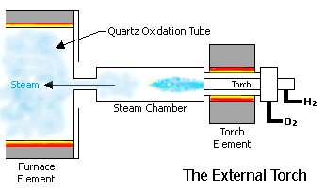
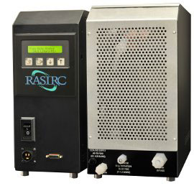
Thermal oxidation – Furnace (wet oxidation)
How to generate water vapour for wet oxidation
Torch
Steamer
Bubbler
All three solutions (torch/steamer/bubbler) are being used for the oxidation furnaces in the cleanroom.
H₂ and O₂ are combined in a quartz torch.
The torch is heated to > 800˚C. At this temperature H₂ will ignite and burn with O₂ into steam (2 H₂ + 1 O₂ → 2 H₂O).
+ High quality and uniform steam
- High temperature, H₂ is explosive
http://www.processpecialties.com/thermox.htm
A heater generates steam from DI water.
The steam is purified by a non-porous membrane, that only allows water molecules to pass.
+ Low temperature, only DI water needed
Steamer
O₂/N₂ carrier gas is bubbled through a glass bubbler that contains DI water near the boiling point. Thus water vapour is added to the carrier gas.
Towards the gas inlet on the furnace, the water vapour is heated further to obtain steam.
+ Cheap and simple solution
- Less clean and uniform steam
- The bubbler has to be filled with water manually
Furnace tube
Notes:
How to generate water vapour for wet oxidation
Torch: H₂ and O₂ are combined in a heated to > 800˚C quartz torch. H₂ ignites and burn swith O₂ into steam (2 H₂ + 1 O₂ → 2 H₂ O)
Steamer: Steam is generated from DI water by a heater. The steam is purified by a membrane, that only allows water molecules to pass
Bubbler: N₂ or O₂ is carrier gas is bubbled through a bubbler with DI water near the boiling point. The water vapor is heated further to obtain steam
The RHS adds controlled amounts of pure water vapor directly into any carrier gas stream. Needing only filtered house de-ionized (DI) water and power, the system delivers precise amounts of water vapor into atmospheric processes. The RHS is an integrated water vapor delivery system featuring adaptive closed loop control. Process parameters are set through automated process recipes or the controller touchscreen. Internal pressure, flow and temperature sensors provide feedback to the control system, which automatically adjusts operations to maintain required temperature and concentration stability. The RHS consists of a non-porous membrane that excludes particles, micro-droplets, volatile gases, and other opposite charged species from being transferred to the carrier gas and ensures only water vapor is added. The membrane selects only the source gas molecules. Other contaminants in the liquid source cannot permeate across the membrane or enter the carrier gas stream, resulting in a saturated product that is consistent and pure.

Slide 30
Thermal oxidation - Process
Oxidation process:
Load Si wafers in the furnace at 700˚C (standby temperature)
Raise the temperature to 800-1150˚C (oxidation temperature)
Flow O₂ or H₂O vapour through the furnace to oxidize the Si wafers
Flow N₂ through the furnace (for annealing and purging)
Cool down the furnace to 700˚C
Unload the wafers
N₂
(for purging and annealing)
O₂
(for dry oxidation)
H₂O vapour
(for wet oxidation)
Torch/steamer/bubbler
Generates water vapour

Slide 31
Thermal oxidation – Process requirements
Recap from earlier
Two types of thermal oxidation:
Dry oxidation – Oxygen reacts with Si to form SiO₂:
Wet oxidation – Water vapour reacts with Si to form SiO₂ :
Process requirements:
Gas flow:
O₂ or H₂O vapour flow
Typical flow: 1-5 SLM
High temperature:
Typical oxidation temperature: 800-1150˚C
Atmospheric pressure:
~1 bar = 100 hPa (vacuum not required)
DTU Nanolab has fixed recipes on most oxidation furnaces, e.g.
”WET1000” – Wet oxidation at 1000˚C
”DRY1100” – Dry oxidation at 1100˚C
Users can change the oxidation time in the recipes to decide how thick an oxide layer they want to grow
Si(s) + O₂(g) → SiO₂(s)
Si(s) + 2H₂O(g) → SiO₂(s) + 2H₂(g)

Slide 32
Thermal oxidation – Properties
Process properties:
Oxide growth on both sides of wafers
Batch process
Good uniformity (<1.5 % non-uniformity over 30 4” wafers)
Very reproducible process
General thermal oxide properties:
Very good electrical insulator
Can be doped with boron or phosphorous
At DTU Nanolab: Using PECVD or pre-deposition in other furnaces
Other places: Using ion implantation

Slide 33
Thermal oxidation – Advantages and limitations
Dry oxidation
Advantages:
Very dense amorphous film
High quality film with few defects
Limitations:
Slow oxidation rate
Maximum oxide thickness at DTU Nanolab ~300 nm
Wet oxidation
Advantages:
Faster oxidation rate
Maximum oxide thickness at DTU Nanolab ~3 µm
(23 hours oxidation at 1100˚C)
Limitations:
Less dense amorphous film
Si(s) + O₂(g) → SiO₂(s)
Si(s) + 2H₂O(g) → SiO₂(s) + 2H₂(g)
Question:
Why does dry oxide have a better quality than wet oxide?
H₂ causes imperfections in wet oxide layers, and therefore these are less dense than dry oxide layers
Notes:
In wet oxides, hydrogen atoms liberated by the decomposition of the water molecules during oxidation, produce imperfections that degrade the oxide quality somewhat

Slide 34
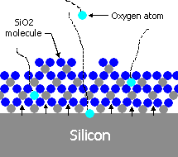
Thermal oxidation - Process
Important:
SiO₂ is grown (not deposited like e.g. PVD, CVD and ALD layers) on Si wafers
The O₂ or H₂O vapour molecules (the oxidants) react with Si on the wafer surface.
The oxide is growth takes place at the interface between the Si surface and the SiO₂ layer that is grown as soon as the
oxidation starts.
I.e. the oxidants have to diffuse through the already grown SiO₂ layer to reach this interface
Advantage:
Contaminations on the Si surface moves to the outer SiO₂ surface, thus the grown SiO₂ layer is very clean
SiO₂ layer
The oxidation reaction takes place at the SiO₂-Si interface
http://www.processpecialties.com/thermox.htm

Slide 35
Thermal oxidation - Process
Question
Do you think that the growth rate for SiO₂ is linear or non-linear as function of time? Explain why
There is no quick answer to this question…
The growth rate for very thin (some hundred nm) oxide layers is linear.
For thicker oxide layers the growth rate is not linear and decreases with time:
When the oxide layer grows, it takes longer and longer time for the O₂ or H₂O vapour molecules to diffuse through the already grown oxide layer and reach Si surface to form more SiO₂
SiO₂ layer
The oxidation reaction takes place at the SiO₂-Si interface
http://www.processpecialties.com/thermox.htm

Slide 36
BREAK

Slide 37
Thermal oxidation – Process (Deal-Grove model)
The oxidation reaction occurs a the interface between the oxide layer and the Si surface
To understand the oxidation process, we first have to understand the kinetics of the oxide growth,
i.e. how the oxidants are being transported to the Si surface.
Oxidants: O₂ or H₂O vapour molecules
What is going to happen for the oxidation to the place?
Oxidants in the gas steam are transported to the gas-SiO₂ interface
The oxidants diffuse through the already grown oxide layer to reach the SiO₂-Si interface
The oxidants reach with Si at the SiO₂-Si interface
Gas steam
(O₂/H₂O vapour)
Gas-SiO₂ interface
SiO₂ layer
SiO₂-Si interface
http://www.processpecialties.com/thermox.htm

Slide 38
Thermal oxidation – Process (Deal-Grove model)
1.
The flux of oxidants in the gas steam is governed by concentration differences:
$F_{1}=h_{G}∙\left(C_{g}−C_{s}\right), { h}_{G}:Gas phase mass transfer coefficient$
Or
$F1=h∙\left(C^{∗}−Co\right), h:Constant$
${ C}^{∗}:Equilibrium concentration of oxidants in the SiO2$
2.
The flux is related to the diffusion of oxidants through the existing oxide layer.
The oxidants move because of a concentration gradient:
$F2=D∙\left(\frac{CO−Ci}{x}\right), D:Diffusion constant$
3.
The flux is related to the reaction between the Si and oxidants at the Si-SiO₂ interface.
The reaction is governed by the reaction rate of the oxidants:
$F_{3}=K_{s}C_{i}, Ks:Reaction rate constant$
Or
$F3=N1∙\frac{dx}{dt}$, $\frac{dx}{dt}:Oxide growth rate$
$$N1:Number of oxidant molecules per cm3 of SiO2$$
Three fluxes are related to the oxidation process: $F1, F2, F3$
Flux: Number of molecules per time per area
Oxide thickness x
Gas steam (O₂/H₂O vapour)
SiO₂ layer
Si sample
Diffusion
Reaction
C_{g}
C_{s}
C_{o}
C_{i}
F₁
F₂
F₃
Concentrations of oxidants (number of molecules per area):
$C_{g}:$in the bulk of the gas
$C_{s}:$right next to the gas-oxide interface
$C_{o}:$ at the outer oxide surface
$C_{i}:$at the inner oxide surface
N₁ values:
Dry oxidation: N₁ for O₂ = 2.2·10²²
Wet oxidation: N₁ for H₂O = 4.4·10²²
(Si(s) + O₂(g) → SiO₂(s))
(Si(s) + 2H₂O(g) → SiO₂(s) + 2H₂(g))
Notes:
Flux: Number of molecules per second per cm² (1/(cm²*s))
The fluxes are related to the concentration of the oxidants in the various regions:
C_G: Concentration of oxidants in the bulk of the gas
C_S: Concentration of oxidants right next to the gas-oxide interface
C_O: Contration of oxidants at the outher oxide surface
C_i: Contration of oxidants at the inner oxide surface
C*: Eqiulibrium concentration of the oxidizing species in the oxide
1.
h_G: Proportional constant/gas phase mass transfer coefficient
Ideal gas law: F1=(h_G/(kT))*(P_G-P_S)
Henri’s law: In equilibrium, the concentration of species within a solid is proportional to the partial pressure of that species in the surrounding gas)
3.
K_S: Proprotional constant/reaction rate constant

Slide 39
Thermal oxidation – Process (Deal-Grove model)
Steady state condition (the system is unchanging in time):
$F1=F2=F3$
From this equation the oxide growth characteristic, i.e. how the SiO₂ thickness increases with time, can be found.
The slowest factor (F₁, F₂ or F₃) now becomes the limiting factor that determines the overall growth rate.
F₁ is not a limiting factor
With some math, the equation can be written as:
This equation is called the linear-parabolic Deal-Grove equation, and it predicts the oxide growth very precisely
$x^{2}+Ax=B\left(t+τ\right), where A=2D\left(\frac{1}{K_{s}}+\frac{1}{h}\right)$
$B= \frac{2DC^{∗}}{N_{1}}$
t: Oxidation time
$τ=\frac{x_{i}^{2}+Ax_{i}}{B}$ (represents the time that is needed to grow the oxide layer that was already present
on the Si surface when the oxidation started - Can be skipped for new/blank Si wafers)
x_{i}: Initial oxide thickness (oxide present when the oxidation started)
Notes:
A system or a process is in a steady state if the variables, which define the behavior of the system or the process, are unchanging in time
Three are three rates to consider:
The rate at which the gas molecules arrive at surface
The rate at which molecules diffuse through the already formed oxide layer
The rate at which the reaction occurs at the interface
In steady-state, all three rates are the same. Then the slowest rate becomes the limiting factor that determines the overall growth rate
Not a limiting factor
Limiting factor in the parabolic growth regime
Limiting factor in the linear growth regime
F3 is related to the reaction between the Si and oxidants at the Si-SiO₂ interface.
The reaction is governed by the reaction rate of the oxidants
F2 is related to the diffusion of oxidants through the existing oxide layer.
The oxidants move because of a concentration gradient

Slide 40
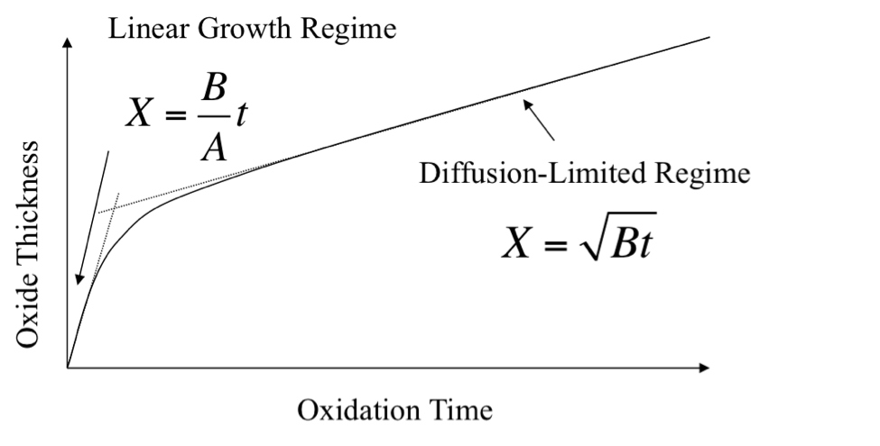
Thermal oxidation – Oxide growth rate (Deal-Grove model)
Deal-Grove equation: $x^{2}+Ax=B\left(t+τ\right)$
The oxide thickness is found by finding the roots (for which x > 0) of the equation: $x=\frac{−A+\sqrt{\left(A^{2}+4B\left(t+τ\right)\right)}}{2}$
Short oxidation time
$t→0 ⇒x=\frac{B}{A}t$
x is linear proportional to time, and thus the oxidation rate follows a linear growth rate curve.
The oxidation rate in limited by how fast the oxidants can react with the Si atoms at the SiO₂-Si interface. I.e. F₃ is the limiting factor.
$\frac{B}{A} is called the "linear rate constant"$
Long oxidation time
$t→∞ ⇒x=\sqrt{Bt}$
The oxidation rate follows a parabolic growth rate curve.
The oxidation rate is limited by diffusion, because it takes longer and longer time for the oxidants to diffuse through the oxide layer. I.e. F₂ is the limiting factor.
$B is called the "parabolic rate constant"$
https://www.semitracks.com/newsletters/october/2014-october-newsletter.php
Notes:
The Deal-Grove model matematically describes the growth of an oxide layer on a Si substrate
The model assumes that the oxidation reaction occurs a the interface between the oxide layer and the Si surface

Slide 41
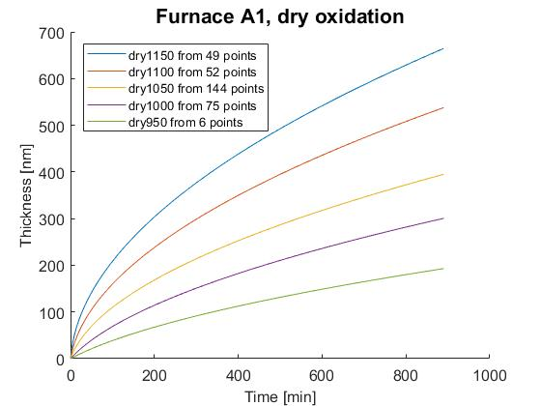
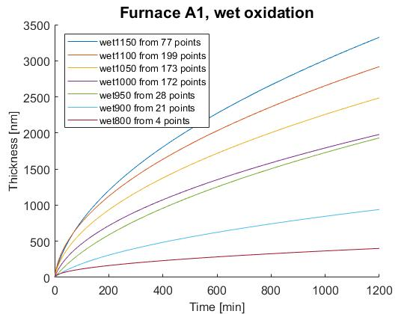
Thermal oxidation – Experimental data
The graphs show experimental data from the A1 furnace (Boron Drive-in and Pre-dep) in the cleanroom
The curves are fitted from the numbers in the process log in LabManager
Dry oxidation
Si (100) wafers
Wet oxidation
Si (100) wafers
Oxide thickness [nm]
Oxide thickness [nm]
Oxidation time [min]
Oxidation time [min]
Oxide thickness as function of oxidation time for different oxidation temperatures

Slide 42
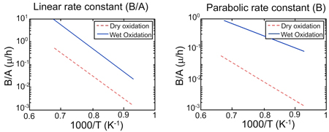
Thermal oxidation – Oxide growth rate (Deal-Grove model)
From the graphs it is seen that:
Both$\frac{B}{A}$and B increase with temperature (T)
So, higher temperature > Faster oxidation rate > Thicker oxide layer
Both $\frac{B}{A}$and B are larger for wet oxidation than for dry oxidation. Thus, wet oxide is grown faster than dry oxide.
$B=\frac{2DC^{∗}}{N_{1}}$ , and C* is much larger for wet oxidation than for dry oxidation,
And H₂O molecules form hydroxide (OH⁻), that diffuses much faster through the already-grown oxide layer than O₂
Linear growth regime:
$t→0 ⇒x=\frac{B}{A}t$
Diffusion-limited growth regime:
$t→∞ ⇒x=\sqrt{Bt}$
B/A (µm/hr)
B (µm²/hr)
https://nptel.ac.in/courses/103106075/30
C* values (for a given T): Dry oxidation: C* = 5.2·10¹⁶
Wet oxidation: C* = 3.0·10¹⁹

Slide 43
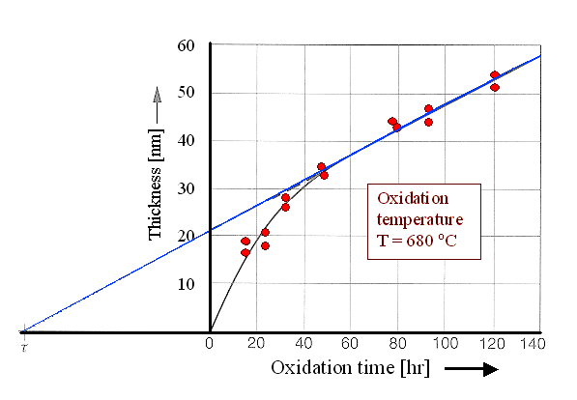
Thermal oxidation – Limitations of the Deal-Grove model
Linear growth regime
$$x=\frac{B}{A}\left(t+τ\right)$$
Limitations of the Deal-Grove model:
Very thin (<30 nm) dry oxide layers grow faster than the
model predicts, and they grow non-linearly
The model is only valid for single crystal silicon
Poly-crystalline Si is oxidized faster than the model predicts, because oxidants diffuse rapidly along grain boundaries. Furthermore, the random orientation of the crystal grains makes it difficult to chose a value for the linear rate constant ($\frac{B}{A}$)
Heavily doped Si wafers might be oxidized faster than the model predicts
More info will come later…
https://www.tf.unikiel.de/matwis/amat/elmat_en/kap_6/backbone/r6_2_1.html
Experimental data points
Extrapolated linear curve fitted to the Deal-Grove model
(assumption: x_{i} = 21 nm at t = 0)

Slide 44
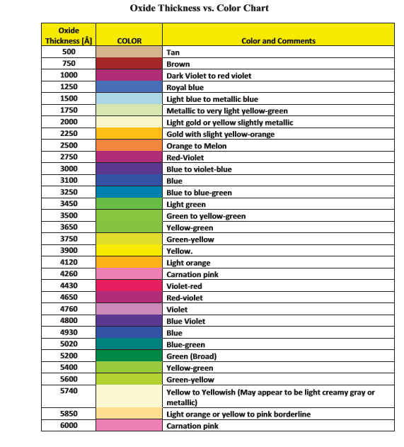
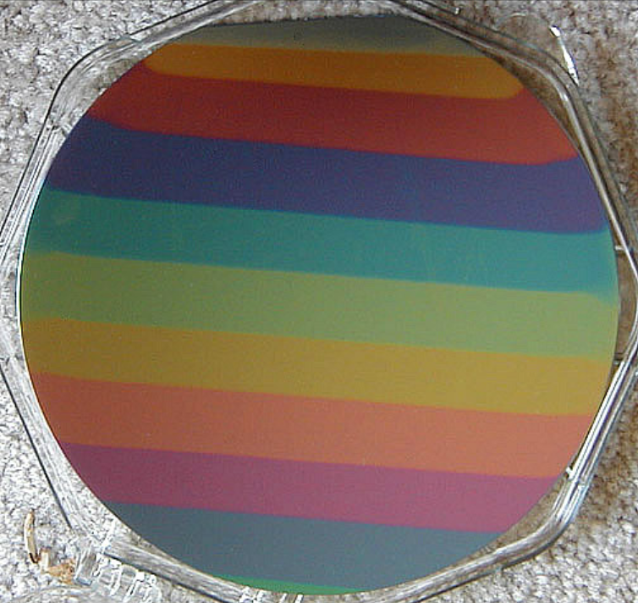
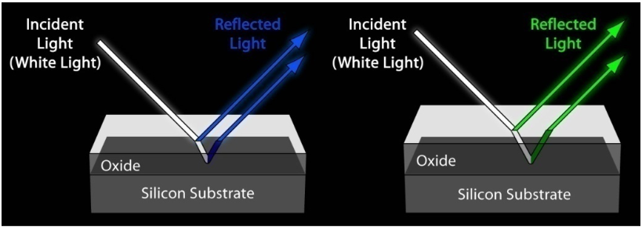
Thermal oxidation – How find the oxide thickness
Question:
How can you tell how thick an oxide layer is?
Measure the thickness
Use an ellipsometer or spectrometer (Filmtek) or use an SEM (cleave the wafer first)
Look at the wafer
The colour is determined by the SiO₂ thickness
The color of the oxide layer is caused by the interference of light reflecting off the Si surface and the light reflecting off the top of the oxide surface. The interference changes with the oxide thickness
The eye can tell the colour difference between two SiO₂ layers having a 10 nm thickness difference
Si wafer with different SiO₂ thicknesses
https://nanohub.org/resources/26366/download/Fab_PrDepo_AC10_PG.pdf
https://nanoscale.unl.edu/pdf/Deposition_Powerpoint.pdf
http://scme-nm.org/files/Rainbow_Activity_PG.pdf
Notes:
Oxide is colorless. However, when you look at an oxide wafer, it has color. The color of the oxide coated wafer is caused by the interference of light reflecting off the silicon (below the oxide) and the light reflecting off the top of the oxide surface.
to use a color chart to estimate oxide thickness consistently,it is very important thatyour line of sight isperpendicular to the wafer's surface. In other words, look straight down on the wafer, not at an angle.

Slide 45
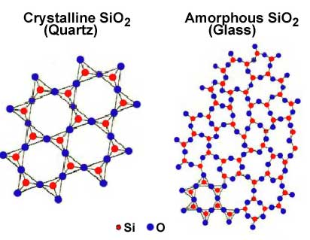
Thermal oxidation – Crystal structure
Thermal oxide has an amorphous/porous crystal structure
43% of the space is occupied by SiO₂ molecules
However, close to the Si/SiO₂ interface thermal oxide has a crystalline structure.
Thermal SiO₂
Amorphous structure
Density 2.21 g/cm³
Quartz crystal lattice
Density 2.65 g/cm³
TEM image of a Si/SiO₂ interface
Thermal SiO₂
https://www.nde-ed.org/EducationResources/CommunityCollege/Materials/Structure/solidstate.htm
Si (wafer)
https://www.slideshare.net/bhargavveepuri/61-thermal-oxidation-12micro-tech2013
Notes:
Silicon dioxide has a tetrahedal structure

Slide 46
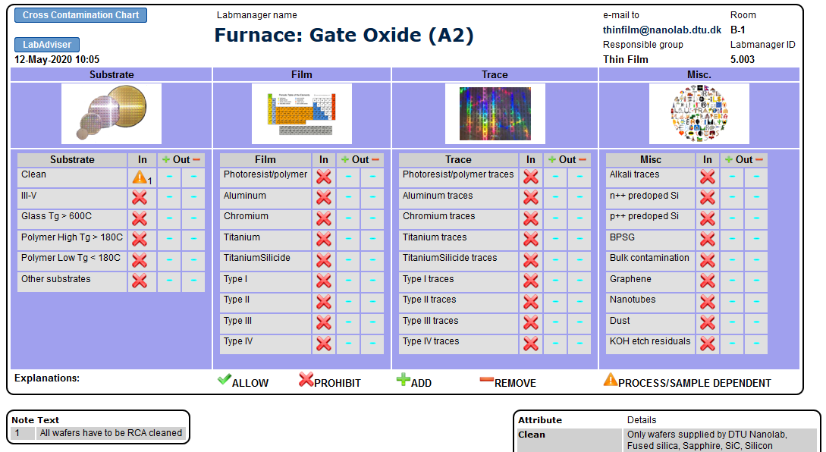
Thermal oxidation – Oxide quality
It is only possible to grow a high quality oxide with a low impurity level in a very clean furnace
The amorphous crystal structure of the grown SiO₂ layer allows O₂ and H₂O molecules to diffuse through it.
Also impurities, e.g. sodium and potassium, can diffuse through the SiO₂ layer.
So even a very small amount of impurities will affect the cleanliness of a furnace.
How to estimate the oxide quality?
Measure the life-time (easy)
Measure the break-down voltage (best, but time consuming as dedicated samples have to be made)
Before you use a furnace
Check the cross contamination information in LabManager (select “Equipment Info” > “Cross contamination” under Basic Info)
Check the RCA cleaning rules
And contact the responsible persons, if you have questions
Example
The A-stack furnaces are some of the cleanest tools in the cleanroom.
Only Si wafers are allowed in these furnaces
All wafers have to be RCA cleaned

Slide 47
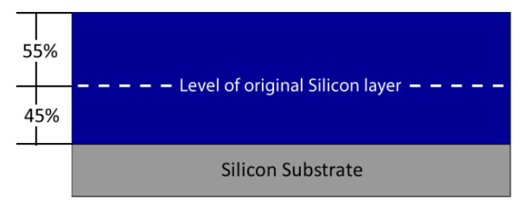
Thermal oxidation – Si consumption and volume expansion
The SiO₂ growth consumes the Si surface, and thus the volume expands
$x_{Si}=0.45∙x_{\begin{aligned}oxide \\ \end{aligned}}$
$$xSi=Thickness of consumed Si$$
$$x_{\begin{aligned}oxide \\ \end{aligned}}=Thickness of grown oxide$$
Example:
How much Si is consumed to grow 100 nm of SiO₂?
$0.45∙100 nm=45 nm$
I.e. 45% of the oxide thickness is below the original Si surface,
and 55 % is above it
How much is the volume expanding?
$\frac{100 nm}{45 nm}=2.2 times$
Grown
SiO₂ layer
SiO₂
https://nanohub.org/resources/26366/download/Fab_PrDepo_AC10_PG.pdf

Slide 48
Thermal oxidation – Stress
The volume of the grown SiO₂ is larger than the volume of the Si it replaces.
But when a Si wafer is being oxidized, the volume can only expand upwards (not to the sides).
Therefore thermal oxide has a high compressive stress
Before oxidation
After oxidation
Compressive stress
– the SiO₂ layer wants to expand
However, the stress will cancel out, when oxide is grown on both sides of a wafer
https://www.kth.se/social/upload/4f283b68f276541a2900000e/Lecture%205%20-%20Spring%202012.pdf

Slide 49
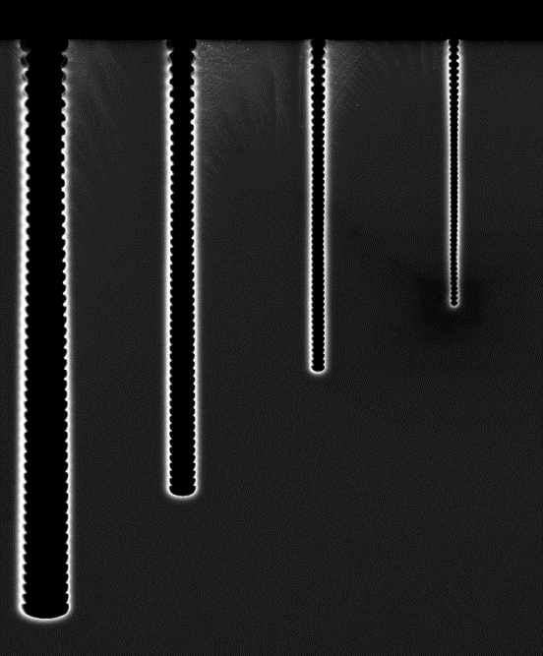
Thermal oxidation – Oxidation of structured samples
For structured samples, the oxide thickness will be smaller in edges compared to flat areas
This is an advantage for e.g. for removal of scallops after DRIE (deep reactive ion etching)
But be aware of that Si is being consumed during the oxidation, and very narrow structures might therefore be completely oxidized
Cross section of 700 nm – 2 µm wide trenches with scallops
Cross section of 700 nm – 2 µm wide trenches with scallops
1500 nm
Scallops before
oxidation
Scallops after
oxidation
Structured Si sample that has been oxidized
Structured Si sample that has been oxidized
Notes:
Færdig

Slide 50
Thermal oxidation – Oxidation of structured samples
Question:
Why is the oxide layer thicker on the sidewalls than in the bottom of the structures?
The oxidation rate is not same for all crystal orientations
1150 nm
Si (110)
995 nm
Si (100)
Structured Si sample that has been oxidized

Slide 51
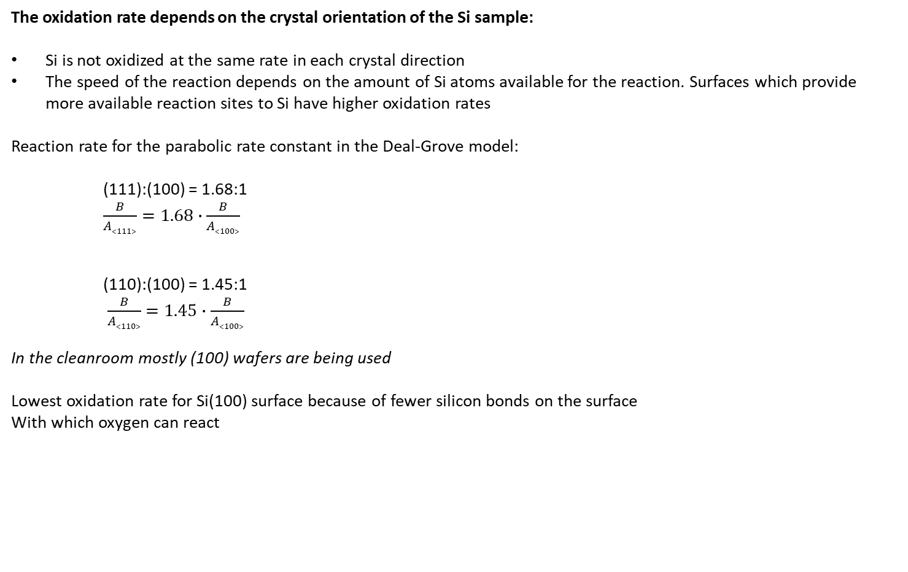
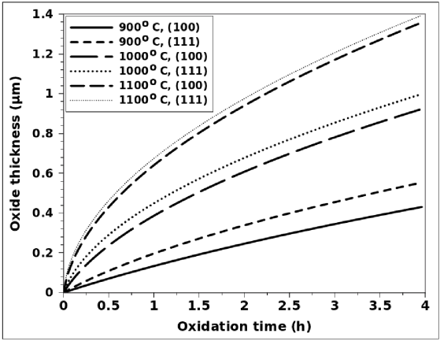
Thermal oxidation – Growth rate as function of crystal structure
The oxidation rate depends the crystal orientation, i.e. on the amount of available Si atoms that the O₂/H₂O vapour molecules can react with:
Example:
Si (111) has more available atoms per unit area on the surface than Si (100).
Therefore, Si (111) oxidizes faster than Si (100) in the linear rate regime, where the oxidation rate is limited by the reaction rate.
Reaction rate for the linear rate constant in the Deal-Grove model:
$\frac{B}{A}\left(111\right)=1.68∙\frac{B}{A}\left(100\right)$
$\frac{B}{A}\left(110\right)=1.45∙\frac{B}{A}\left(100\right)$
In the diffusion-limited regime, this advantage is somewhat lost, because the oxidation rate is limited by diffusion
At DTU Nanolab mostly (100) wafers are being oxidized
http://www.iue.tuwien.ac.at/phd/hollauer/node14.html
Notes:
In parabolic rate regime, the curves come closer together, because the oxidation rate is diffusion dependent
of silicon atoms available for the reaction. It was found experimentally that surfaces which provide more available reaction sites to silicon have a higher oxidation rate [122]. The ratio for the parabolic rate constant in silicon crystal orientations (111):(100) was found to be 1.68:1.
Similarly, it has been suggested that the ratio for the parabolic rate constant in crystal orientations (110):(100) is approximately 1.45:1, noticeable on thicker oxide along sidewall surfaces.

Slide 52
Thermal oxidation – Oxidation of doped Si wafers
For heavily doped wafers, the oxidation rate is faster than the Deal-Grove model predicts
Boron doped wafers (p⁺ doping):
Faster oxidation rate
Boron converts the oxide into borosilicate glass (boron-doped SiO₂) that strains the lattice constant,
so the O₂ /H₂O molecules diffuse faster through the layer than through undoped SiO₂
Phosphorous doped wafers (n⁺ doping):
Faster oxidation rate, but only in the reaction limited regime
High concentration of vacancies in the silicon substrate, and phosphorous creates a defect region is created at the Si-SiO₂ interface, and this increases the reaction rate

Slide 53
Thermal oxidation – Annealing after oxidation
An annealing with N₂ is normally done after the oxidation
Advantages of the annealing:
Improve the oxide density
Repair atomic defects within the crystal structure
Reduce vacancies and dislocations at grain boundaries
At DTU Nanolab the annealing time is normally 20 minutes, but the time can be adjusted.
The annealing is done at the same temperature as the oxidation.
Notes:
Virker annealing med N2? H2/forming gas bedst
Advantages of the annealing:
Improved the oxide density
Repair atomic defects within the crystal structure (from the Si wafer microsctructure?)
Remove dangling bonds at the Si-SiO₂ interface
Reduce vacancies and dislocations at grain boundaries

Slide 54
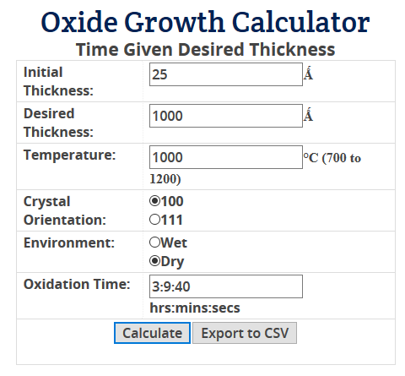
Thermal oxidation – Oxidation time
How to decide the oxidation time required to get a certain oxide thickness:
Look at the results in the process log
Look at the oxidation curves by the furnaces or in LabAdviser
Use calculators on the Internet – search for “Oxide growth calculator“
Maximum allowed oxidation time:
8 hours at 1150˚C (only in the A-stack and C3 furnaces)
23 hours at 1100˚C (but max 8 hours wet oxidation in the C3 furnace)
This will result in ~3 µm wet oxide
https://cleanroom.byu.edu/OxideTimeCalc

Slide 55
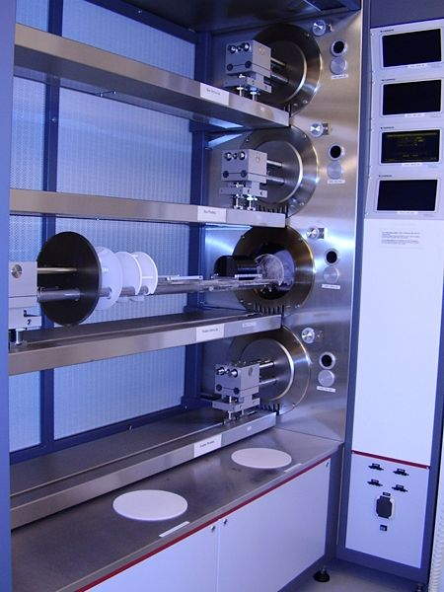
Thermal oxidation furnaces at DTU Nanolab
A-stack furnaces:
A1 Boron Drive-in and Pre-dep Furnace
Dry and wet dry oxidation (using a torch) of p-type Si wafers
Sample size: 4” wafers
Maximum oxidation temperature 1150˚C
A2 Gate Oxide Furnace
Dry oxidation of very clean Si wafers
Sample size: 4” wafers
Maximum oxidation temperature 1150˚C
A3 Phosphorous Drive-in Furnace
Dry and wet oxidation (using a torch) of n-type Si wafers
Sample size: 4” wafers
Maximum oxidation temperature 1150˚C
(A4 Phosphorous Pre-dep Furnace – Not an oxidation furnace)
A1
A2
A3
A4
A-stack furnaces

Slide 56
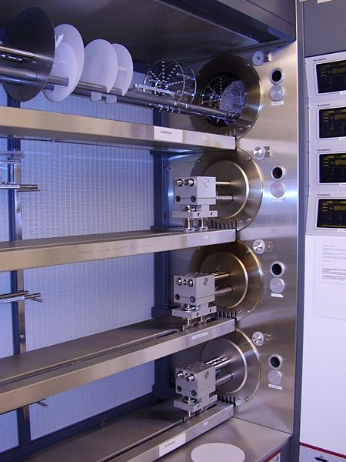
Thermal oxidation furnaces at DTU Nanolab
C-stack furnaces:
C1 Anneal Oxide Furnace
Dry and wet oxidation (using a steamer)
Sample size: 4” and 6” wafers
Maximum oxidation temperature 1100˚C
C2 III-V Oxidation Furnace
Wet oxidation (using a bubbler) of samples with III-V materials
Sample size: 4” and small samples
Oxidation temperature 420-460˚C
Being tested at the moment
C3 Anneal Bond Furnace:
Dry and wet oxidation (using a bubbler)
Sample size: 4” wafers
Maximum oxidation temperature 1150˚C
(C4 Al-Anneal Furnace – not an oxidation furnace)
C1
C2
C3
C4
C-stack furnaces

Slide 57
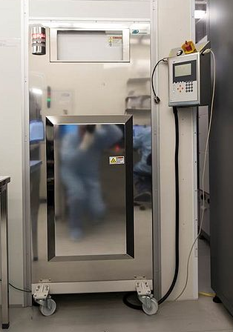
Thermal oxidation furnaces at DTU Nanolab
Multipurpose Anneal furnace
Dry oxidation of ”dirty” samples (e.g. samples with metals)
Sample size: Small samples, 4” and 6” wafers
Maximum oxidation temperature 1100˚C (without vacuum, 1050˚C with vacuum)
Furnace reponsible persons
Pernille Patama Roy Flemming N.
Multipurpose Anneal furnace

Slide 58
Thin film TPT course – 1st part
Introduction to thin films
Before you start – Material properties to consider
Overview of techniques
Equipment overview in LabAdviser
Thin film techniques – 1st part
Thermal oxidation
Electroplating
Notes:
SEM course contents

Slide 59
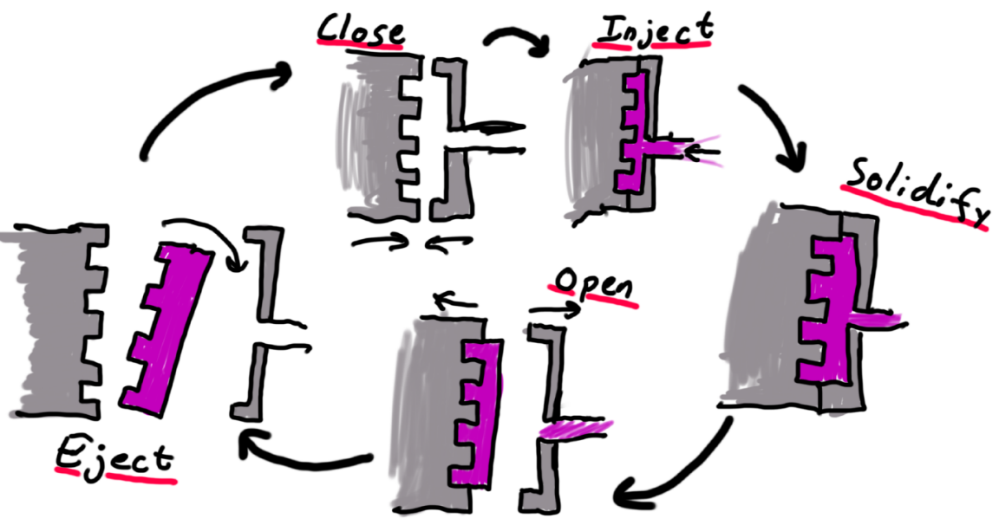
Electroplating
Electroplating is an electrochemical deposition technique for deposition of thicker metal layers
Embossing/imprinting
Electroplating at DTU Nanolab:
Material: Ni
Thickness: Up to 700 µm
Ni electroplating is typically used to transfer structures from Si wafers to Ni shims
Application examples – Ni shims are used as:
Foils for embossing/imprinting (100-200 µm Ni)
Stamps for injection moulding (≈350 µm Ni)
Process:
Make structured Si wafer (with seed layer)
Ni electroplating
Remove Si wafer to release Ni shim
Si
Injection molding
Ni
Polymer
Ni stamp

Slide 60
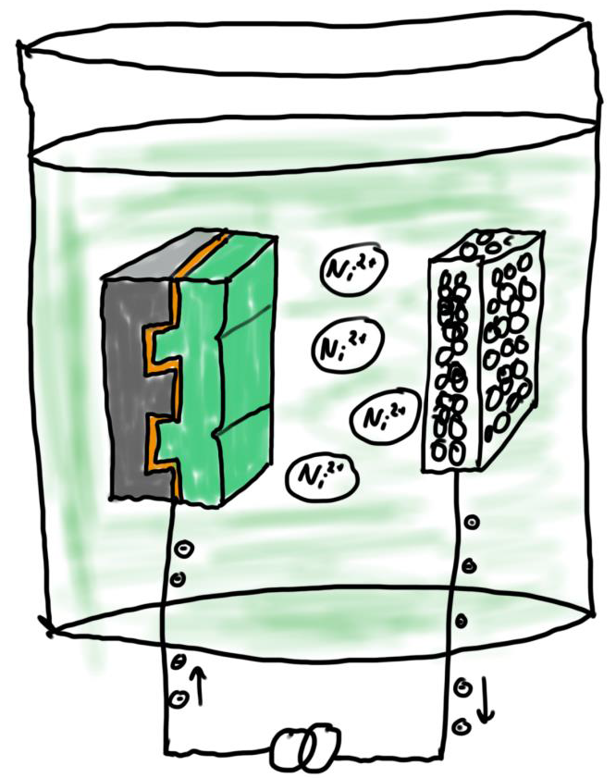
Electroplating – Process (electroplating of Ni)
Electrolyte containing Ni ions
A sample is lowered into an electrolyte (an aqueous solution) containing Ni ions.
The electrolyte has a well-controlled temperature and pH that are adjusted automatically:
Temperature: 52˚C
pH: ~3.7 (acidic)
A voltage is applied between a titanium basket with Ni pellets and the sample, i.e. across an anode and a cathode
At the anode, metallic Ni is oxidized to Ni ions:
$\text{Ni}\text{(}\text{s}\text{) → }\text{Ni}\text{2+}\text{(}\text{aq}\text{) + 2 }\text{e}\text{−}$
At the cathode, Ni ions from the electrolyte
is reduced to metallic Ni:
$\text{Ni}\text{2+}\text{(}\text{aq}\text{) + 2 }\text{e}\text{−} \text{→ }\text{Ni}\text{(}\text{s}\text{)}$
Electroplating is an electrochemical deposition technique
Anode (+)
Titanium basket with Ni pellet
Cathode (-)
Samplewafer
(aq): in aqueous solution
(s): solid
Si wafer
Conducting seed layer
Electroplated Ni layer
Notes:
The plating bath is an aqueous solution of nickel sulfamate, borid acid and sulfamate acid
Ni ions are transported from anode to cathode
Ni is deposited at the cathode, when positively changed Ni ions are discharged

Slide 61
Electroplating – Sample requirements
Sample requirements:
Sample size: 50, 100 and 150 mm wafers
Wafer thickness: ~350-1000 µm
Sample materials must be compatible with the electrolyte
Electroplating can only be done on wafers with a conducting surface
For instance, Si wafers can be covered by a thin (~50-100 nm) seed layer of Ti/Cr+Au or NiV (nickel-vanadium) using PVD deposition.
Important:
All parts of the wafer surface, including sidewalls on high aspect ratio structures, must covered with a uniform conducting seed layer.
Sputter deposition is the preferred PVD method to cover wafers with a seed layer, because it gives a good step coverage.
More info in the 2nd part of this course…
A dedicated wafer holder has to be used in the sputter coater to ensure deposition in the edge of the wafer surface - and thus electric edge contact in the electroplater.
Si wafer
Conducting seed layer
Electroplated Ni layer
Electroplater sample holder with 4” wafer
Notes:
Nickel-Vanadium is used, becaues nickel is oxidizing too fast and becomes non-conductive
Au alone on Si is not allowed (poor adhesion, delaminates and causes clogging of filters).

Slide 62
Electroplating – Process
The deposition rate is controlled by:
The charge [Ah]
The current density [A/dm²], i.e. current and the wafer size
The deposition rate increases with the current density
However, normally a low current density is used – Why?
Advantages of using a low current density:
Improve filling of structures
Better uniformity
Lower surface roughness
More hard surface

Slide 63
Electroplating – Process example
Example:
DTU Nanolab has three standard programs for deposition of 350 µm Ni on 4” Si wafers coated with ~100 nm NiV.
The maximum current [I_{max}] and thus the deposition
time is different for the three programs
The charge is 18.3 Ah for all the programs
1.
$$I_{max}=5.5 A⇒dep.time≈4 hours$$
2.
$$I_{max}=3.5 A⇒dep.time≈6 hours$$
The depositions starts with a slow current ramping to avoid wafer (and sample holder) damage, as the seed layer cannot conduct high currents.
Current [A]
3.
$$I_{max}=1.5 A⇒dep.time≈12 hours$$
Time [minutes]

Slide 64
Electroplating at DTU Nanolab
Typical process results
Thickness of deposited Ni layer: ~50-700 µm
Uniformity of deposited Ni layer: 2-10%
Contact email:
wetchemistry@nanolab.dtu.dk
Electroplater (Electroplating-Ni) in the cleanroom
Ni shim with micro channels made by electroplating
Wafer mounted in a sample holder above the electrolyte

Slide 65
Thanks for your attention
Please send feedback, questions and comments to thinfilm@nanolab.dtu.dk
Or contact one of the responsible persons
For training, please contact training@nanolab.dtu.dk
See you again next week for the 2nd Thin Film TPT lecture ☺

