Slide 1
Temescal ion etch
August 2025 test by reet
4 min etch with Ion_etch_Steven recipe Measured with ellipsometry with standard Nanolab 9-point recipe for SiO2 on 150 mm wafer. Model used as it was in recipe on instrument computer (SiO2 Sellmeier + INTR_JAW interface of 1 nm + SI_JAW substrate)
Reports and raw data on O-drive

Slide 2
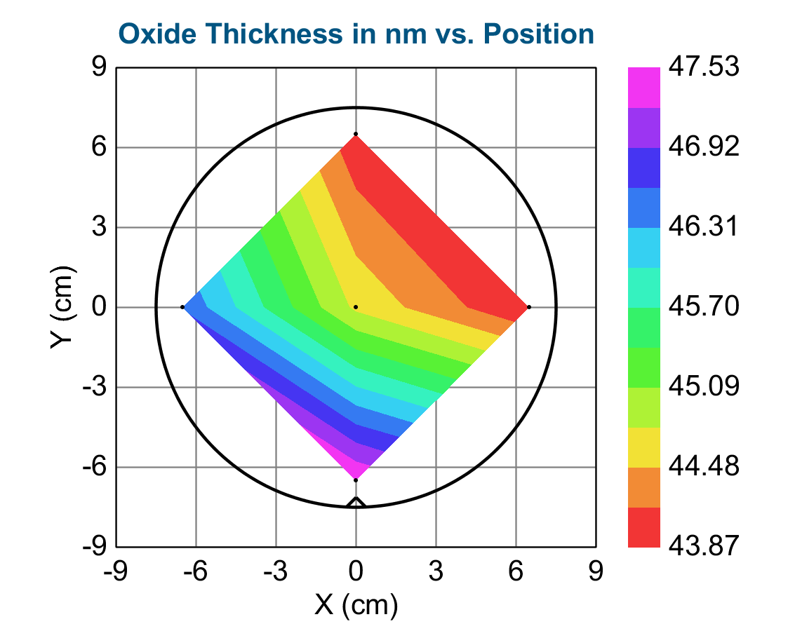
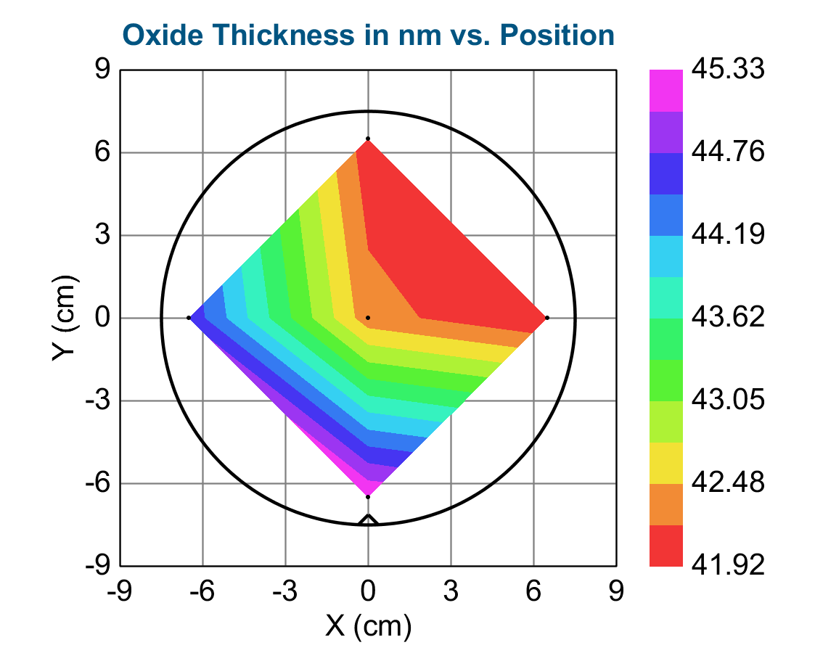
W1 first run 18-08-2025 5 pt ellipsometry recipe, post measured on 22-08
Result (based on same pre- and post models): 2.1 +/- 0.4 nm in 4 min etch; 0.5 +/- 0.1 nm per min using 2*std dev as uncertainty
Pre and Post data:

Slide 3
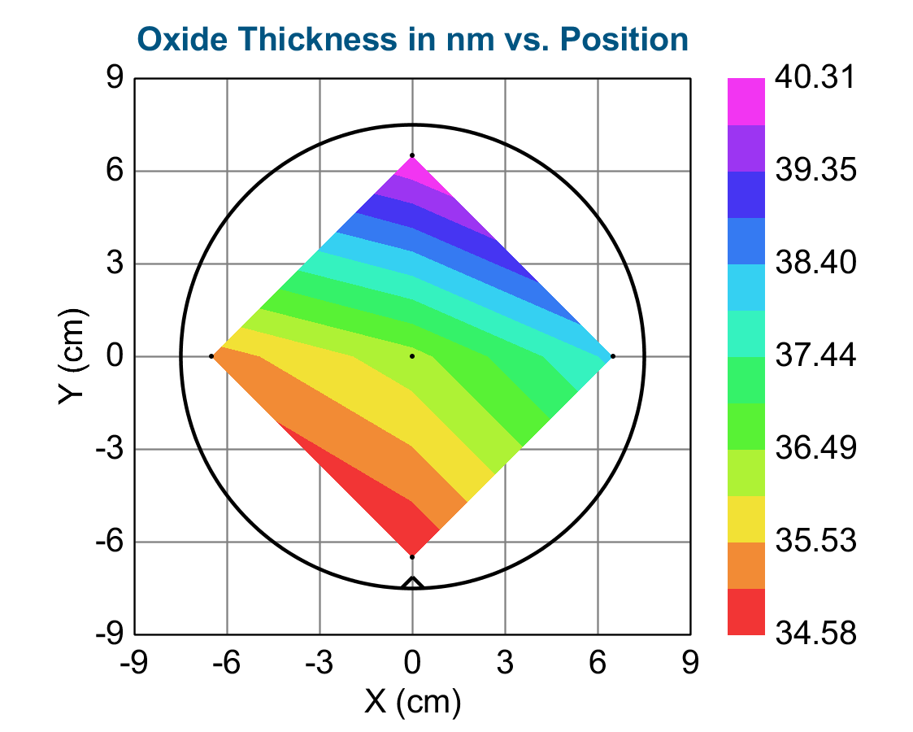

W2 first run 18-08 5 pt ellipsometry recipe, post measured on 22-08
Result: 3.7 +/- .4 nm in 4 min
0.9 +/- 0.1 nm per min using 2*std dev as uncertainty
Pre and Post maps:

Slide 4
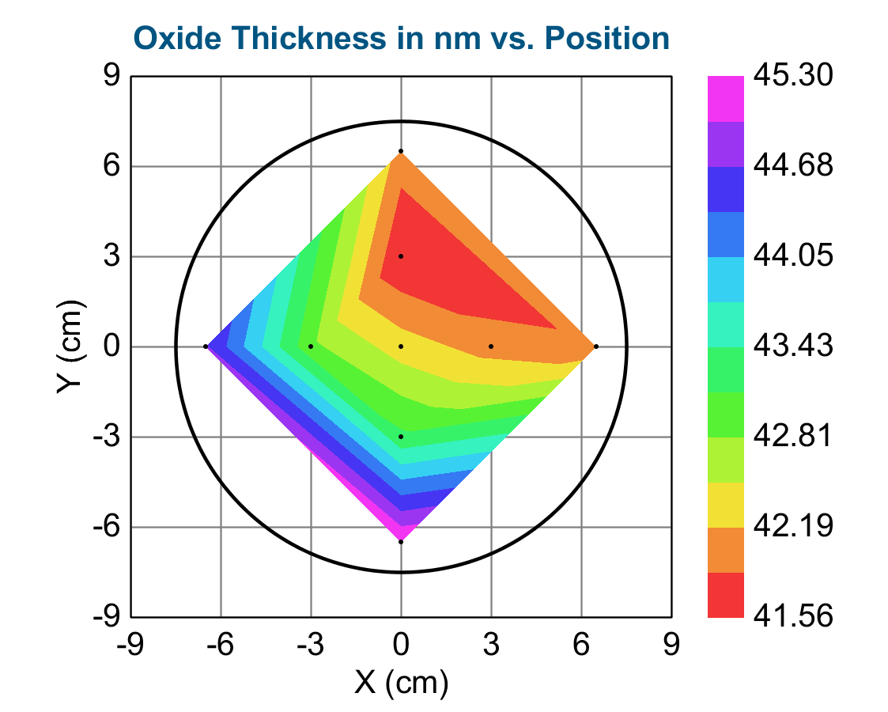
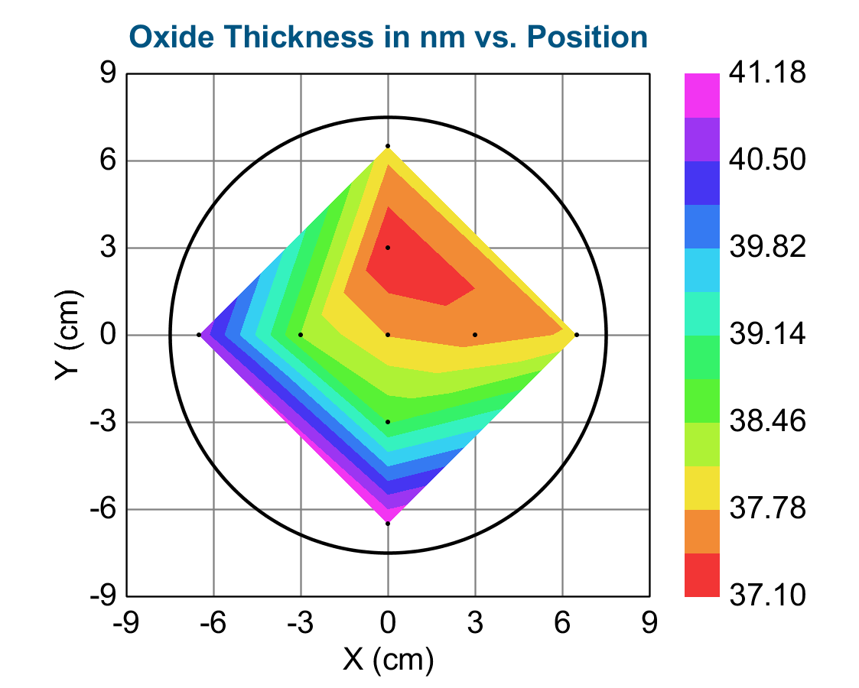
W1 second run 22-08 9 pt ellipsometry recipe, pre and post measured on 22-08
Result: 4.3 nm +/- 0.4 nm etch in 4 min; 1.1 +/- 0.1 nm per min using 2x standard dev as uncertainty
Pre and Post maps:

Slide 5
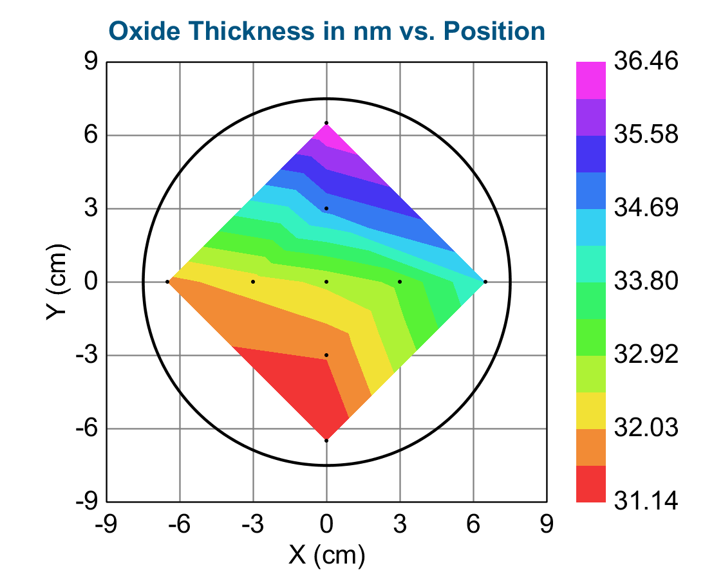
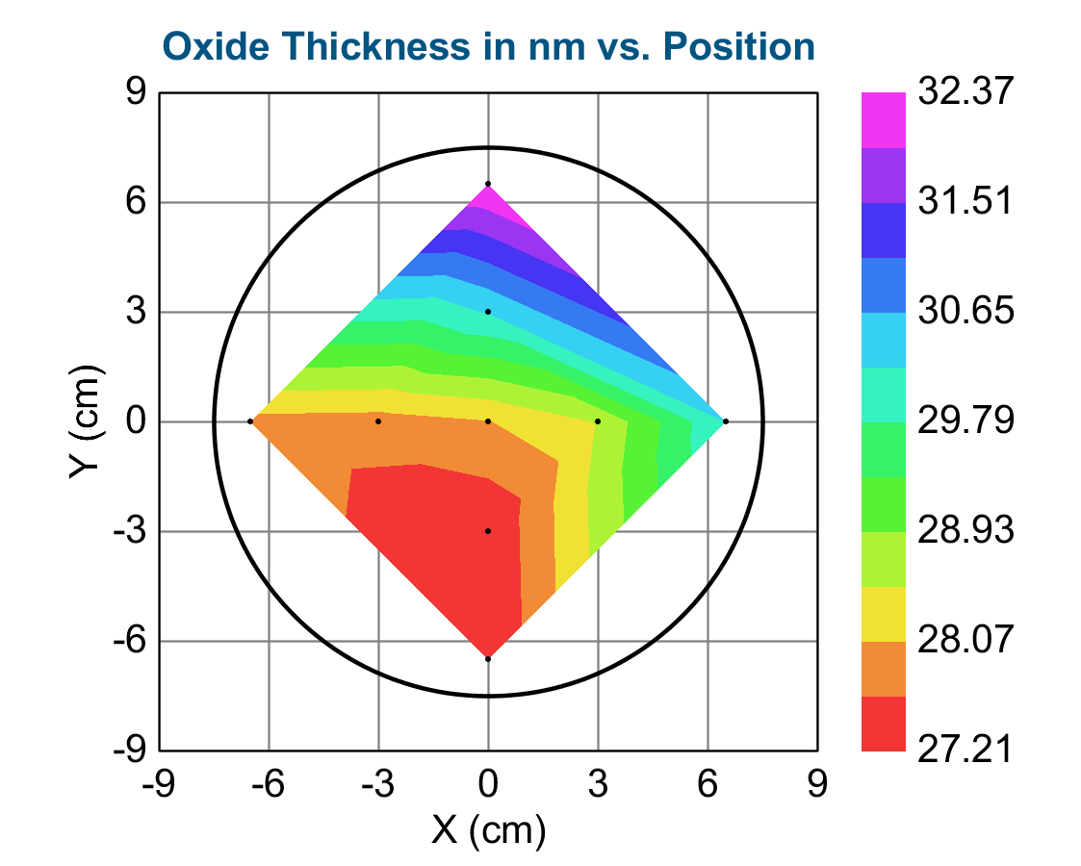
W2 second run 22-08 9 pt ellipsometry recipe, pre and post measured on 22-08
Result: 4.3 nm +/- 0.5 nm etch total; 1.1 +/- 0.1 nm per min using twice the standard deviation as the uncertainty
Pre and Post maps:

Slide 6
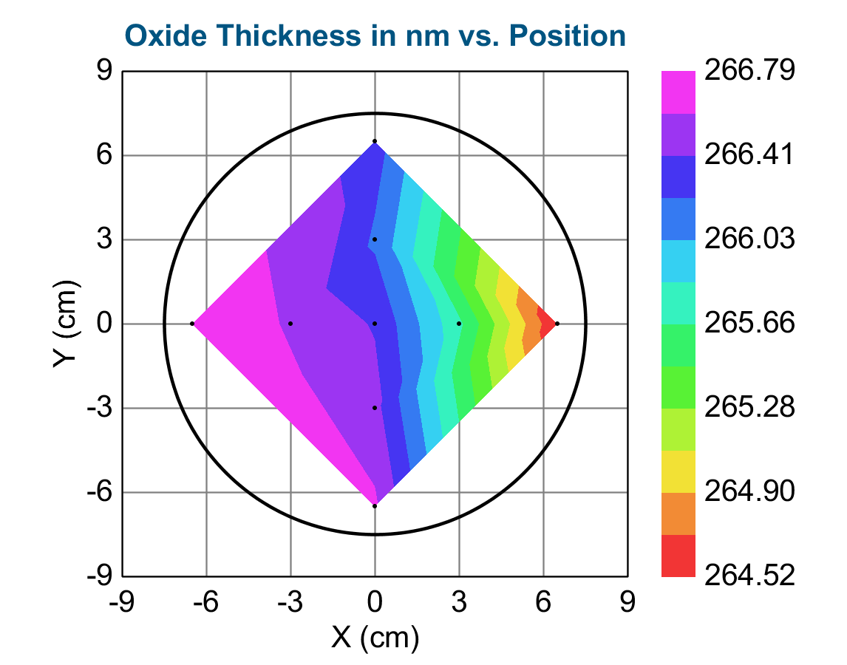
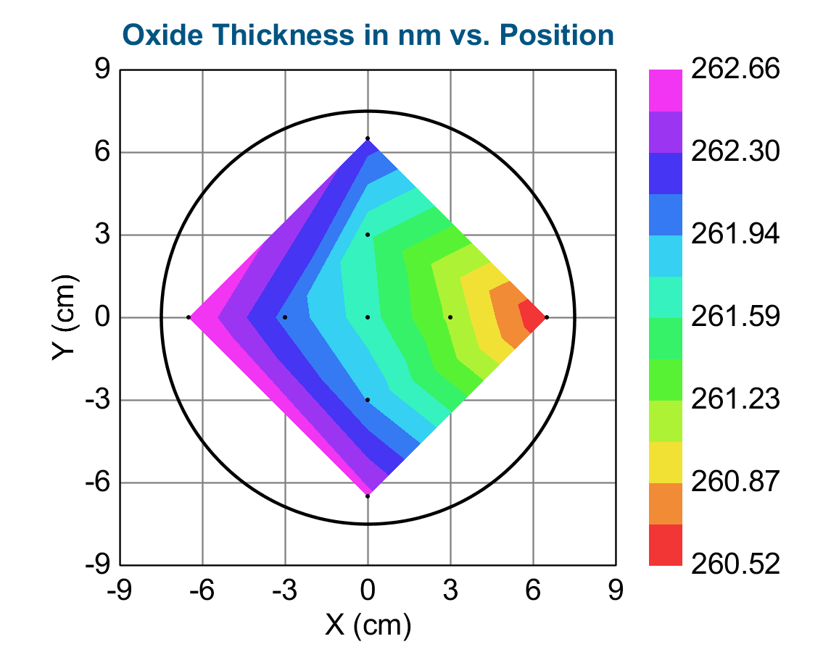
W3 (22-08) same run as W1 and W2 second run
Result: 4.4 +/- 0.5 nm total or 1.1 +/- 0.1 nm / min etch
Using 2x standard deviation of the 9 points as uncertainty
Pre and post maps:

Slide 7
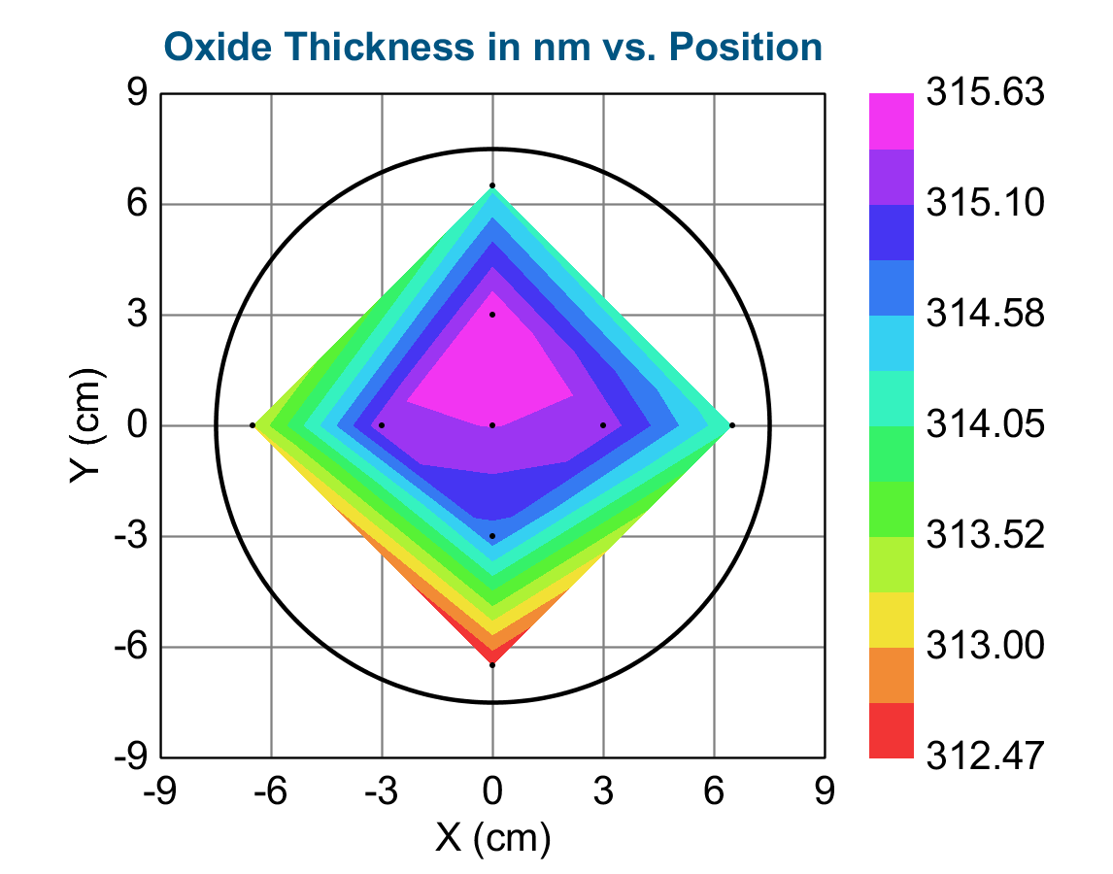
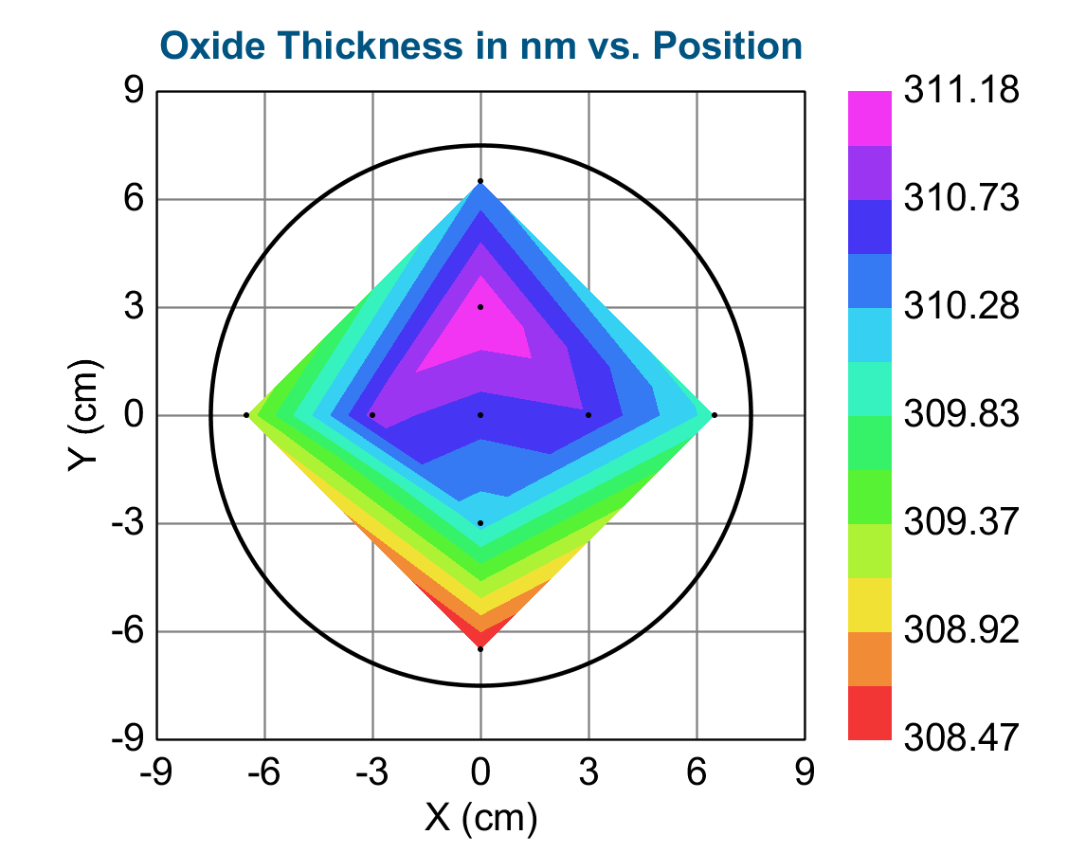
W5 (22-08, same run as W1 and W2 second run) This wafer had a wet oxidation oxide – others had dry oxides – all oxides from E1 – no appreciable difference in etch rate nor n
Result: 4.3 +/- 0.6 nm total or 1.1 +/- 0.2 nm / min etch
Using 2x standard deviation of the 9 points as uncertainty
Pre and post maps:

Slide 8
Summary
18-08 result with 5-pt recipe on 1 x 150 mm wafer: 0.5 and 0.9 +/- 0.1 nm per minute
Fit on n resulted in slightly different values (>1 % difference) of n for pre and post measurements - larger variation (<0.4 %) than for 22-08 measurements – so these measurements seem rather unreliable – edge versus center results also not consistent with 22-08 results. Maybe issue was that pre- and post measurements were made on different days?
22-08 result with 9-pt recipe on 4 x 150 mm wafers: 1.1 +/- 0.1 nm per minute
Etch rate stronger in center than edge by about 10-15 %
Overall the 1 nm/min for SiO2 rule of thumb still seems to hold for the ion_etch_Steven recipe

