Slide 1
Number of particles found on the films deposited on 4’’ wafers (13-08-2019)
13-08-2019 | Gain 1 (7.48µm -120 µm) | Gain 2 (2.99µm -48 µm) | Gain 3 (0.489µm -19 µm) | Gain 4 (0.509µm -8.2 µm)
Ti/Au Wordentec | 175 | 1498 | Overload (>30000) | Overload (>30000)
Pt Wordentec | 1 | 6 | 33 | 71
Ti/Au Temescal | 16558 | Overload (>30000) | Overload (>30000) | Overload (>30000)
Pt Temescal | 20 | 28 | 49 | 70
13-08-2019 | Deposition rate | Thickness setpoint | Thickness (Profilometry) | Sheet resistance*
Ti/Au Wordentec | 10/5 Å/s | 10/90 nm | 93-97 nm | 353.5 mΩ/□
Pt Wordentec | 5 Å/s | 100 nm | 90-94 nm | 1.83 Ω/□
Ti/Au Temescal | 10/5 Å/s | 10/90 nm | 98-103 nm | 358.8 mΩ/□
Pt Temescal ** | 5 Å/s | 100 nm | 99-104 nm | 1.60 Ω/□
* Sheet resistance measured on a films deposited on 2 µm thermal grown SiO₂ layer.
** The first run of Pt on Temescal result the thickness of 57-60 nm, the tooling factor has been adjusted from 127.3 to 76.2. The correct thickness has been obtained, resulting sheet resistance change from 3.03Ω/□ to 1.6Ω/□

Slide 3
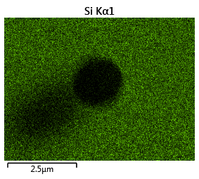
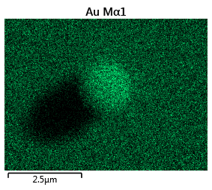
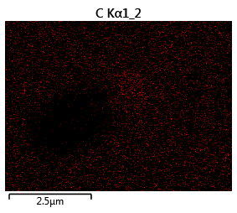
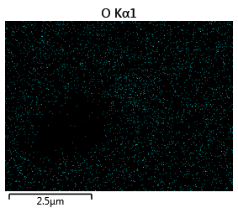
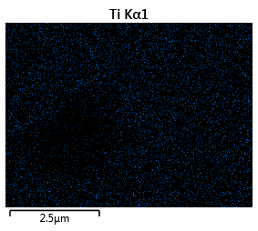
EDX data

Slide 4
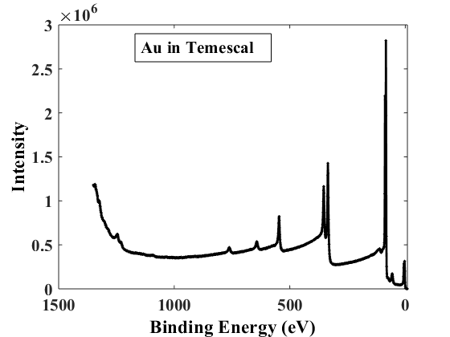
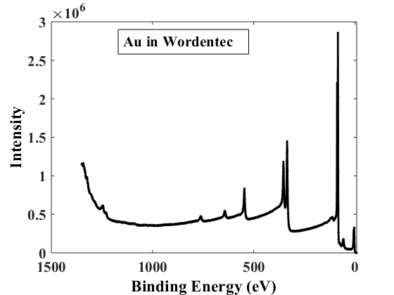
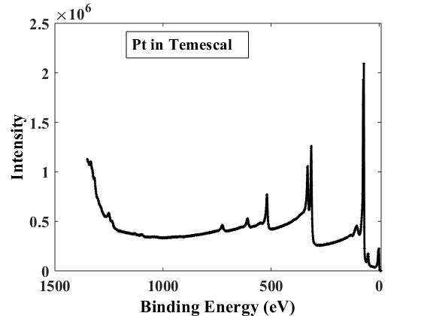
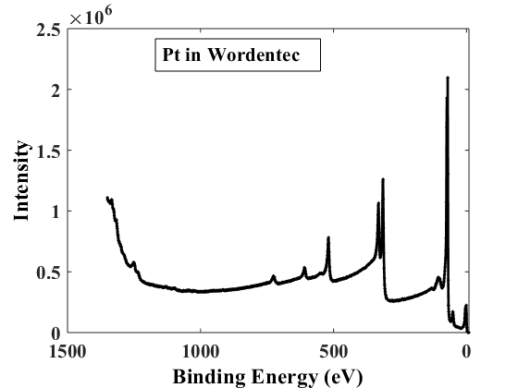
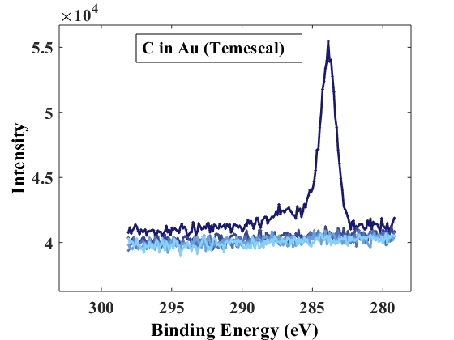
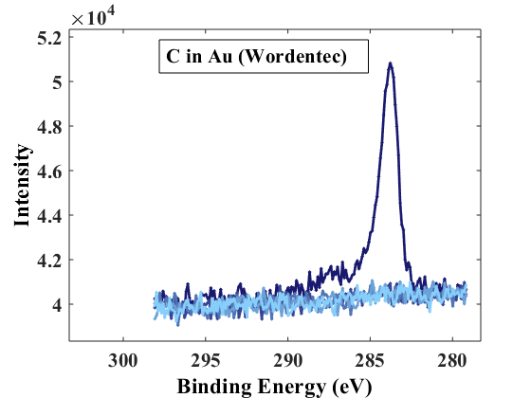
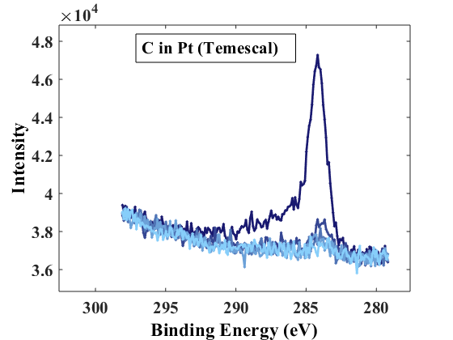
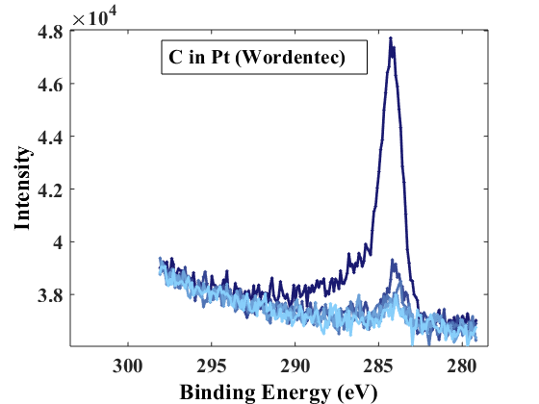
XPS Analysis
No contamination has been found in any samples. Pt may contain traces of carbon. If any other material compounds exists they lever are below 0.1 at. %
C 1s
C 1s
C 1s
C 1s
Surface
Surface
Surface
Surface
Bulk
Bulk
Bulk
Bulk

Slide 5
Number of particles found on the films deposited on 4’’ wafers in Wordentec
Old Cu hearth (13-08-2019)
13-08-2019 | Gain 1 (7.48µm -120 µm) | Gain 2 (2.99µm -48 µm) | Gain 3 (0.489µm -19 µm) | Gain 4 (0.509µm -8.2 µm)
Ti/Au Wordentec 10nm/90 nm 10 Å/s and 5 Å/s | 175 | 1498 | Overload (>30000) | Overload (>30000)
New Cu hearth (16-08-2019)
16-08-2019 | Gain 1 (7.48µm -120 µm) | Gain 2 (2.99µm -48 µm) | Gain 3 (0.489µm -19 µm) | Gain 4 (0.509µm -8.2 µm)
Ti/Au Wordentec 10nm/90 nm 10 Å/s and 5 Å/s | 95 | 710 | Overload (>30000) | Overload (>30000)
Ti/Au Wordentec 10nm/100 nm 2 Å/s and 2 Å/s | 48 | 597 | Overload (>30000) | Overload (>30000)

Slide 6
Temescal. Number of particles found on the old wafers (november 2018)
Nov. 2018 | Gain 1 (7.48µm -120 µm) | Gain 2 (2.99µm -48 µm) | Gain 3 (0.489µm -19 µm) | Gain 4 (0.509µm -8.2 µm)
Ti/Au Temescal 10nm+90 nm 2Å/s / 2Å/s | 36 | 67 | 367 | 1003
Ti/Au Temescal 10nm+90 nm 10Å/s / 10Å/s | 47 | 116 | 637 | 1571
Number of particles found on the films deposited on 4’’ wafers with and without liner (19-08-2019)
19-08-2019 | Deposition rate | Thickness setpoint | Thickness (Profilometry) | Sheet resistance*
Ti/Au Temescal No liner | 10/5 Å/s | 10/90 nm | 91-95 nm | 404.6 mΩ/□
Ti/Au Temescal With liner | 10/5 Å/s | 10/90 nm | 97-101 nm | 367.3 mΩ/□
* Sheet resistance measured on a films deposited on 2 µm thermal grown SiO₂ layer.
19-08-2019 | Gain 1 (7.48µm -120 µm) | Gain 2 (2.99µm -48 µm) | Gain 3 (0.489µm -19 µm) | Gain 4 (0.509µm -8.2 µm)
Ti/Au Temescal No liner | 113 | 378 | 3648 | 12137
Ti/Au Temescal With liner** | 14377 | Overload (>30000) | Overload (>30000) | Overload (>30000)
** Identical result acquired 13-08-2019

Slide 7
Number of particles found on the films deposited on 4’’ wafers (21-08-2019)
A new recipe used. It includes different sweep pattern, lower ”Rise 2 power” and prolonged rise/soak times.
21-08-2019 | Gain 1 (7.48µm -120 µm) | Gain 2 (2.99µm -48 µm) | Gain 3 (0.489µm -19 µm) | Gain 4 (0.509µm -8.2 µm)
Ti/Au Temescal (run 1) | 15 | 56 | 476 | 1699
Ti/Au Temescal (run 2) | 7 | 37 | 490 | 1735
Ti/Au Temescal (run 3) ** | 30 | 62 | 678 | 2450
21-08-2019 | Deposition rate | Thickness setpoint | Thickness (Profilometry) | Sheet resistance*
Ti/Au Temescal | 10/2 Å/s | 10/100 nm | - | 334 mΩ/□
Ti/Au Temescal | 10/2 Å/s | 10/100 nm | 105-108 | 323 mΩ/□
Ti/Au Temescal** | 10/2 Å/s | 10/100 nm | 110-112 | 309 mΩ/□
* Sheet resistance measured on a films deposited on 2 µm thermal grown SiO₂ layer.
** Tooling factor adjusted (from 81 to 78)

Slide 8
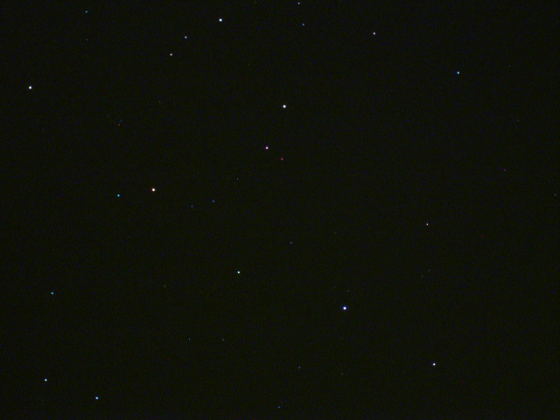
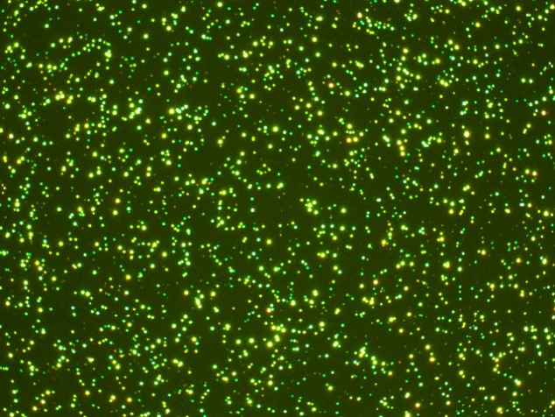
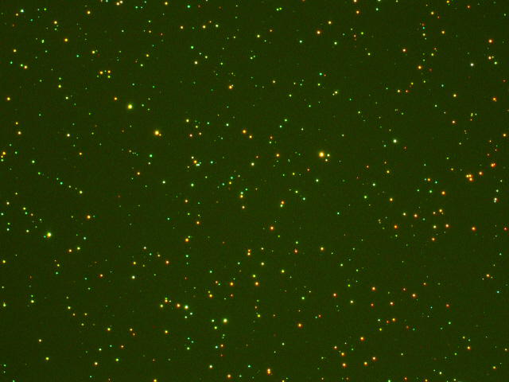
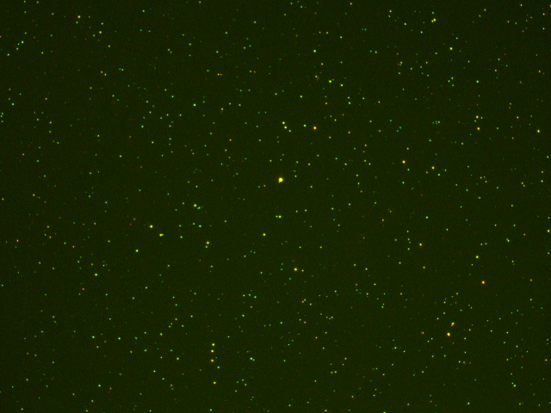
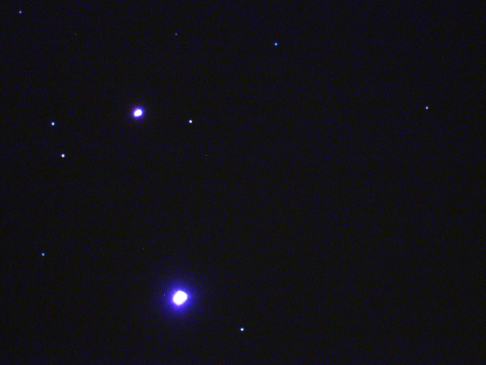
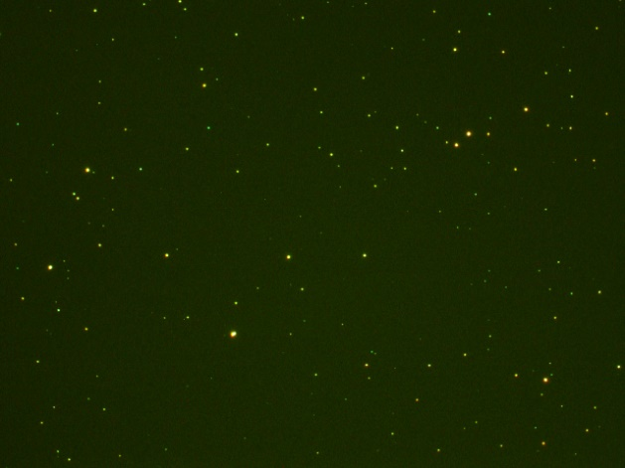
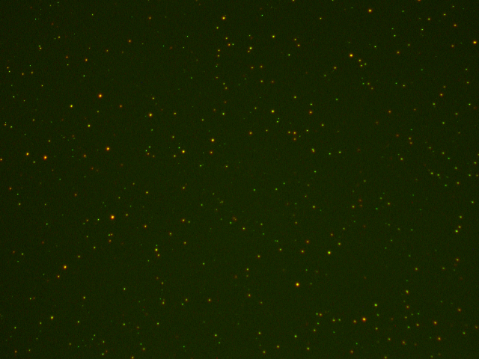
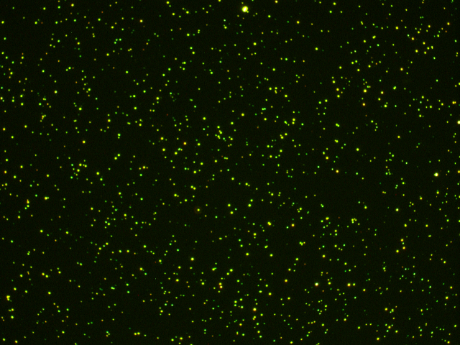
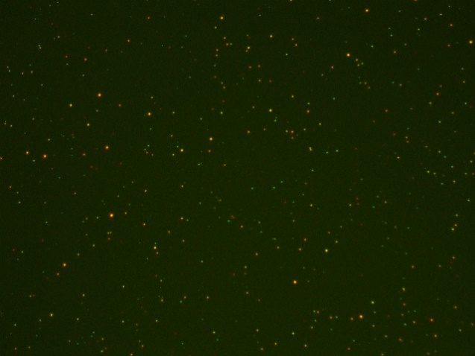
Temescal
Wordentec
03-2019 without liner
19th Aug 2019 with Liner
15th Aug old Au
16th Aug, 5 A/s
05-2019 without liner
19th Aug 2019 without Liner
15th Aug New Au
06-2019 with Liner
16th Aug, 2A/s lower power

