Slide 1
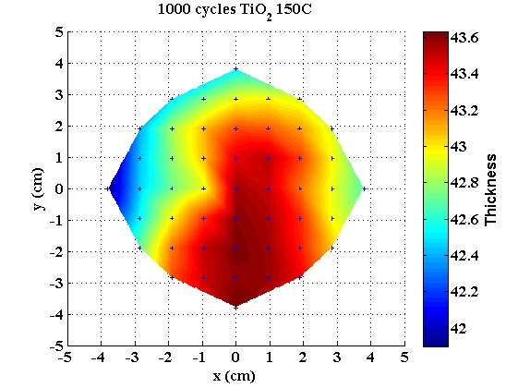
TiO₂ deposition in ALD1
Date: 2016
Substrate: 4” Si wafer with native oxide
Deposition parameters:
Recipe: ”TiO2”
Temperature: 150˚C
Number of cycles: 1000
Results:
Deposition rate: 0.041 nm/cycle
Non-uniformity: 2.01 %

Slide 2
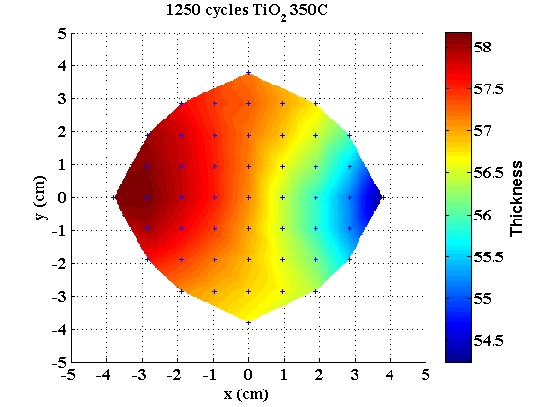
TiO₂ deposition in ALD1
Date: 2016
Substrate: 4” Si wafer with native oxide
Deposition parameters:
Recipe: ”TiO2”
Temperature: 350˚C
Number of cycles: 1250
Results:
Deposition rate: 0.046 nm/cycle
Non-uniformity: 3.45 %

Slide 3
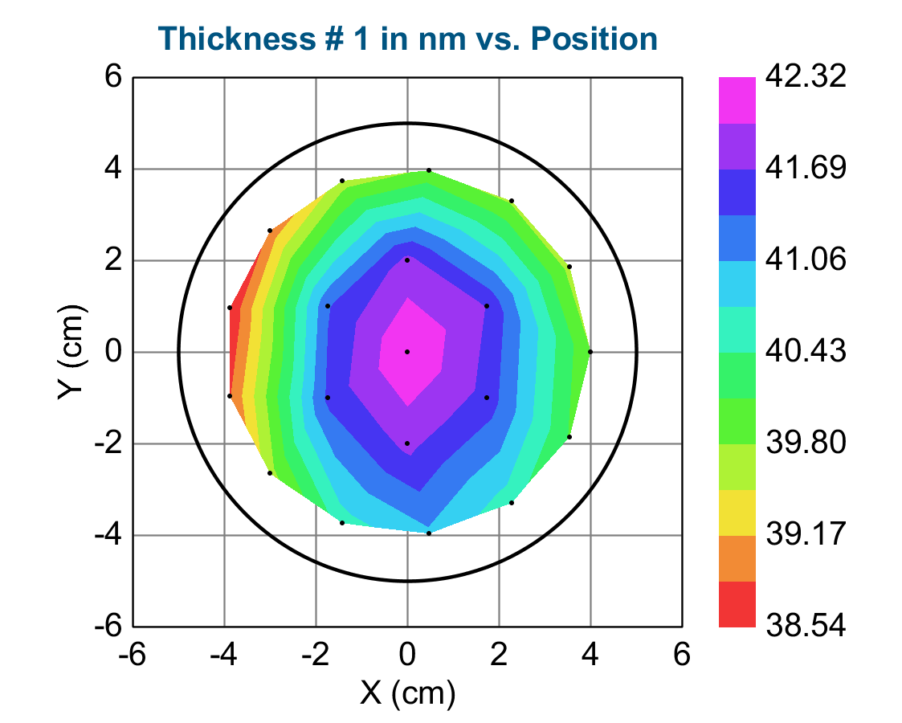
TiO₂ deposition in ALD2
Substrate: 4” Si wafer with native oxide
Date: 2018-10-23
Deposition parameters:
Recipe: ”TiO2 amorphous”
Temperature: 150˚C
Number of cycles: 1000
The thermal lid has been mounted
Results:
Deposition rate: 0.040 nm/cycle
Non-uniformity: 4.68 %

Slide 4
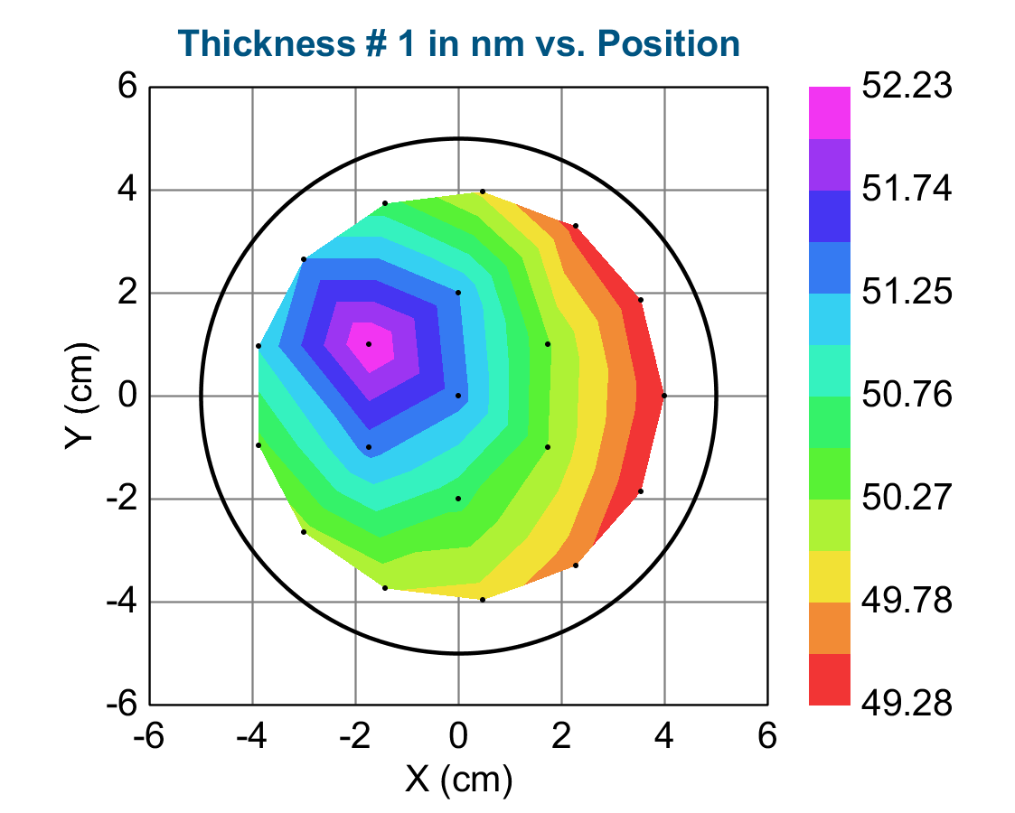
TiO₂ deposition in ALD2
Date: 2018-10-24
Substrate: 4” Si wafer with native oxide
Deposition parameters:
Recipe: ”TiO2 anatas”
Temperature: 350˚C
Number of cycles: 1250
The thermal lid has been mounted
Results:
Deposition rate: 0.040 nm/cycle
Non-uniformity: 2.93 %

