Slide 1
Cluster-based multi-chamber high vacuum
sputtering deposition system
Acceptance test. DTU Nanolab, 13-24 January 2020
Nick Franzer
Nate Lottes
Marc Croft
Henrik Nielsen
Patama Pholprasit
Evgeniy Shkondin

Slide 2
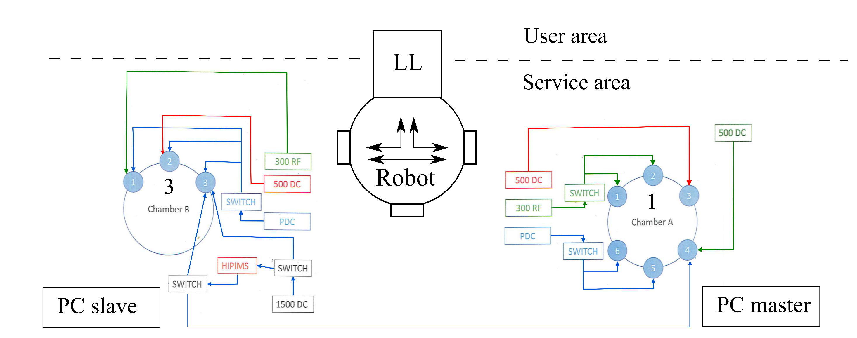

Slide 3
13 January Monday
Al DC manual deposition PC1
Al DC recipe run PC1
Al DC cassette recipe 6 wafers PC1 (overnight)
14 January Tuesday
Al recipe run PC3
AlN reactive p-DC PC3 with RF bias on substrate
Al DC cassette recipe 6 wafers PC3 (overnight)
RF clean PC1
RF clean PC3
ITO RF failed unstable bias
Heat courve PC1 failed (overnight)
XPS

Slide 4
15 January Wednesday
AlN reactive p-DC PC3 with RF bias on substrate (uniform)
AlN rective p-DC PC3 without RF bias on substrate (nonuniform)
ITO p-DC manual PC1
ITO p-DC cassette recipe 6 wafers PC1 (overnight)
SiO2 RF cassette recipe 2 wafers PC1 (overnight) src1-not uniform, src2-uniform
Heat courve PC3 failed (overnight)
XPS
XPS
XPS (3’rd wafer)
XPS, SE
16 January Thursday
Ni DC PC1
ITO p-DC after substrate holder adjustement (unsufficient uniformity of ITO cassette run from 15.01.2020)
SiO2 RF cassette recipe. Src1 failed. Unstable bias. Src2 failed. Miscommunication with HIPIMS from PC3 (no deposition)
Cu HiPIMS PC3 src3 recipe run
Ni DC cassette recipe PC1 (noticed no rotation –accidental cancel), (overnight)
Cu DC cassette recipe PC1 (overnight)
Heat courve PC3 failed (overnight, software issue)

Slide 5
17 January Friday
Heat courve test up to 100C
RF test. Change of dark space shield in PC1 and test on 4’’ Al in PC3.
AlN p-DC reactive in PC3. 900W triple the power, reduced 3 times dep. time. 15 N2 MFC2
SiO2 RF PC1 src1. Cassette recipe
SiO2 RF PC1 src2. Cassette recipe
Ni DC PC1. Cassette recipe
XPS
SE
SE
18-19 January Weekend
24 hours pump test
Heat courve in PC1&PC3
ITO batch PC1
20 January Monday
Cu DC in PC3
Manual HiPIMS Cu in PC1
SiO2 RF src2
AlN batch without bias in PC3 p-DC Reactive. Cassette recipe (overnight). Came out with bad uniformity.
SE
XPS

Slide 6
21 January Tuesday
HiPIMS Cu on Si trench PC1 (recipe)
HiPIMS Cu on Si trench PC3 (recipe)
AlN quick test to improve deposition
AlN batch (overnight)
XPS
22-24 January Wednesday-Friday
AlN testing. Adjusting the position for AlN target to get uniformity from 6-8% down to 3%
Co deposition tests in PC3 and PC1
HiPIMS tests in PC1 and PC3 in manual and automatic mode and with co-deposition
Residual gas analysis in PC3

Slide 7
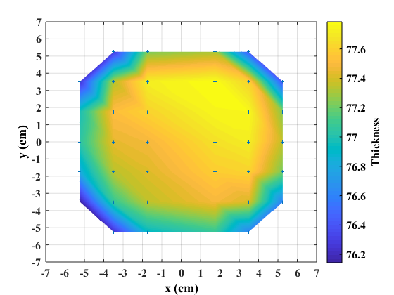
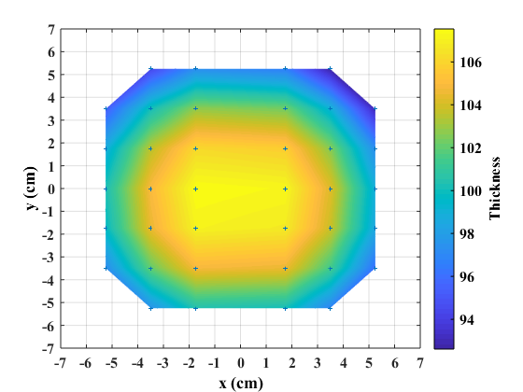
SiO2 RF deposition 15 01 2020
procent deviation of the thickness: 1.0636 %
mean value of thickness: 77.1778 nm
standart deviation: 0.49334
procent deviation of the thickness: 7.4015 %
mean value of thickness: 100.8372 nm
standart deviation: 4.1588
Src 1 PC1
We observed unstable RF bias!
Src 2 PC1

Slide 8
SiO2 RF deposition 17 01 2020
scr1
scr2
RF bias issues fixed
procent deviation of the thickness: 1.0636 %
mean value of thickness: 77.1778 nm
standart deviation: 0.49334
procent deviation of the thickness: 7.4015 %
mean value of thickness: 100.8372 nm
standart deviation: 4.1588

Slide 9
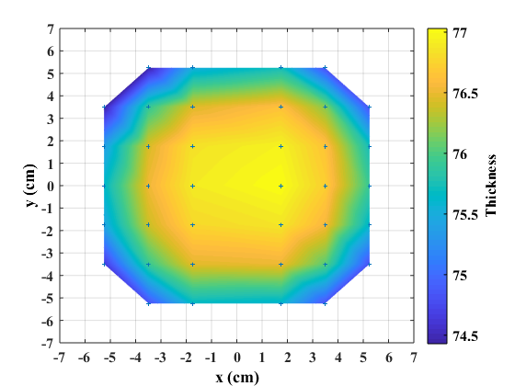
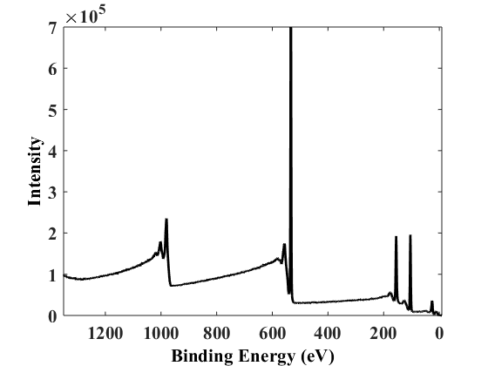
SiO2 RF deposition 20 01 2020
PC1 src2 position adjusted
O1s
Si 2p
procent deviation of the thickness: 1.7125 %
mean value of thickness: 75.909 nm
standart deviation: 0.78878

Slide 10
XPS results 15.01.2020
sample | AL | N | O | In | Sn | Si
AlN reactive p-DC PC3 with RF bias on substrate 14.01.2020 center/edge | 48.38/49.83 | 37.22/42.04 | 14.40/8.13
AlN reactive p-DC PC3 with RF bias on substrate 15.01.2020 | 47.91 | 35.50 | 16.59
AlN rective p-DC PC3 without RF bias on substrate 15.01.2020 center/edge | 46.96/46.87 | 30.51/32.38 | 22.53/20.75
ITO p-DC cassette recipe (3rd wafer) 15.01.2020 PC1 |  |  | 58.41 | 38.59 | 2.99
SiO2 RF cassette recipe PC1 15.01.2020 src1/src2 |  |  | 63.87/64.51 |  | ! (surface signal in src2) | 35.44/35.49

Slide 11
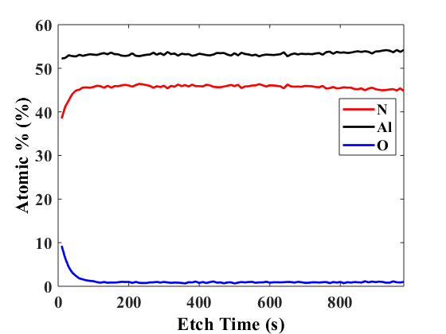
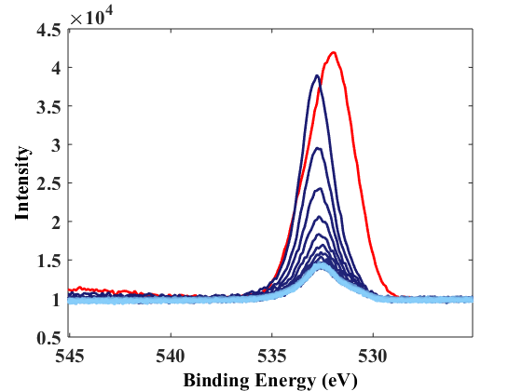
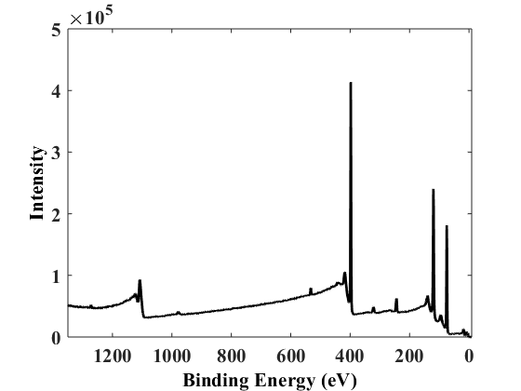
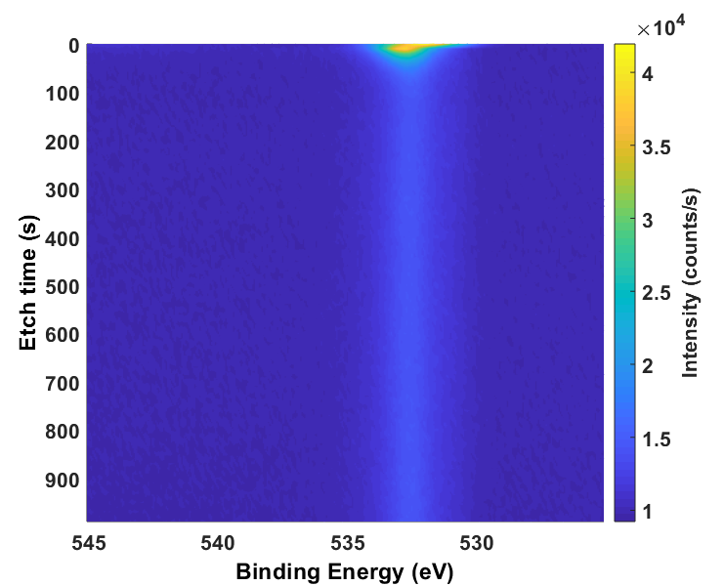
22% at the surface
XPS analysis of AlN
Deposited 17 01 2020
O1s
Below 1.5% in the bulk
O1s
N1s
Al2p
O1s

Slide 12
Cu HiPIMS on Si trench
Depth of trench: 1 µm
Period: 400 nm

Slide 13
CuAl/SiO2/CuAl coating on shallow holes etched in Si.
Cu HiPIMS co-deposited with Al DC

Slide 14
Source/recipe name | Material | Pressure(mTorr) | Power (W) | Voltage(V) | Deposition time (Sec) | Thickness (nm) at the center | Unifomity (%) | Comments
1/MD PC1 Src1 RF Upstream | SiO2 | 3 | 140(RF) | 590 | 900 | 35,62 | 0,5
2/MD PC1 Src2 RF Upstream | SiO2 | 3 | 140(RF) | 588 | 900 | 40,77 | 3
3/MD PC1 Src3 DC Upstream | Ni | 3 | 500(DC) | 420 | 900 | 350 | 2,5
4/MD PC1 Src4 DC Upstream | Cu | 3 | 500(DC) | 463 | 900 | 783 | 2,2
5/MD PC1 Src5 DC | Al | 3 | 200(DC) | 373 | 300 | 40 | -
5/MD PC1 Src5 Pulse DC Downstream with Reactive O2 gas | Al | 3 | 500(PDC) Frequency: 100Hz Revers time: 2µs | 283 | 900 | 25 | - | n=1,66
6/MD PC1 Src6 Pulse DC Upstream | ITO | 3 | 140(PDC) Frequency: 100Hz Revers time: 2µs | 354 | 900 | 175 | 4,5

