Slide 1
Dektak XT and P17 ”flat” scans
Measurements of surfaces that should be ”flat”

Slide 2
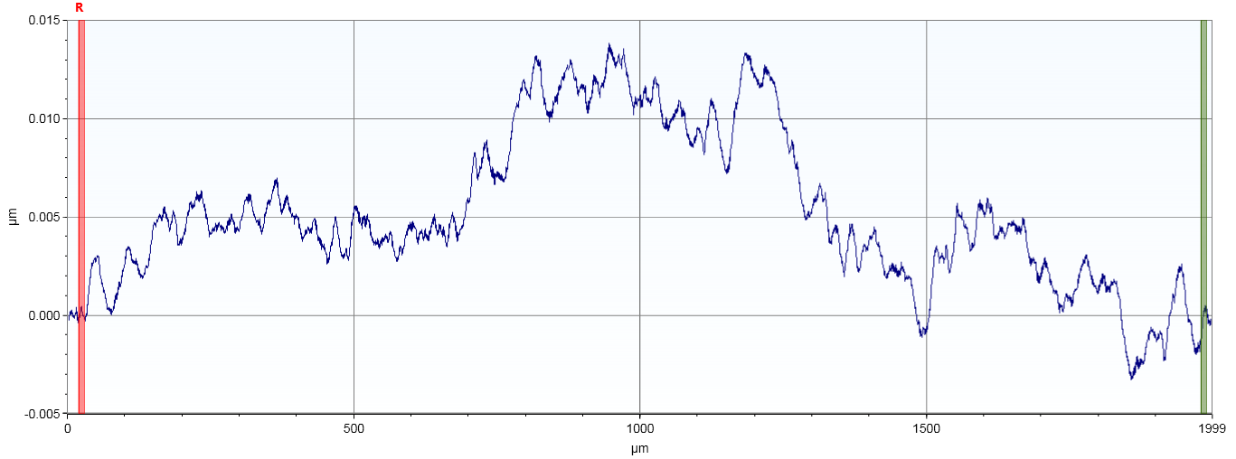
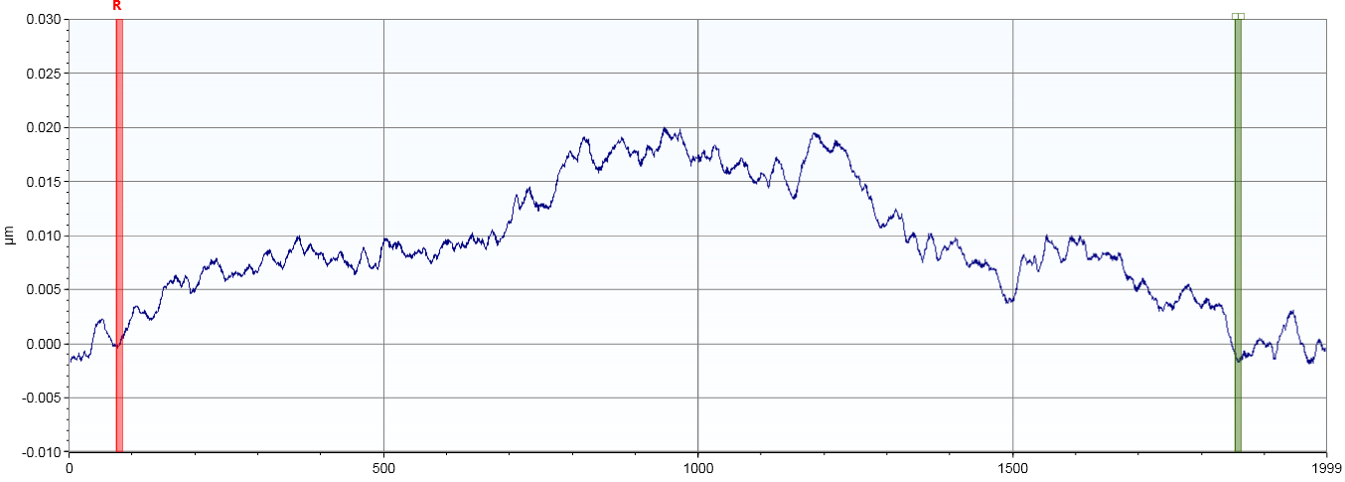
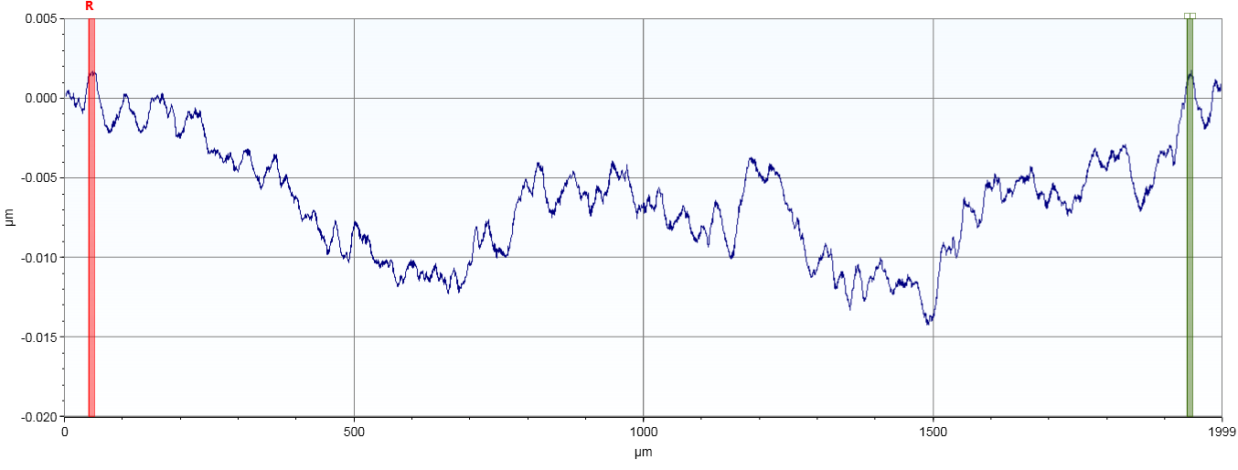
DektakXT
6” blank Si
center spot 1
Same scan, variation in leveling cursors
Range 15-20 nm

Slide 3
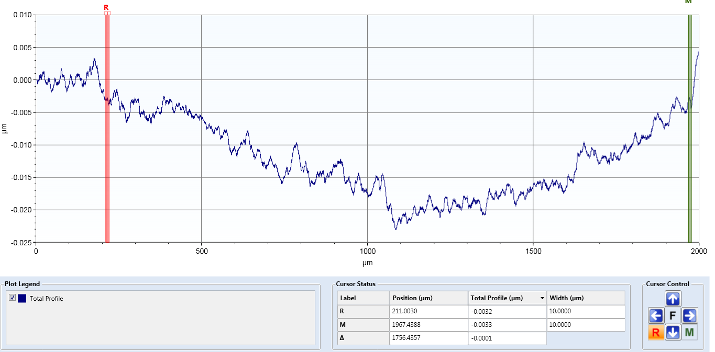
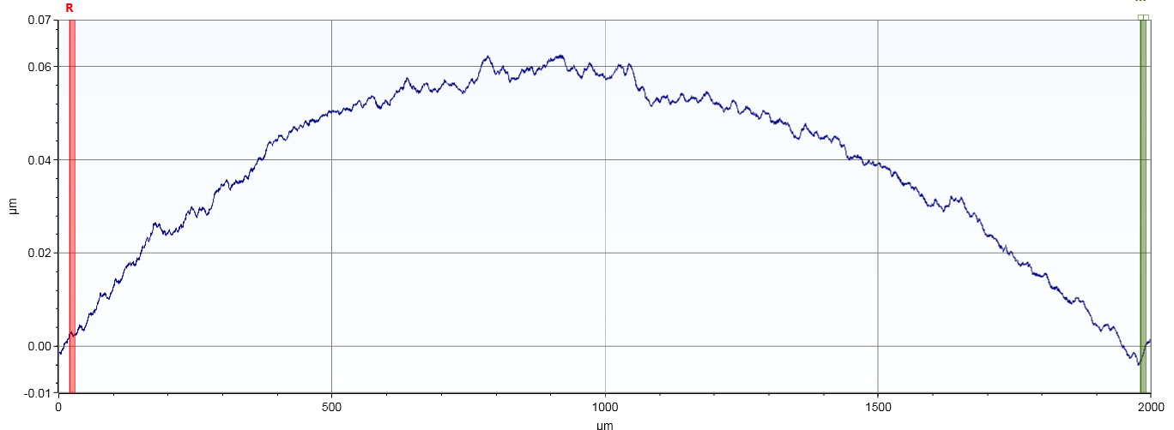
DektakXT
6” blank Si
center spot 1
Same scan, variation in leveling cursors
Range in one case 20 nm
In the other 6 nm

Slide 4
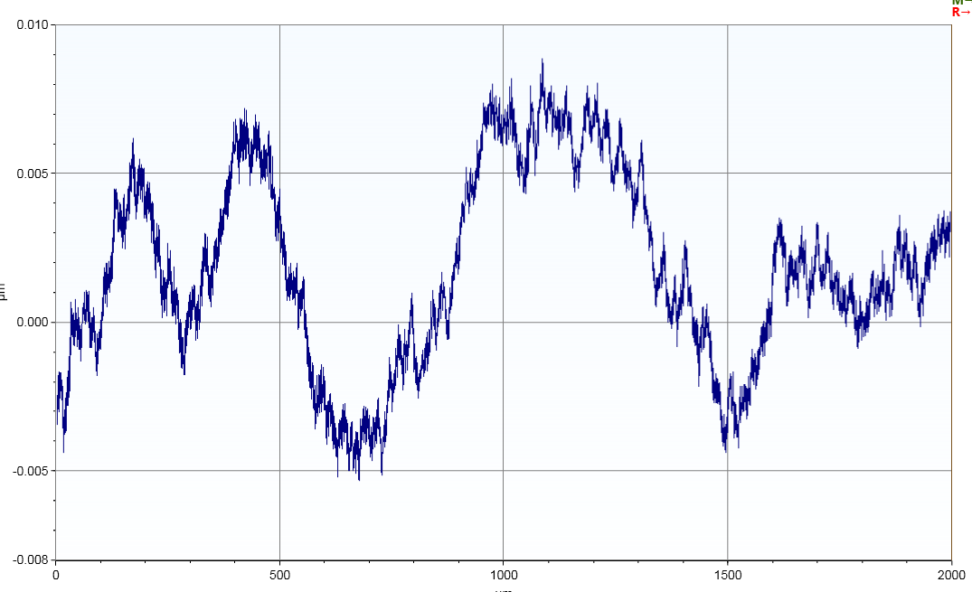
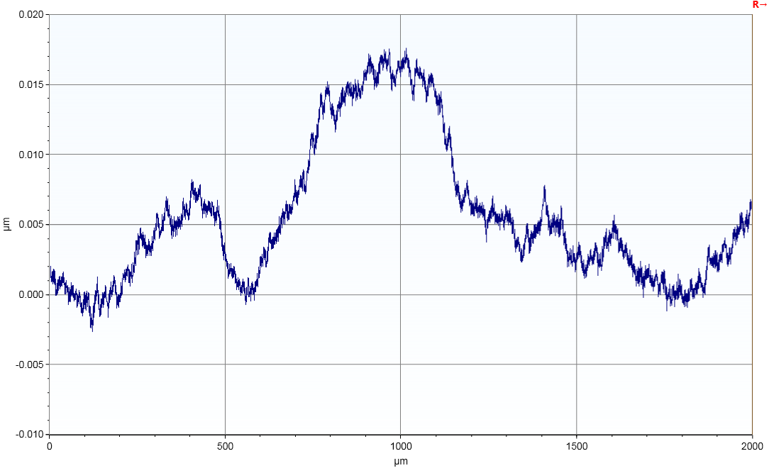
DektakXT
6” blank Si near edge spot 1
2 separate scans
Jun 23, 2025 app. 15 nm range variation scan-scan

Slide 5
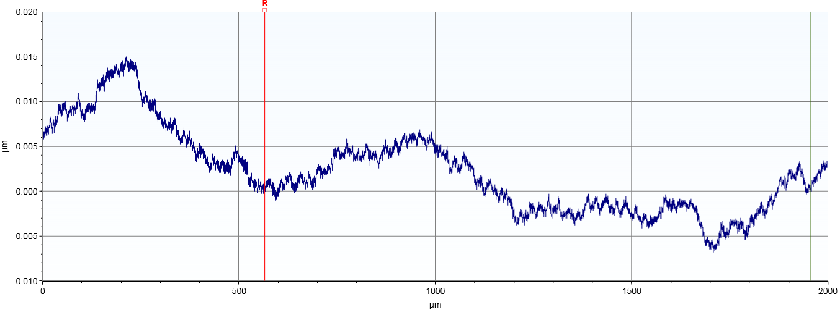
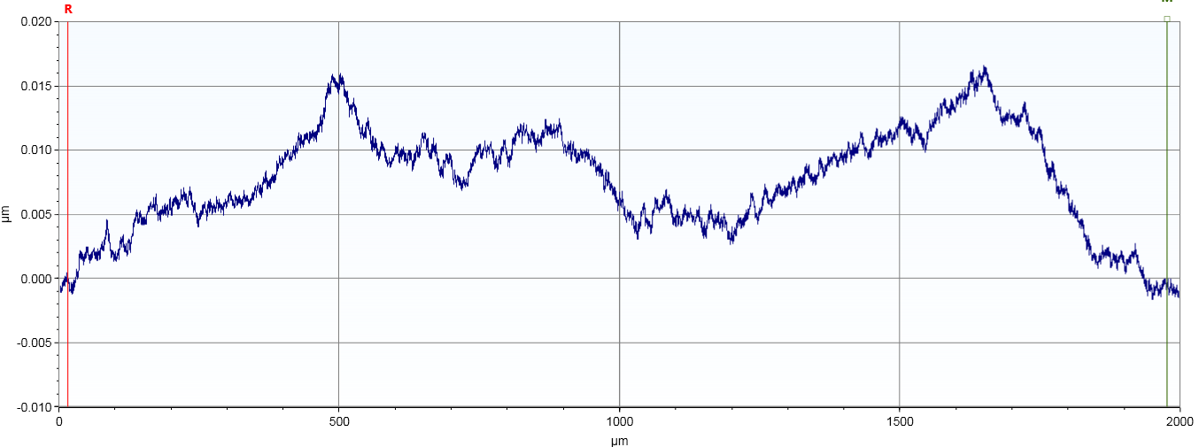
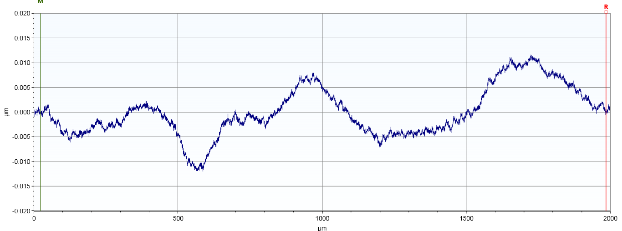
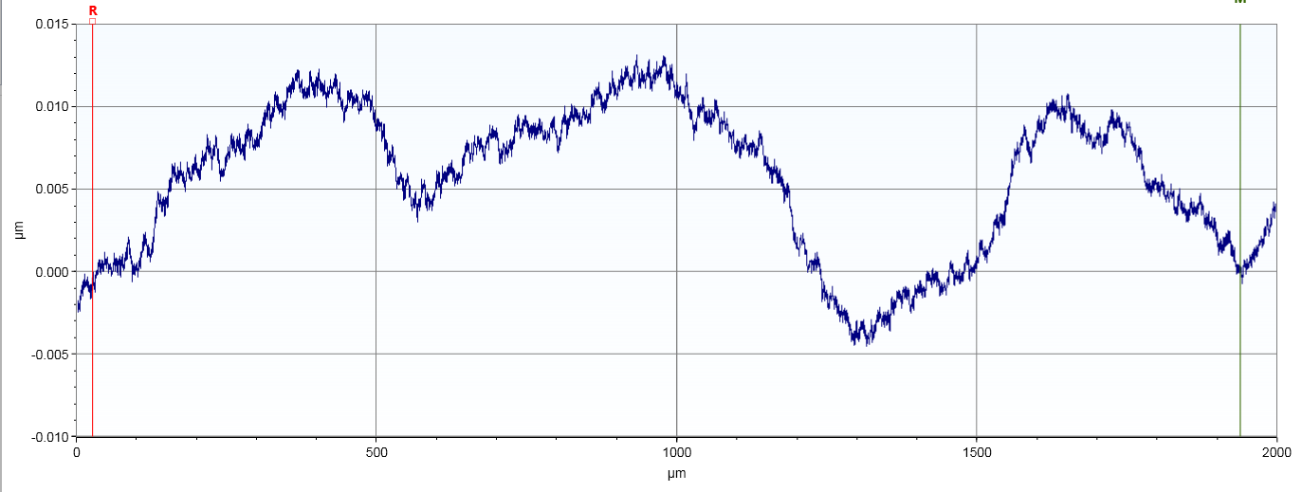
DektakXT
6” blank Si
near edge
spot 2
Range app 20 nm
Variation scan-scan

Slide 6
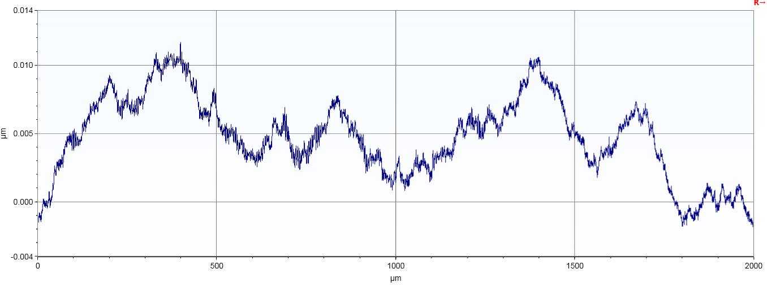
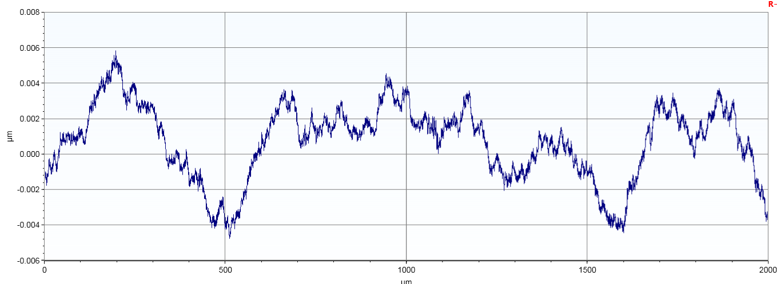
DektakXT
6” blank Si
near edge
spot 3
Range app 10 nm
Variation scan-scan

Slide 7
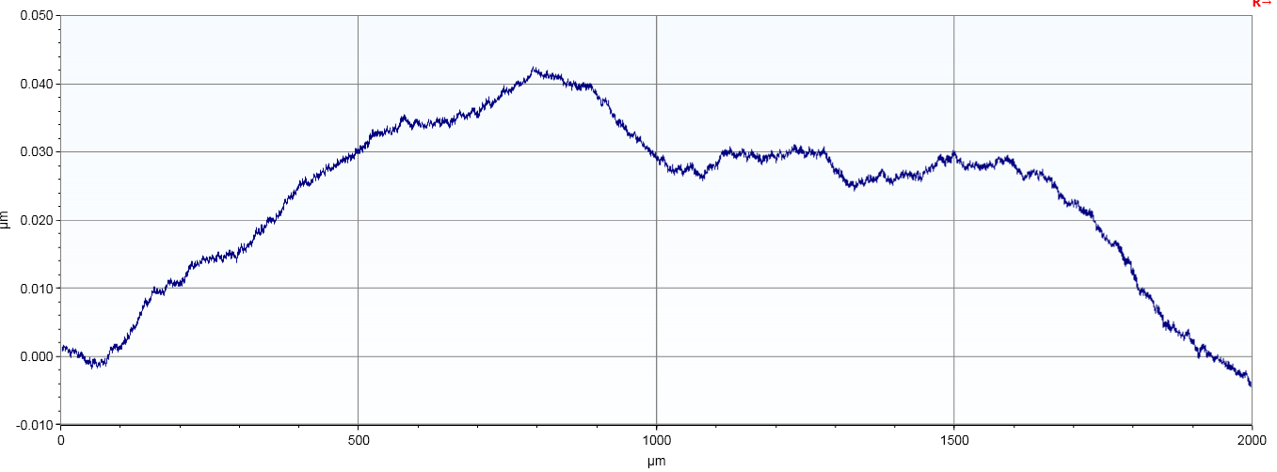
DektakXT
6” blank Si
near edge
spot 4
Range app 40 nm

Slide 8
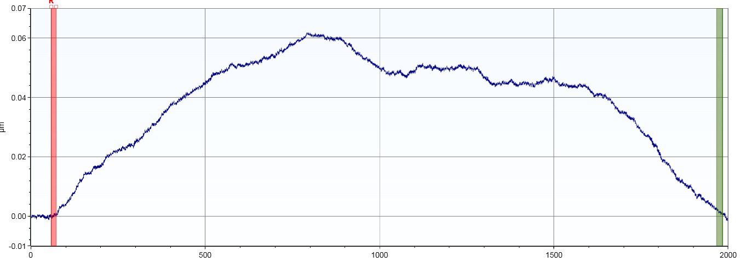
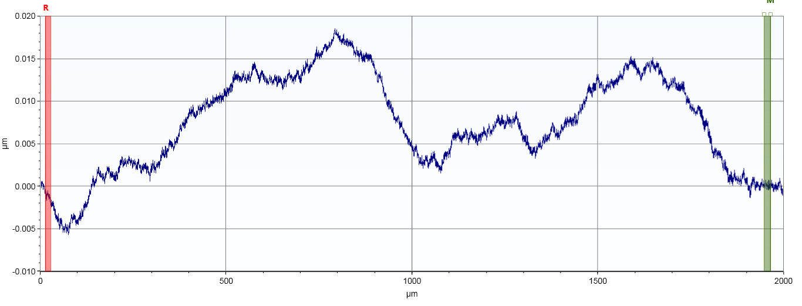
DektakXT
6” blank Si
near edge
spot 4
Same scan as previous slide
Alternate leveling
Range 25-60 nm

Slide 9
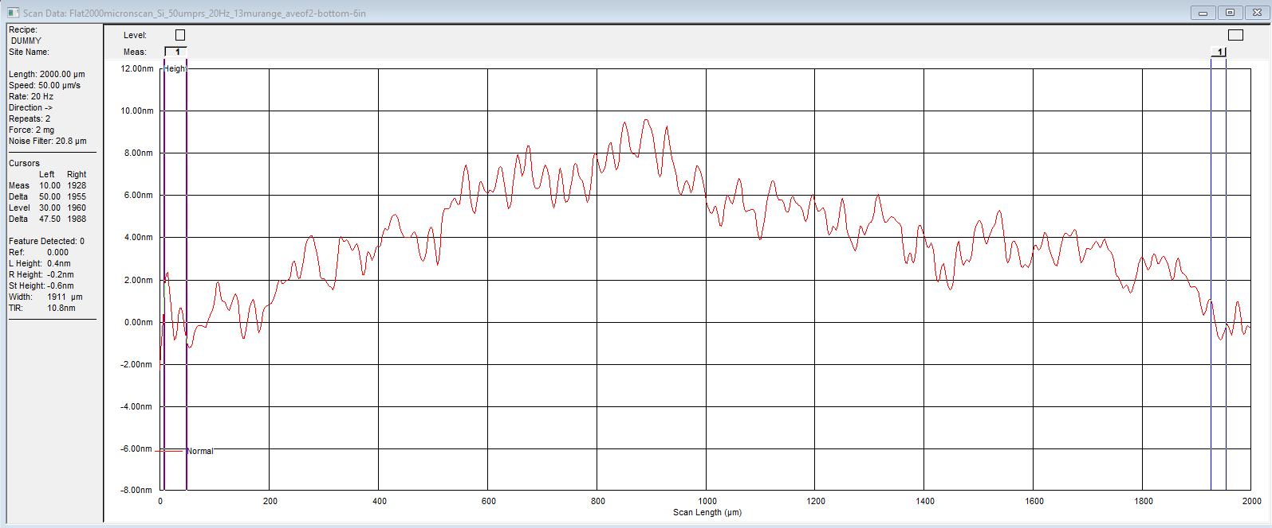
P17
6” blank Si wafer
near edge
Spot 1
Jun 20, 2025
Range app 10 nm

Slide 10
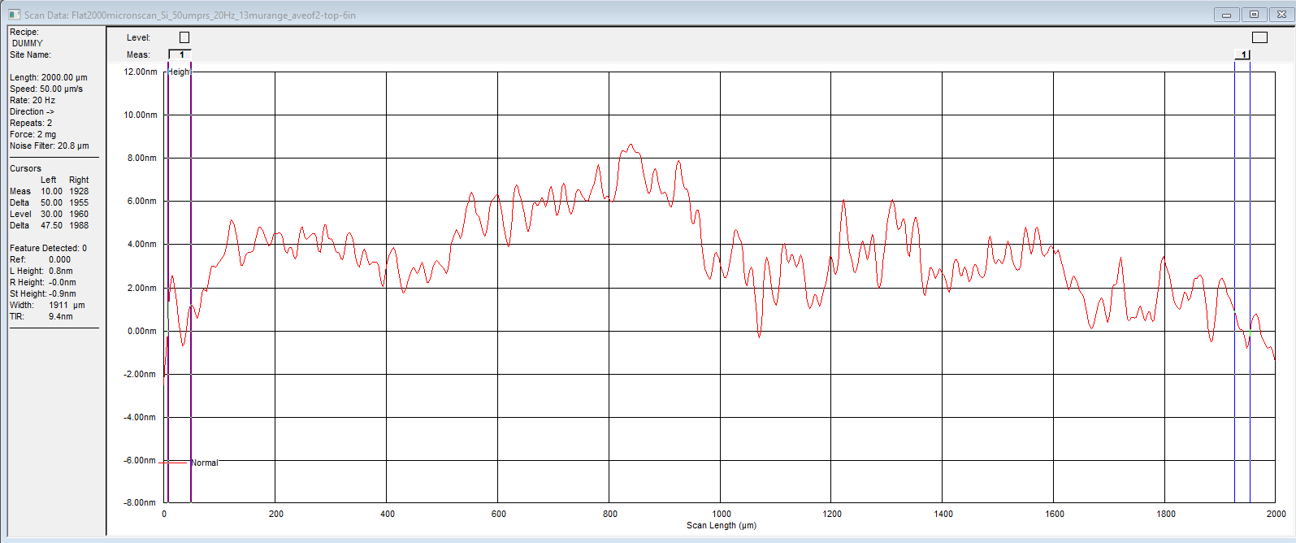
P17
6” blank Si near edge
Ave of 2
Spot 2
Range app 10 nm

Slide 11
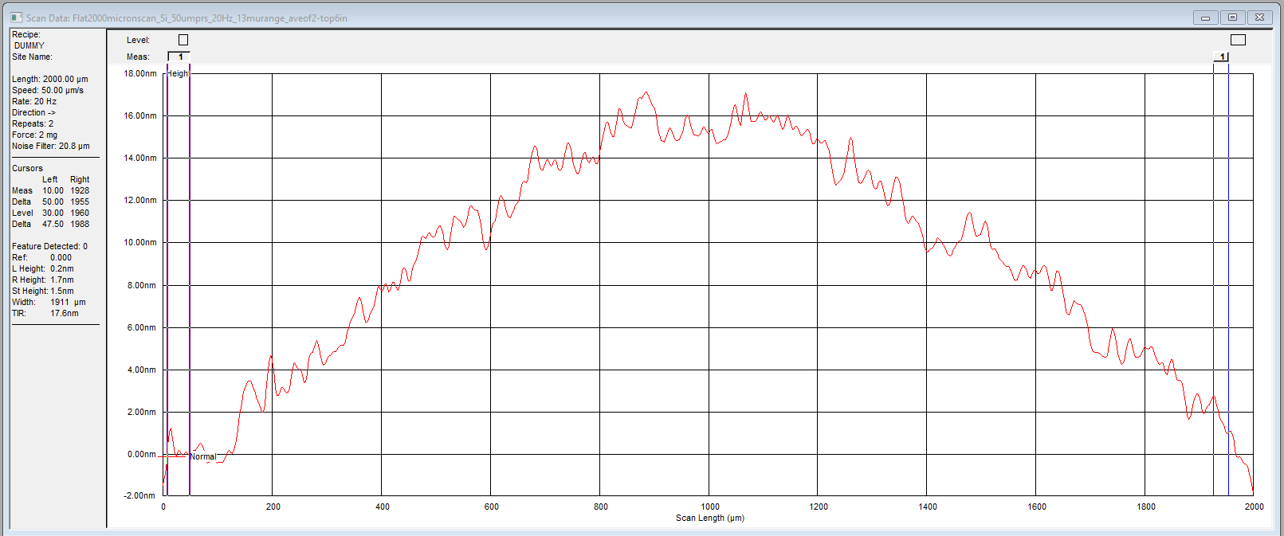
P17
6” blank Si
near edge
Ave of 2
Spot 3
Range app 17 nm

Slide 12
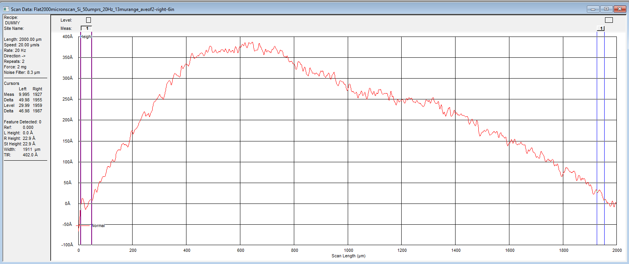
P17
6” blank Si wafer Near edge spot 4
Ave of 2 scans
Jun 20, 2025
Range app 40 nm

Slide 13
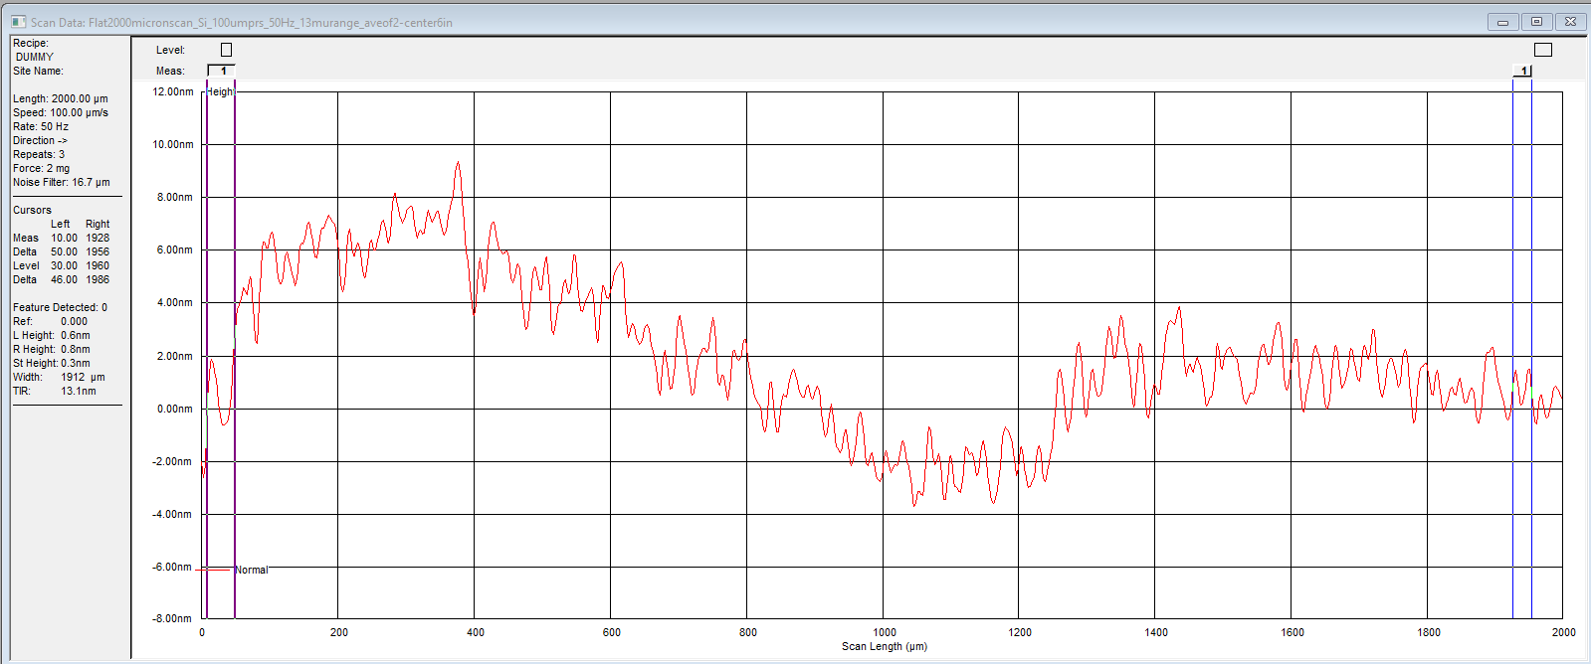
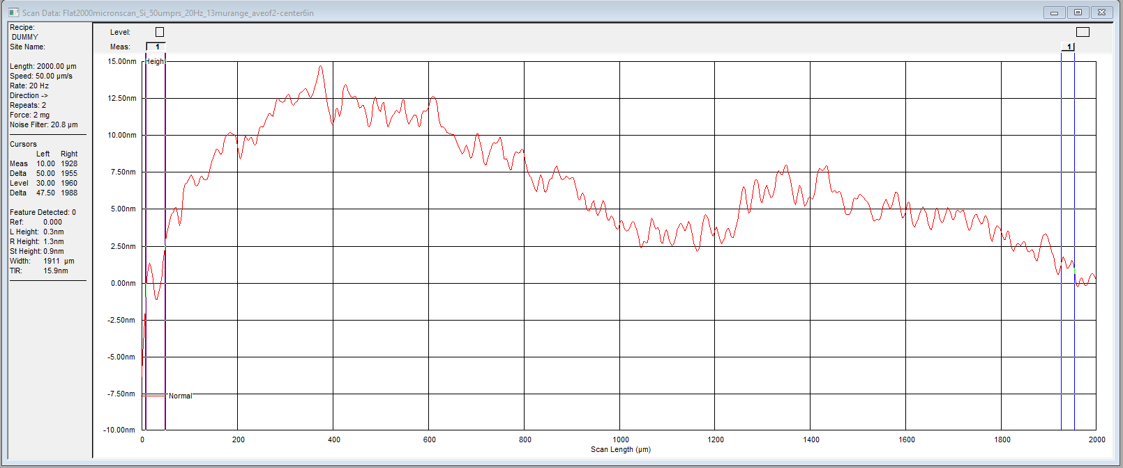
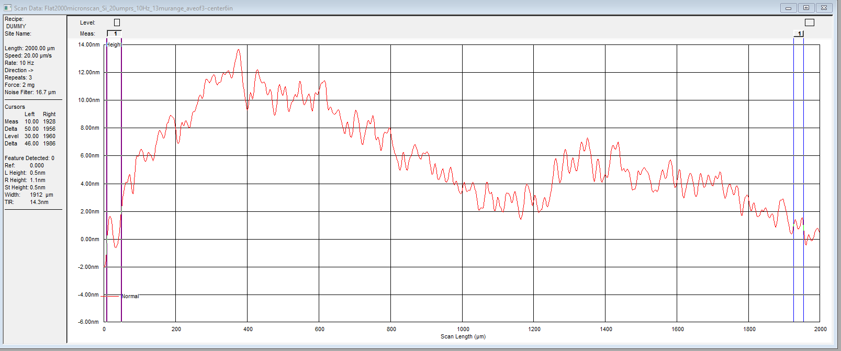
P17
6” blank Si wafer
Center
Ave of 2-3 scans in each graph
Scans at diff speed and resolution, same location
Range app 15 nm

Slide 14
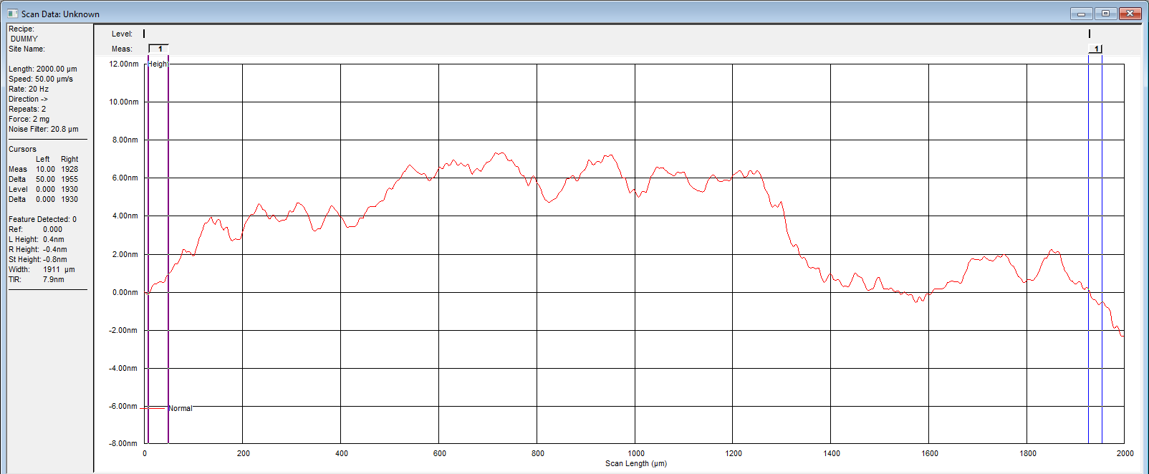
P17
6” blank Si wafer with Ni
near edge
Ave of 2 scans
Jun 20, 2025
Range app 10 nm

Slide 15
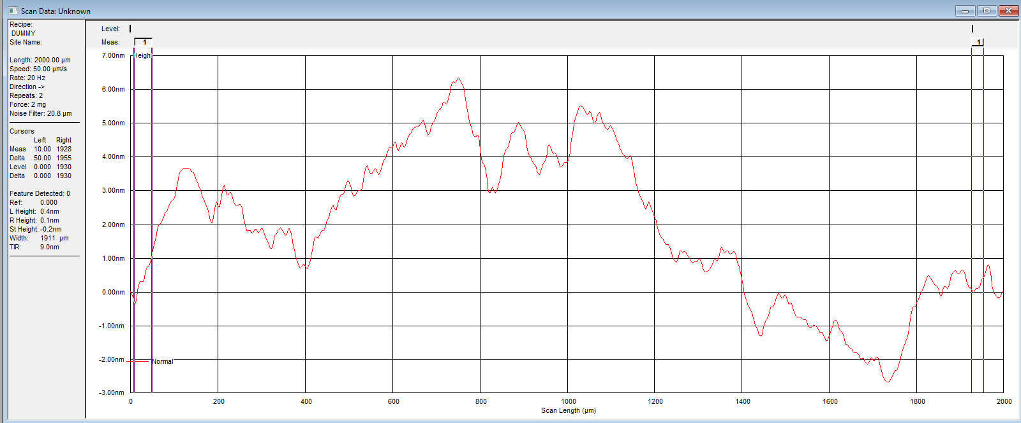
P17
6” blank Si wafer with 10 nm Ti/ 90 nm Ni
near center
Ave of 2 scans
Jun 20, 2025
Range app 10 nm

Slide 16
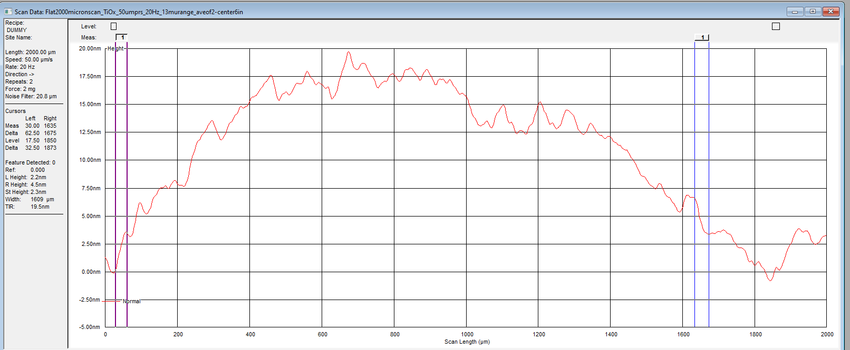
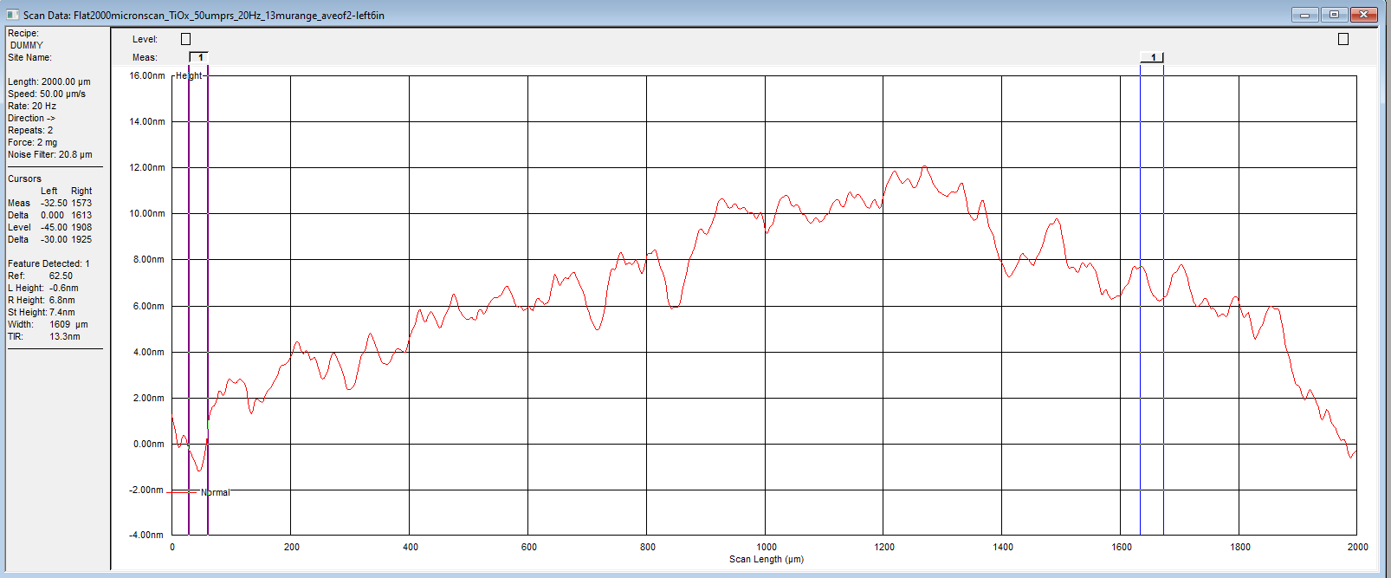
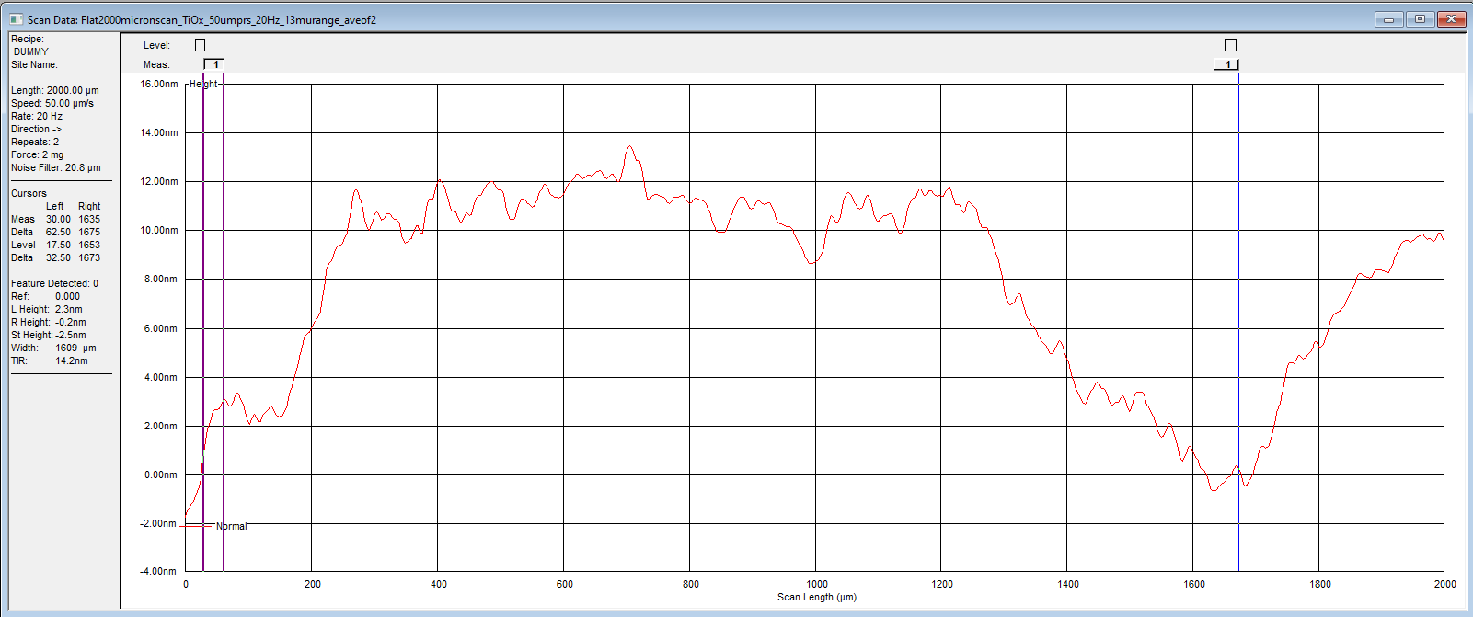
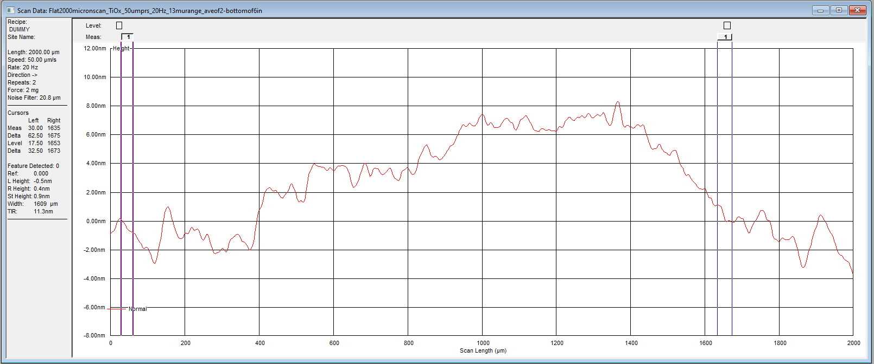
P17
6” blank Si wafer with TiOx
Various positions
Ave of 2 scans in each graph
Jun 20, 2025

