Slide 1
Wordentec vs Thermal evap thickness uniformity
4” wafer in Wordentec November 2018:
  3 % WIW (wafer-in-wafer) thickness variation (std. dev / average)
  Not sure what the uncertainty is on this measurement – not repeated
4” in Thermal evaporator:
  4 % -14 % WIW thickness variation observed in QC, usually 6-9 %
  Wafer placement must make a big difference (fixed in Wordentec but not in Thermal evaporator)
WIW thickness variation with 6” wafer in Wordentec: 3 %
WIW thickness variation with 6” wafer centered on source in Thermal evaporator: 10 % (presumably +/- several percent)
WIW thickness variation with 6” wafer with full contact to backplate for better temperature uniformity in Thermal evaporator: 8-13 % measured for 3 wafers
Measurements on 6” made with a small systematic error on DektakXT but overall trend is robust

Slide 2
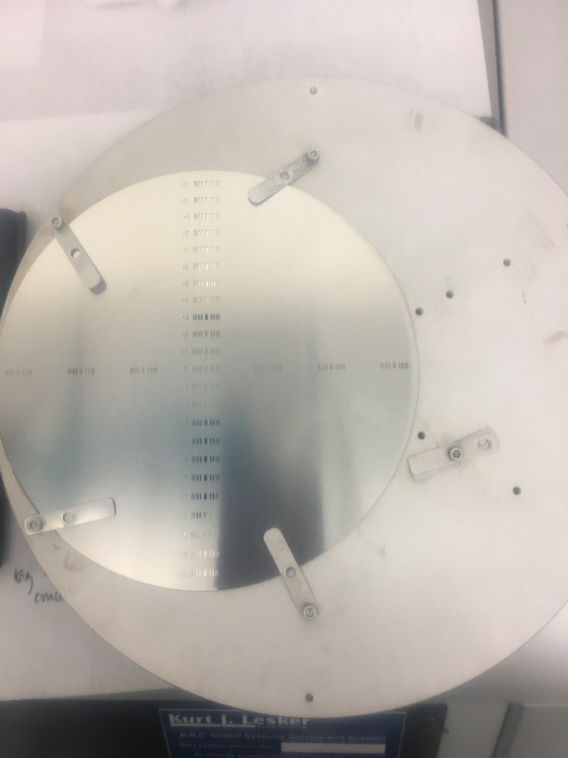
6” placement on sample holder for best heat distribution versus how a 4” is placed for QC, centered on source
Thickest point is at E1 right above crucible
Therefore the WIW variation measured is significantly worse for 6” than 4”.
It is possible to attach the 6” wafer so it would be better centered but heat distribution may then be non-uniform and heat sensitive resist could be overheated where there is no backplate.
B11
B6
E3
E2
E1
A
C1
C2
C3
D6
D11

Slide 3
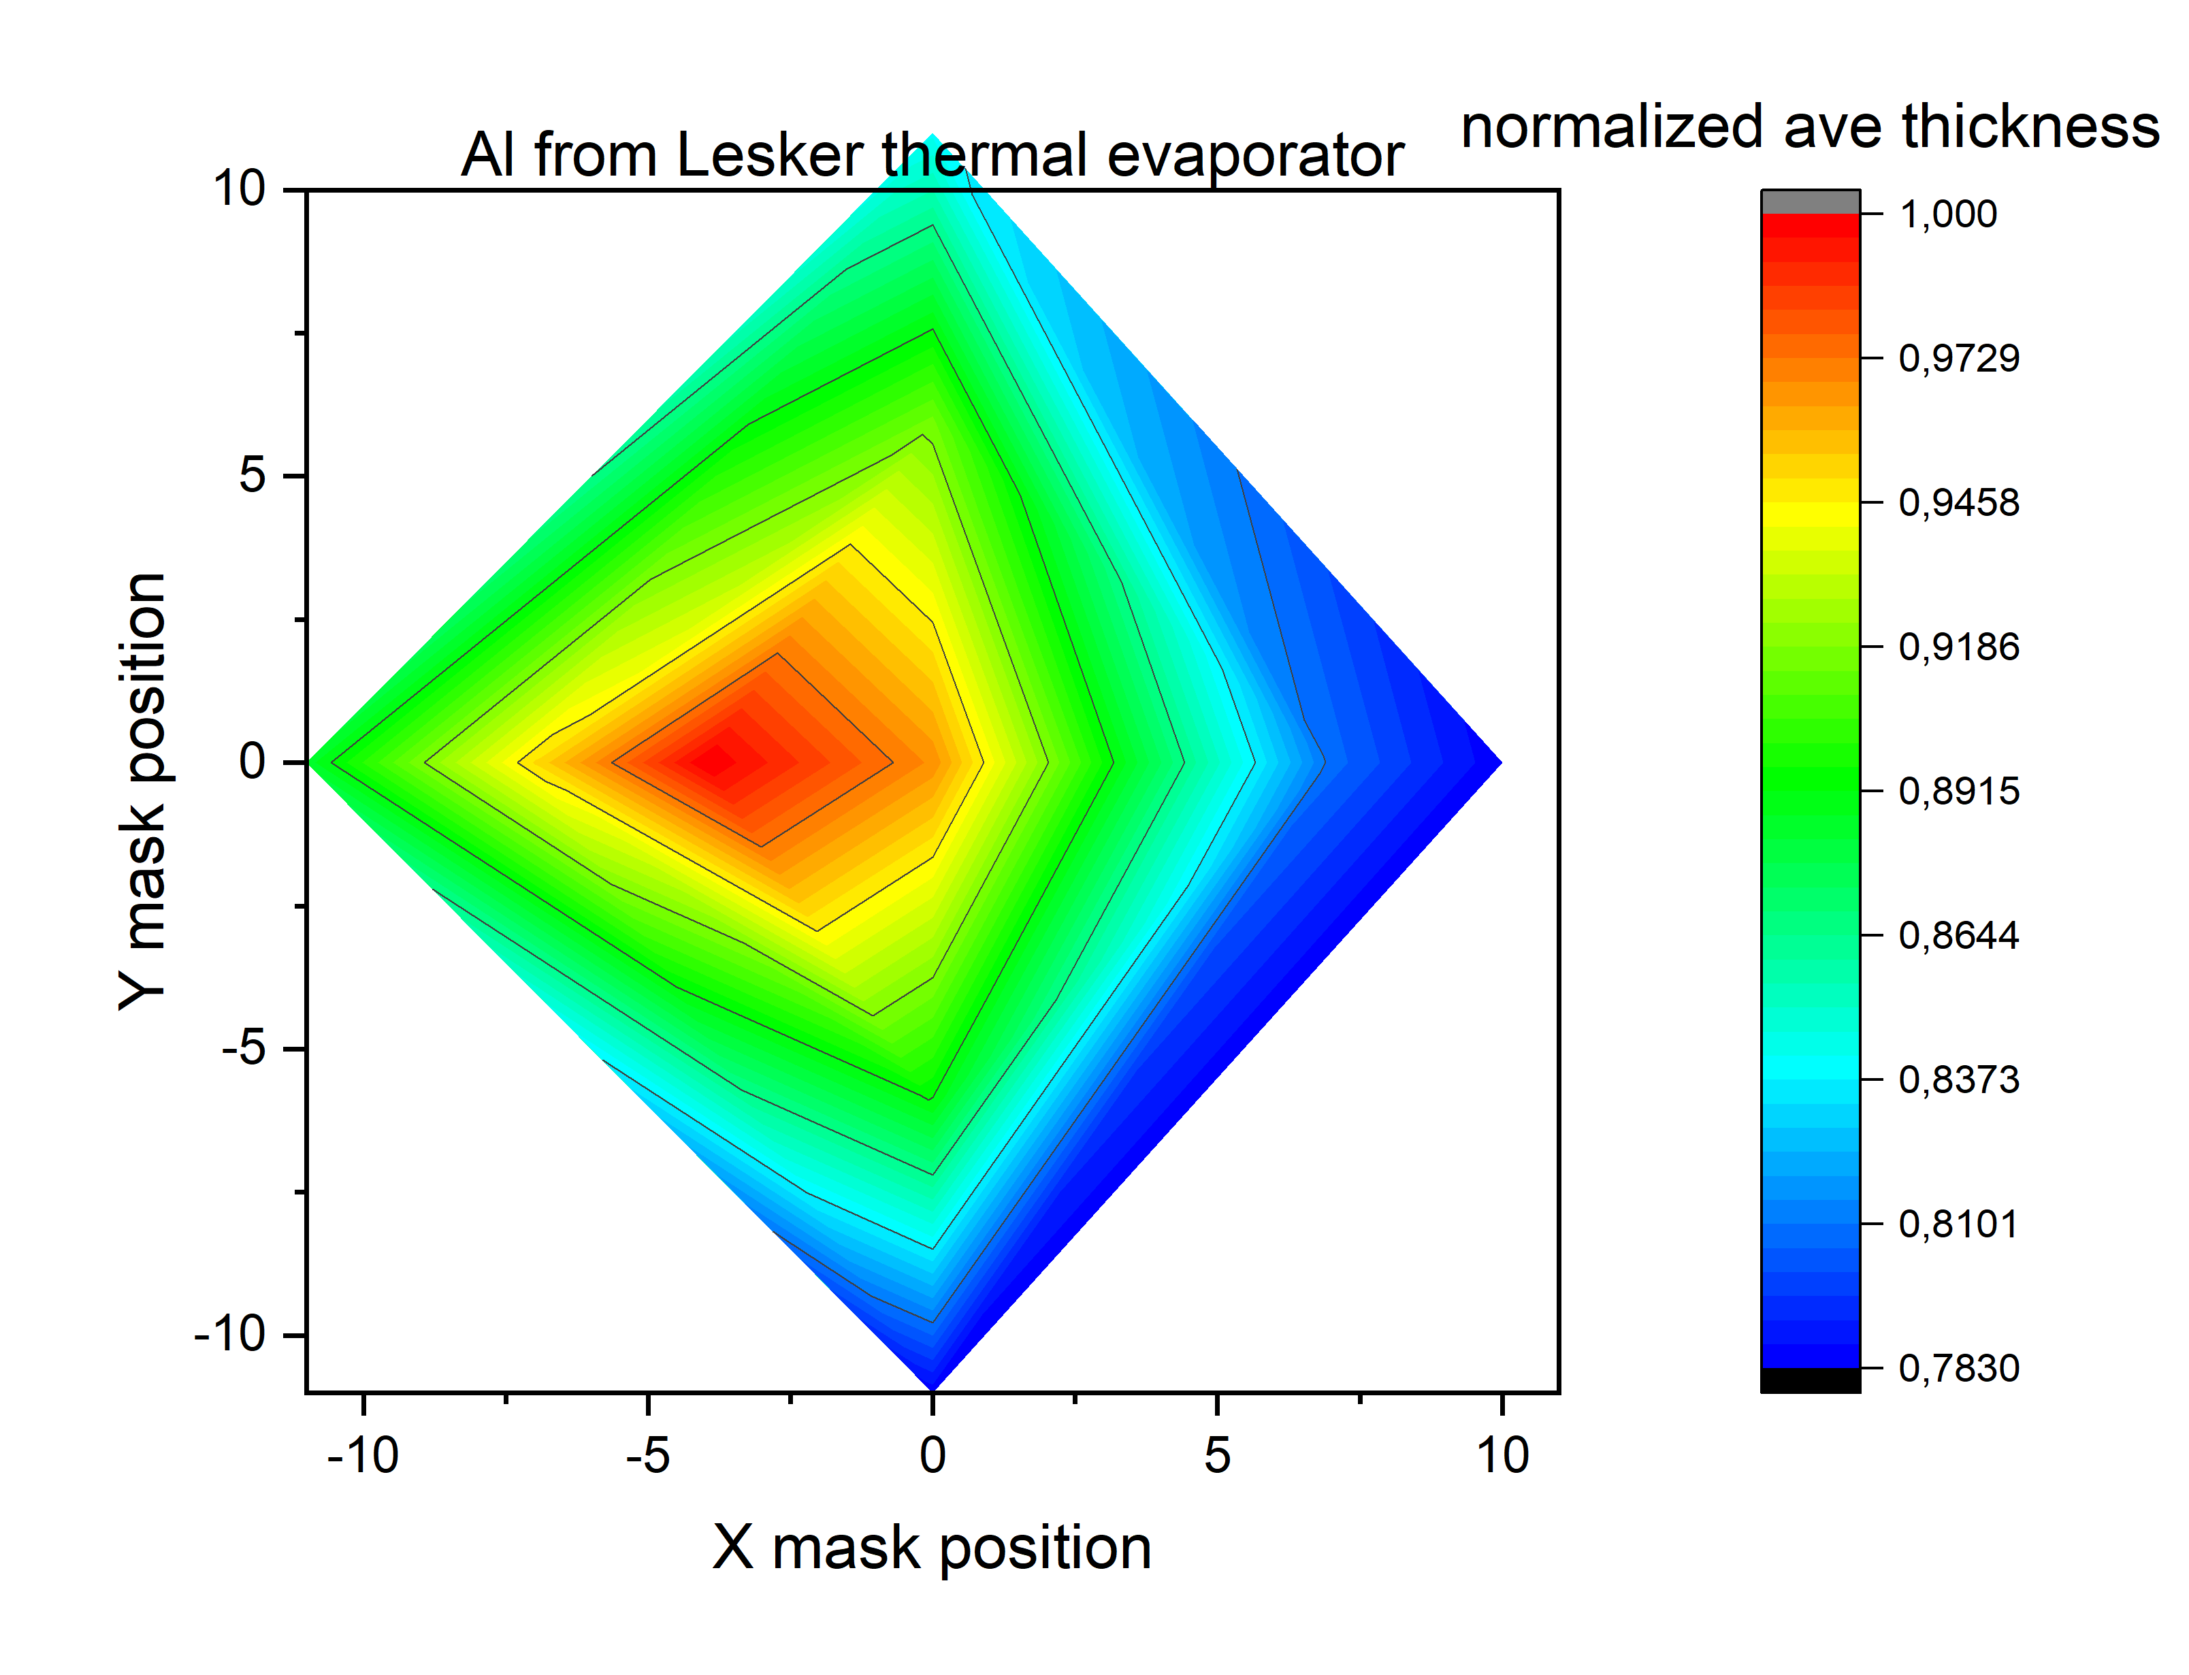
Averaged thickness distr. for 3 depositions on 6” wafers in Lesker Thermal evaporator
- wafers placed entirely on backplate as in slide 2
WIW thickness variation for these 6” wafers was 8-13%
Thickest point is right above crucible
Measurements were made only along the X- and Y-axis, so the plot here is distorted
A 4” wafer is within the light green area if properly aligned to the center of the crucible
Measurements were made only along the X- and Y-axis so the plot is distorted.
Unit is based on QC mask holes. 10 is equivalent to ~2.5 cm

Slide 4
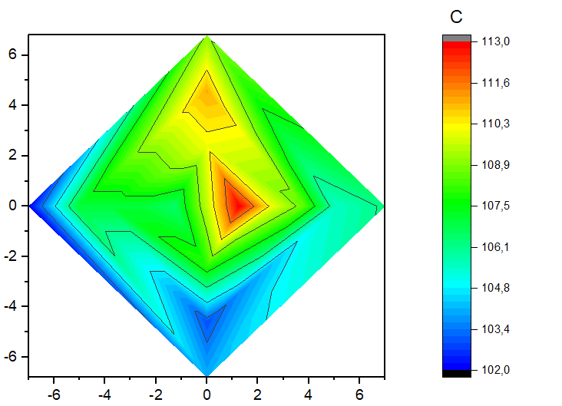
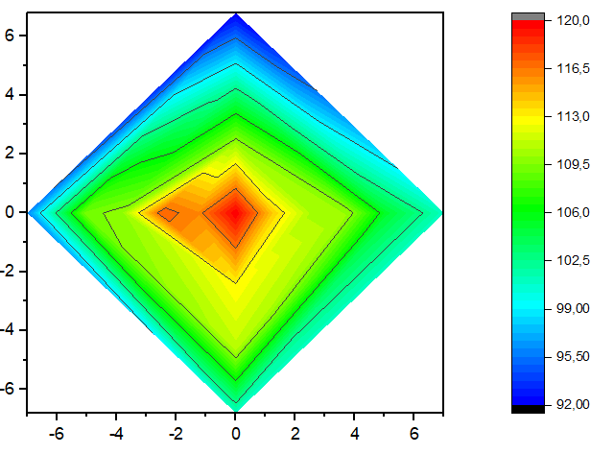
Wordentec vs Thermal evaporator 6” wafers
Wordentec: scale from 102-113 nm
Thermal evap: scale from 92-120
cm
cm
cm
cm
WIW thickness variation in Wordentec: 3 %
WIW thickness variation centered on source in Thermal evaporator: 8 %
Measurements made with a small systematic error on DektakXT

Slide 5
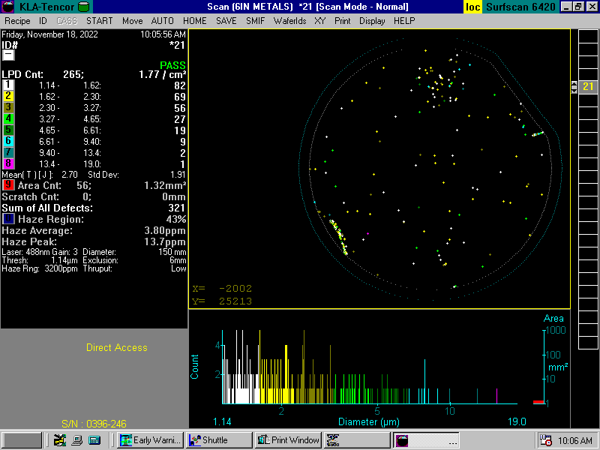
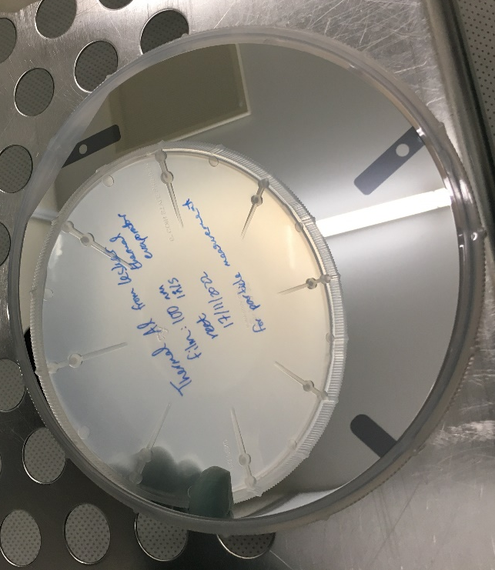
Thermal evaporator: 265 particles on 6” – many from clips
clip
clip
clip
Photo of where the clips held the wafer

Slide 6
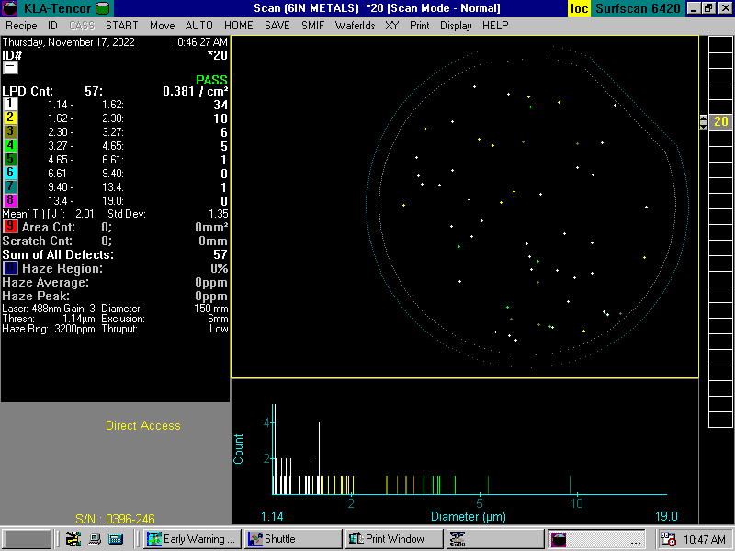
Wordentec: 57 particles on 6”
Nice result for full wafer
Chips would be held by clips and the result might not be much different from the Lesker thermal evaporator.

Slide 7
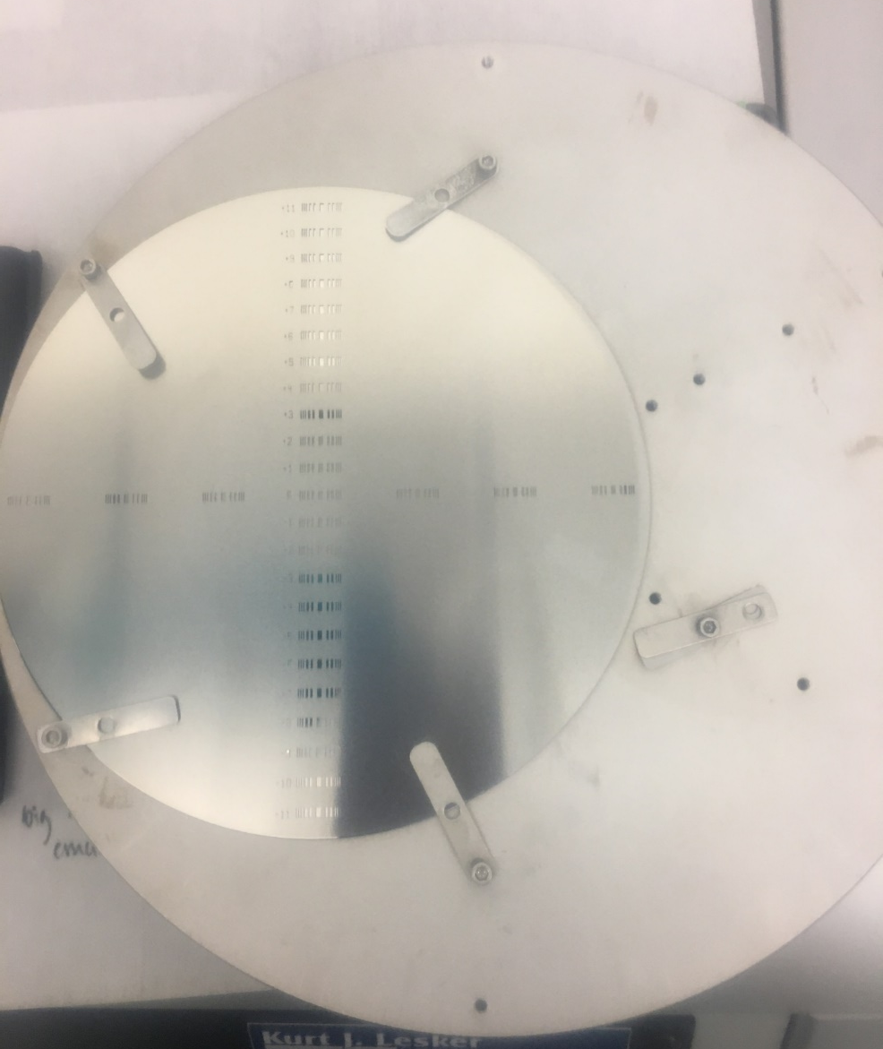
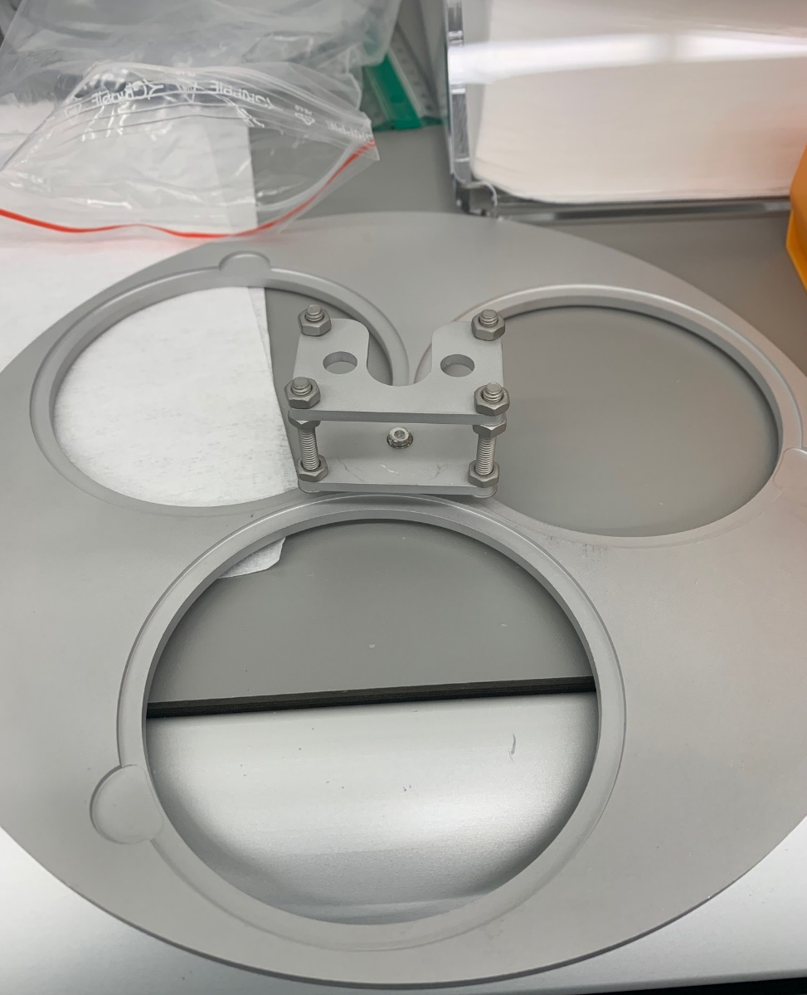
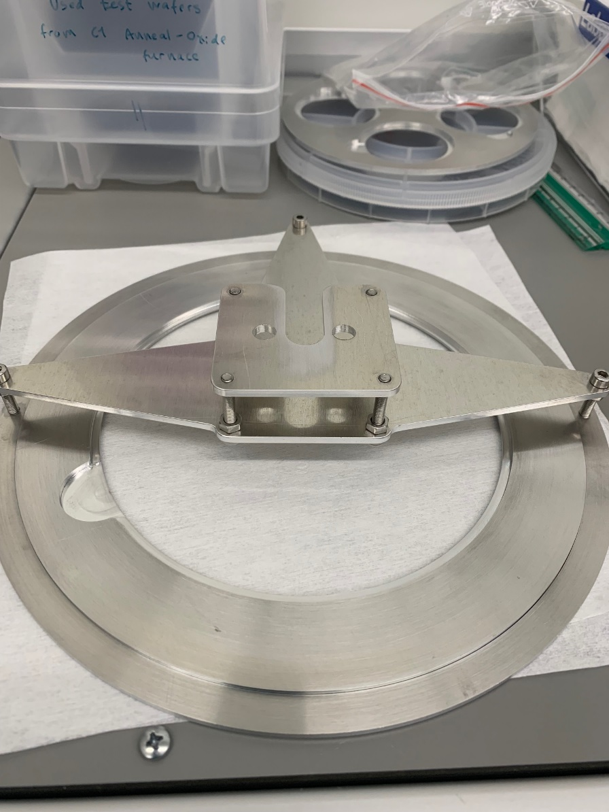
Holder #1
Holder #2
Holder #3

